Slide 1
Introduction to
Achievement Pathways
Current as of 22nd November 2020 – V3 by Ged Hook, VL Whitehorse Venturers, with input from Michael Wong
Notes:
Welcome People to meeting
If not done already, do acknowledgement of country
Explain purpose of presentation
To highlight the importance of Our Program
Cover what we should already be doing
What is coming up

Slide 2
What are we covering today?
What is the Achievement Pathways?
What is Scouts | Terrain?
What does our Unit need to do?
When do we need to do it?

Slide 3
Disclaimer!
The Achievement Pathways program in Victoria is still being rolled out in full, and there is a good chance that some information may change in the near future. Keep an eye out on all the usual news sources for the latest info.
Note: - Achievement Pathways is being rolled
out at different stages in each State

Slide 4
But firstly, things we already know …….
The Scout Method
SPICES
Plan>Do>Review>
Challenge Areas
Notes:
Things we should already be doing:
The Scout Method – Our Scouts develop and learn through the use of the Scout Method – a unique educational method
SPICES – The six Areas of Personal Growth that are part of the Purpose of Scouting
Plan>Do>Review> - The process that helps us seek continuous improvement (since Jan 2019)
Challenge Areas (since Jan 2020)

Slide 5
What is Achievement Pathways?
Notes:
Who is already aware of Our Program?
What is our program? It’s a new way of thinking about how scouting works
First major refresh of the Youth Program in nearly 50 years
5 years in the making
Attempts to rectify issues discovered when surveying past and present members
Places the youth member at the centre of the program
Scouts have the opportunity of determining and planning their own Scouting journey

Slide 6
Achievement Pathways
One program for all Sections of Scouting, from Joey Scouts to Rover Scouts
Focusing on your personal progression and encouraging all Scouts to be active in their program
Some of your achievements will follow you on your Scouting journey, so no more re-starting badges at each Section
A good Unit program will push you towards achieving a Peak Award, you shouldn’t need a youth member to push ahead.
Notes:
Achievement Pathways
Made up of four main elements 1/ Program Essentials, 2/ Outdoor Adventure Skills, 3/ Special Interest Areas 4/ Peak Award
Same program structure for every Section, with increasing responsibility (Youth Lead, Adult Supported) as you go along
Individual development rather than “ticking boxes”
Some areas (OAS) follow you through your time in scouting, allowing for continued progression. This was requested particularly by people who get a peak award.
A good unit program will lead to people achieving their Peak Award, not the other way around.

Slide 7
Language of the Achievement Pathways
Everyone is a Unit now! We have Joey Scout Units, Cub Scout Units, Scout Units, Venturer Units, and Rover Units
Patrols are now common across all Sections (e.g. Cubs are now in Patrols instead of Sixes). This means that a larger Venturer Unit may choose to have Patrols, or more likely form Project Patrols for specific activities.
Unit Chair is now known as Unit Leader. Unit Leader for all sections is a knowledgeable youth member who can lead part or all of the Unit (in Scout section, replaces Troop Scout).
We all have Unit Councils
Notes:
New language.
Structure not really changed, but language updated to be suitable across all sections.
Some thematic elements (eg Jungle Book in Cubs, Knights of the Round Table in Rovers) now optional.
Patrols not super relevant to Venturers except for Project Patrols

Slide 8
What makes up Achievement Pathways?

Slide 9
Achievement Pathways
Program Essentials
Outdoor Adventure Skills
Special Interest Areas
Peak Award

Slide 10
1. Program Essentials
Introduction to Scouting
Introduction to Section
Milestones
Program Essentials is a Scouts core scouting experience – the expectation is that all Scouts will achieve their Program Essentials Milestones
Program Essentials was introduced in July 2020
Notes:
It’s expected that all Scouts will achieve their Program Essentials Milestones regardless of their interest in exploring other aspects of the program such as achieving their peak award.
Not every Scout will want to journey to their peak award
We do want all scouts to thrive in the Program Essentials
The Program Essentials have been designed to be completed through attendance and active participation.
Program Essentials is the regular Scouting program and the elements should not be treated as stand-alone items.

Slide 11
Introduction to Scouting
Helps the new member understand what to expect from Scouting
Important for the discussion to occur as part of experiencing the program first-hand
A discussion involving the youth member, a peer or Youth Leader, and if needed, their Adult Leader
A Scout progressing to the next Section is not required t complete Introduction to Scouting
Upon completion the new member will be invested and presented with the World Scout Badge
Notes:
Introduction to Scouting needs to be completed when a youth joins the Scouting Movement for the first time or if they join after having a break.
It is important for the discussion to occur as part of experiencing the program first hand.
This will help the new Scout to fully understand what’s covered through the discussion.
Discussions should involve the youth member, their peer mentor or Patrol Leader, and if needed, their adult Leader.
This isn’t an interview or test and the person leading the discussion should have a good understanding of Scouting.
Once the Scout has completed their Introduction to Scouting they’ll be invested and presented with the World Organisation of the Scout Movement badge for their uniform.

Slide 12
Introduction to Section
For Scouts transitioning to the next Section
This replaces Venturing Skills
A discussion about how the program works in that age Section
Completed when a Scout transitions from their current Section or when a member joins the Movement
Notes:
Introduction to Section is not a replacement for the Link Badge – they are totally different
Introduction to Section badge for Scouts transitioning to the next Section
Discussions should involve the youth member, their peer mentor or Patrol Leader, and if needed, their adult Leader.
Replaces Link Badges and Venturing Skills.
Scouts can now wear all Introduction to Section badges on their uniform

Slide 13
Milestones
Achieved by active participation in the Unit’s program
Milestones typically take 6-12 months to complete
Each Milestone will have different participate, assist and lead requirements
Milestones becomes progressively more challenging as the Scouts transitions through the Unit
Personal Reflection at the completion of each Milestone
Notes:
Milestones
Driven by Unit Program – good program should lead to all active members achieving these without difficulty
Milestones involve Venturers being actively involved in a diverse range of Challenge Area-related activities over a 6 to 12 month period
Each Venturer will take on roles of Participating, Assisting and Leading
There are 3 Milestones in the program
A Scout transitioning form the Scout Unit will start on Milestone 1
The personal reflection is about the Venturer thinking how they have developed their SPICES whilst completing the Milestone Highlight self reflection interview as common to most parts of Achievement Pathways

Slide 14
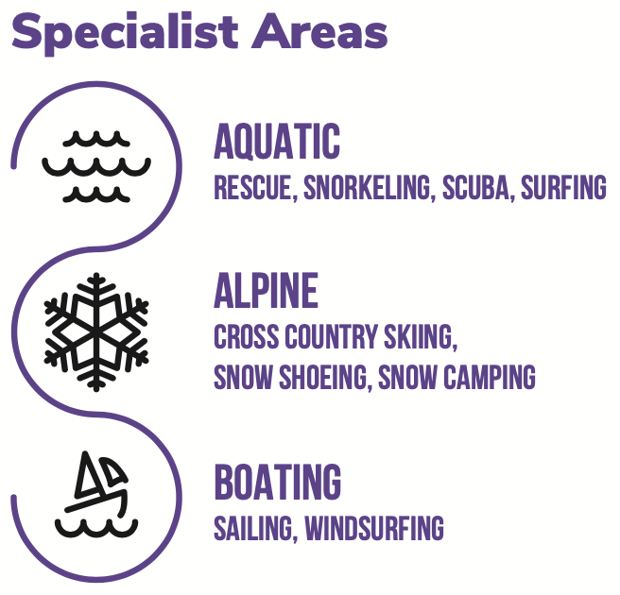
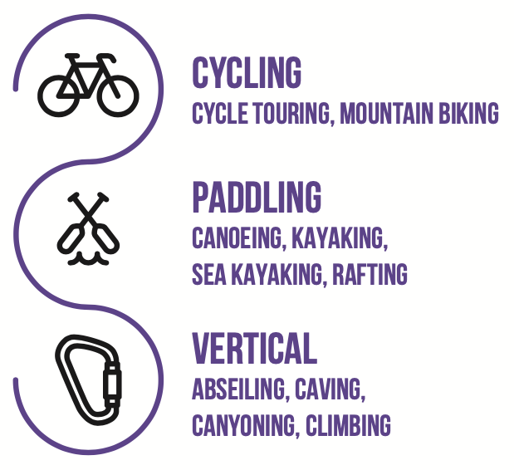
Outdoor Adventure Skills
3 Core Areas
6 Specialist Areas
Some Outdoor Adventure Skill Areas split into streams at Stage 4, and some again at Stage 7
Stage progressions carry through their Scouting journey
To be launched February 2021
Notes:
OAS
Main core “Scouty” elements of the program
Works on Stage progressions system
3 Core areas which are most typical activities, will mostly be done in unit
6 Specialist areas, which will be mostly done with activity teams
Some areas split into Streams at Stage 4, you only need to complete one stream to gain progressions.

Slide 15
Special Interest Areas
Opportunity for Venturers to develop experiences, skills and knowledge based on their interests
6 Special Interest Areas
Adventure & Sport
Arts & Literature
Creating a Better World
Environment
Growth & Development
STEM & Innovation
To be launched July 2021
Notes:
SIA
Most similar to current Venturer System, Similar to Venturer/Rover award schemes.
Venturers set goals for areas of interest or projects they want to complete
Important that Venturers are challenged and progress at a reasonable level based on their capabilities.
Can be completed as an individual together as a Patrol, or as a Project Patrol
Will require Unit Council approval
Proposal based system with Assessors/Mentors/Examiners

Slide 16
Peak Award - Queen’s Scout Award
Culmination of all elements of the Achievement Pathways
Program Essentials, Outdoor Adventure Skills & Special Interest Areas
Plus
An Adventurous Journey
Leadership/Personal Development Course
Personal Reflection
Approval of the peak award is completed by the Unit Council
Notes:
Peak Award
Very similar amount of work, but different structure.

Slide 17
In Depth – Program Essentials Milestones

Slide 18
Milestones – Core Features
Requires the Venturer Unit to have an active program
A program based on what the Venturers want to do
A program cycle should have a balance of Challenge Areas
One Challenge Area per meeting
Programs will provide Venturers the opportunity to assist and lead
The challenge for an assist or lead in the next Milestone increases as a natural progression
Attendance Tracking also needed to prove Participates
Plan>Do> Review> is essential for continual improvement
Notes:
Active program is key to Milestones
Activities are based on what the Venturers want to do
Units Term/Nightly programs should have one Challenge Area for the night. each activity and who is Assisting/Leading
Tracking attendance is key to proving Milestones
Leads and Assists should be a reasonable challenge, IE kid who never talks shouldn’t be expected to chair a Unit Council as their first Lead
PDR is crucial

Slide 19
How to Achieve Milestone 1
Participate in 6 activities from each Challenge Area (24 participates)
Assist in (at least) 2 activities from at least 2 Challenge Areas (2 assists)
Lead (at least) 1 activity from any Challenge Area (1 lead)
Personal Reflection

Slide 20
How to Achieve Milestone 2
Participate in 5 activities from each Challenge Area (20 participates)
Assist in (at least) 3 activities from at least 2 Challenge Areas (3 assists)
Lead (at least) 2 activities from any challenge area (2 leads)
Personal Reflection

Slide 21
How to Achieve Milestone 3
Participate in 4 activities from each Challenge Area (16 participates)
Assist in (at least) 4 activities from at least 2 Challenge Areas (4 assists)
Lead (at least) 4 activities from any Challenge Area (4 leads)
Personal Reflection

Slide 22
Milestones – things to note
You can use an assist or lead on an activity as a participate if you need to increase participates.
An activity can only be assigned to one Challenge Area
Programs should be varied to ensure a balance of Challenge Areas within the program cycle
If a Venturer has finished the participates for one Milestone, they can start to count participates for the next Milestone, even if they’ve not completed their assists or leads
Bigger nights and camps could be broken into multiple activities to allow more opportunities for Leads and Assists

Slide 23
In Depth – Outdoor Adventure Skills

Slide 24
Outdoor Adventure Skills – Core Areas
Bushcraft
Pioneering and Survival Skills
Bushwalking
Mapping, Planning, Risk Management, First Aid, Minimal Impact
Camping
What it says on the tin!
Notes:
Core areas cover what we have traditionally done in our weeknight program. Most members will be familiar with the concepts in these areas.
Venturers will likely sit somewhere between Stage 3 and 6 in these areas depending on age and experience.

Slide 25
Outdoor Adventure Skills – Specialist Areas
Aquatic
Alpine
Boating
Cycling
Paddling
Vertical
Notes:
These are areas usually covered by Activity Teams, although up to Stage 3 may be doable within your Unit program.

Slide 26
Outdoor Adventure Skills
Covers our core ”Scouty” activities.
As the name suggests, they are Skills for the Outdoors and/or Adventurous Activities
3 Core Areas, 6 Specialist Areas
Each skill area has 9 Stages progressions - 1 to 9
All scouts start their progressions from Stage 1
A Scout’s Stage progression achievements are retained as they transition to the next Section
2 down peer assessment – for example, a Scout with a Stage 4 in Camping can assess a Scout working on their Stage 2 Camping
Venturers may be asked to help assess Scouts and maybe Cubs
Venturers may need to ask Rovers to assist with assessing older unit members
Notes:
Importance of forming relationships with sections above and below for signoff purposes

Slide 27
Outdoor Adventure Skills
Achievement is tracked by the number of Stage progressions across all Outdoor Adventure Skills (ie progression from Stage 3 to Stage 4).
The number of Stage progressions required for the peak award are counted from the time the Scout joined the Section
A Scout’s Stage progressions achieved in the Scout Unit won’t count toward their Queen’s Scout Award
Specialist Areas may involve Adventurous Activities Teams for Stages 4 and above
Assessed with peers using I-Statements (I can light a match, I can plan a hike route, etc)
Notes:
Encourage people to get involved in activity teams

Slide 28
Outdoor Adventure Skills
It is important when new members join Scouting or transition from the old Award Scheme(s) that an accurate assessment of skills is made, otherwise you may inadvertedly set a too high or low bar for a member.
When in doubt, don’t sign off.
As of November 2020, Venturer Leaders can sign off up to Stage 5 in the Core Areas (Bushcraft, Bushwalking and Camping). However, if you have a youth member who can sign off that is preferred.
Some weeknight activities may cover the lower stages of the specialist areas.
Notes:
Encourage people to get involved in activity teams

Slide 29
In Depth Special Interest Areas

Slide 30
Special Interest Areas
Generally covers activities not experienced within Outdoor Adventure Skills
Proposal System similar to current Award Scheme
Involves a strong focus on Plan>Do>Review>
Each Special Interest Area activity requires a minimum of 12 hours of effort
Using a Mentor system (same as Examiners)
Can be individual activity or in a Project Patrol
All participants must be part of Plan > Do > Review>
Notes:
Similar to Current Venturer Program
If you have existing proposals or completions, would be easy to map across to SIA (assuming its not an OAS activity)

Slide 31
Special Interest Areas
Adventure & Sport
Team Sports, Animal Care, non-physical adventures
Arts and Literature
Things that would go in Expressions
Creating a Better World
Citizenship activities, Service, Community Work and Engagement
Environment
Sustainability, Clean Up Australia Day, Climate Change, Waste/Recycling
Growth and Development
Learning new skills/languages, Volunteering work, Fitness
STEM and Innovation
New technologies, innovative ideas. Some more interesting construction.

Slide 32
So how do I achieve my Queen’s Scout Award again?

Slide 33
Queen’s Scout Award in the Achievement Pathways
What makes up our Queen’s Scout Award?
Complete Milestone 3 in the Program Essentials
(Milestones 1 and 2 are optional)
Outdoor Adventure Skills
Stage 5 in the Core Areas – Bushcraft, Bushwalking and Camping
Four Stage 4+ progressions
Eight additional Stage progressions
Special Interest Areas
6 activities (each of at least 12 hours duration) across at least 3 different Special Interest Areas
Adventurous Journey
Plan and lead an adventurous journey of at least 4 days and 3 nights duration
Leadership/Personal Development Course
Personal Reflection

Slide 34
What is Scouts | Terrain

Slide 35
Scouts | Terrain
Our new digital record book
Covers all sections
Adds great programming tools to help manage your Unit, while automagically calculating Milestones
Heaps of visual feedback
Tools for working with members outside your Unit

Slide 36
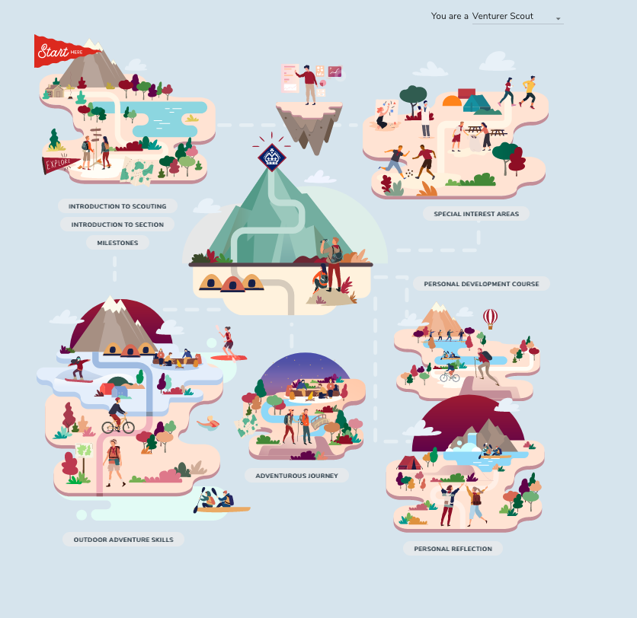
Where do I start in Scouts | Terrain?
The best place to start is your Basecamp
Links to each area of the Achievement Pathways
Programming
Log Book
Notes:
Visual layout designed to be intuitive
Each section contains information as well as records of achievements

Slide 37
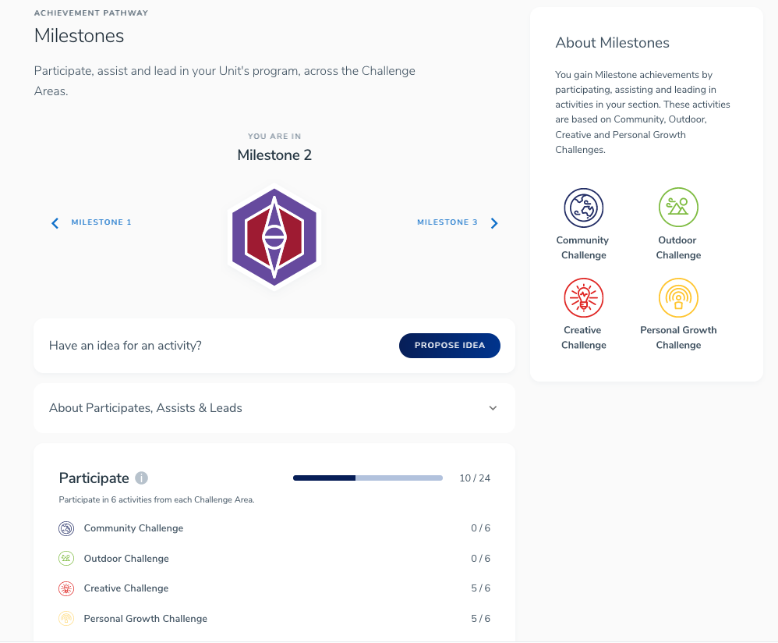
Milestones
Automatically calculated when you use the Programming tool
Allows you to complete your milestone review

Slide 38
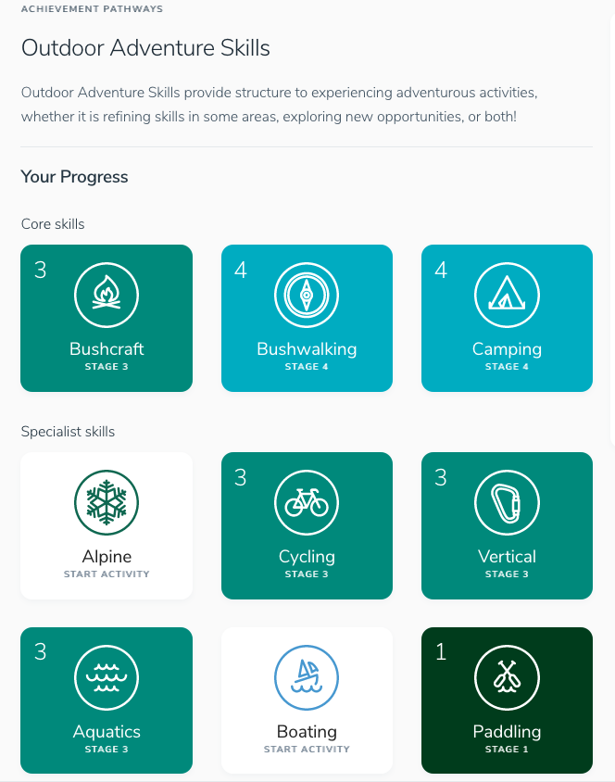
Outdoor Adventure Skills
Shows an overview of your current stages
Colours line up with Badge Colours

Slide 39
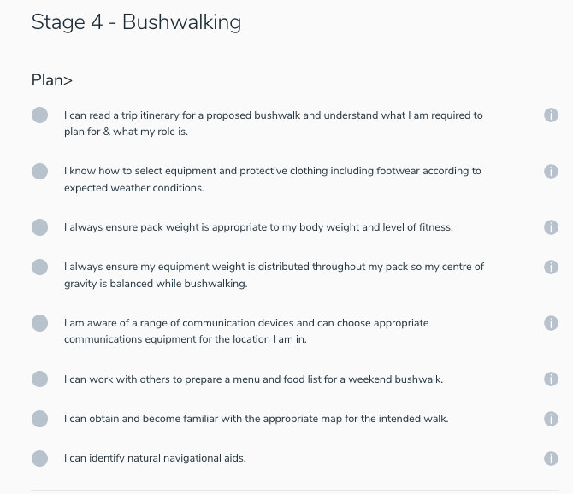
Outdoor Adventure Skills
Tick list of all requirements that can be completed as you go
Information bubbles for each requirement to assist with verifying your skills

Slide 40
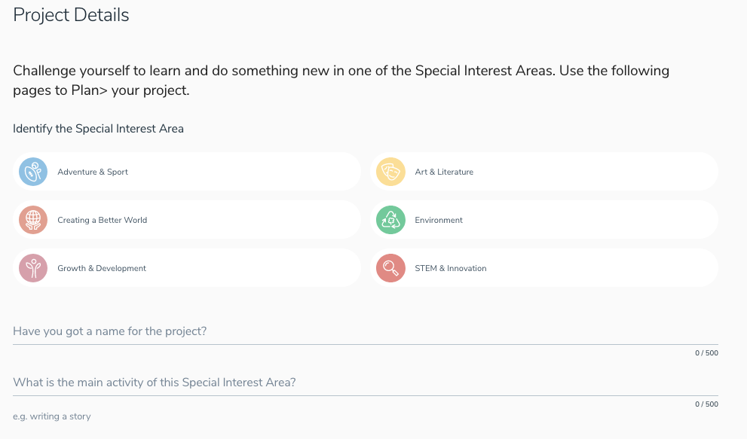
Special Interest Areas
Online proposal form for projects
For Mentors within Scouting, you can add them directly
For Mentors outside Scouting, work is being done to provide temporary logins

Slide 41
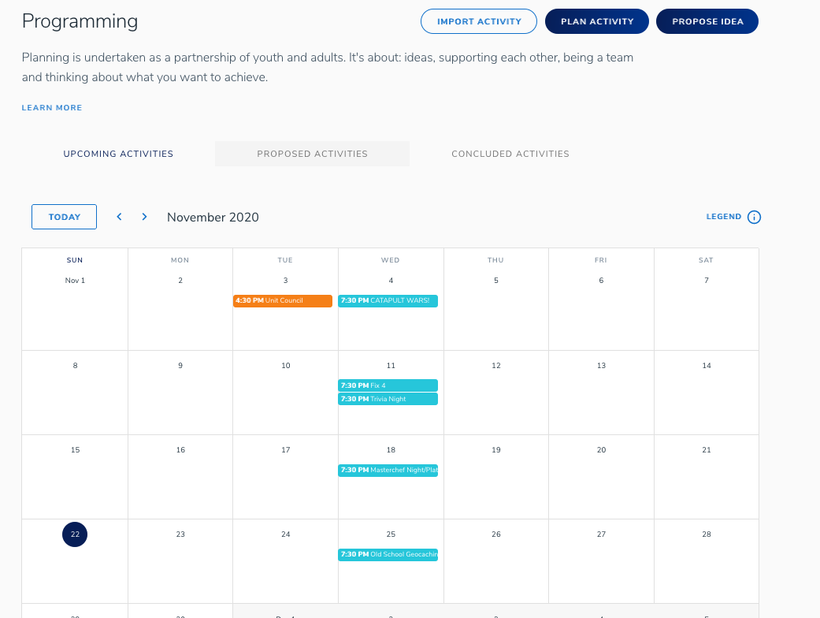
Programming
Combines the benefits of a Calendar with Activity Planning
Automatically credits Milestones on completion of activity Review

Slide 42
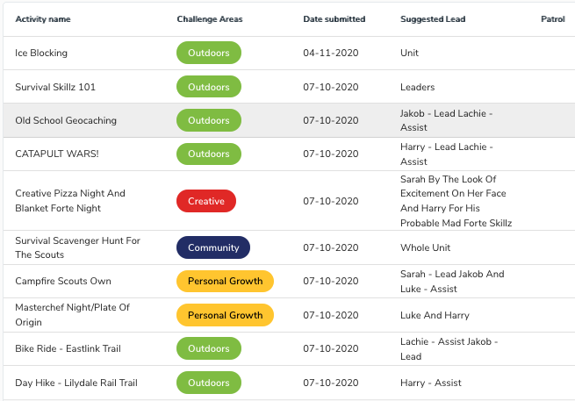
Programming
Unit members can contribute program ideas at any time
Once submitted, Unit Council can schedule to the Calendar and assign a Lead
Activity Lead can then complete the plan and add other Leads and Assists.

Slide 43
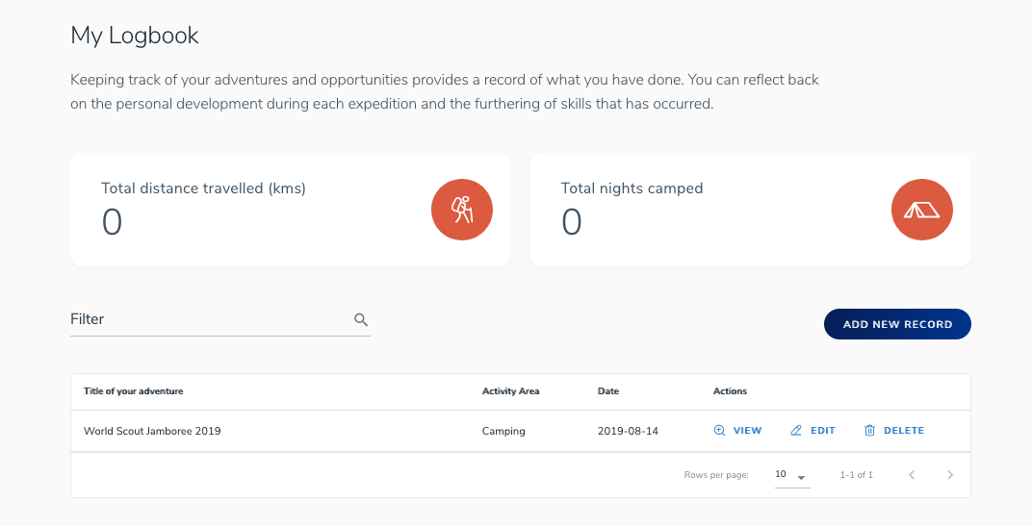
Logbook
Camps, Hikes and other outdoor activities can be recorded in Scouts | Terrain.
Can be used for evidence in OAS work

Slide 44
Scouts | Terrain FAQ’s
All unit members have access once they have a Membership Number.
All members now have access. If you haven’t been sent your password, bug your Group Leader!
Role assignments can be completed by any leaders. Once youth members are marked as on Unit Council, they get access to approvals and programming tools.
Updates are being constantly rolled out

Slide 45
What do we need to do?

Slide 46
What should your unit do and when?
Plan>Do>Review>, SPICES, Challenge Areas – Should already be core elements of our program
Milestones – Start ASAP.
A Scout’s choice
Transitioning across will be a little messy, but the earlier you start tracking Participates, Assists and Leads, the easier it will be.
Make sure your term program cycle has a balance of Challenge Areas as well as assists and leads!
Outdoor Adventure Skills – Start tracking activities that may fall under OAS
Support not quite ready, official start date is not until next year. However, we are not prohibited from starting early if we want to.
Special Interest Areas – Can start now, will be easy to convert at a later date if you are already doing proper proposals and completions.
Scouts | Terrain – Get on it!
More information available on pr.scouts.com.au

Slide 47
Which peak award scheme should I use?
As a general guide, if you have completed your Venturer Award or higher you will likely finish your Queen’s Scout Award on the current scheme, however you could choose to transition to the Achievement Pathways model if you wished
If you haven’t yet completed your Venturer Award, you should probably transfer to the Achievement Pathways model when possible
If you want to work out where you sit in Outdoor Adventure Skills, look at the I-Statements for the level you think you are at, if you can’t answer all the questions go down one.

Slide 48
Resources
Scouts | Terrain - https://terrain.scouts.com.au
https://pr.scouts.com.au – for all the latest resources and information about The Achievement Pathways
https://s2p.scouts.com.au – Current Award Scheme to Achievement Pathways conversion tool. Helps start a discussion if a Venturer is considering converting to the Achievement Pathways model
Your Program Champions. 150+ Members across Victoria who can help find the answers you seek
npi@scoutsvictoria.com.au – Any Victorian specific questions that can’t be answered by a Program Champion
OAS Questions - State Team (Narelle and Jenna)

