Slide 1
Cuboree 2023
September 25-29 2023

Slide 2
Acknowledgement of Country
As Scouts of Australia, we acknowledge Australia’s First Nations Peoples, the Aboriginal and Torres Strait Islander peoples, as the Traditional Custodians of this land. We pay our respects to Elders past, present, and emerging.
We’re grateful to do our Scouting in this country; we commit to use its resources wisely, and develop our understanding of Aboriginal and Torres Strait Islander cultures.
We also acknowledge any Aboriginal and Torres Strait Islander Scouts who are part of our movement today.

Slide 3
Notes:
Short video. Good to have an external speaker if possible.

Slide 4
What is a Cuboree?
The biggest Cub Scout event in Australia, run by Scouts Victoria
Held every three years at Gilwell Park (Gembrook)
Held on the second week of the September school holidays
Monday 25 – Friday 29 September 2023
This will be Victoria’s 11th Cuboree
Previous Cuborees have had:
Over 3,000 Cubs
Over 1,000 Leaders, Venturers, Rovers and adults
Notes:
A big Cub Camp - biggest in Australia
11th Cuboree, so lots of experienced leaders
Feedback from previous Cuborees has been incorporated where it can.
Camping in "Units" of around 36 Cubs, a mix of groups from a district/region.
Supported by "Subcamps" - catering, welfare, first aid, information
Bus-in and Bus-out
Set up beforehand, pack up afterwards - parents!

Slide 5
Cuboree Themes
Notes:
Each Cuboree has been themed. This captures the imagination of the Cubs, Leaders and organisers.
Many parts of the camp are designed with this in mind, including subcamps, activities and campsites.
Past themes have included space, Arabian nights, fairytales and places around the world.

Slide 6
Notes:
Our Theme: “Open for Adventure”
This was chosen by our Cuboree Unit Council – a group of Joeys, Cubs and Scouts who have been helping to plan the event.
”we have been closed due to COVID, and not able to do our normal Scouting camps and fun”
”we are now opening up, and Cuboree will be full of fun things to do we can’t do at home”

Slide 7
A “Cuboree Camping Unit”
36 Cub Scouts (in 6 Patrols)
6 Line Leaders (1 per Patrol)
1 Unit Akela
2-3 Cooks
Carer(s) (if needed)
All the tents, camping kitchen, eating area, food storage and other equipment needed to support 45 people for 5 days and 4 nights in a bush camping setting
Notes:
There will be up to 100 “Camping Units” around Gilwell Park.
You will be with other Cubs from your Group and your District.
Adults will help run your campsite.

Slide 8
Five Days of Cuboree
Nine
Saturday/Sunday (weekend before)
Monday
Tuesday
Wednesday
Thursday
Friday
Saturday/Sunday (weekend after)
Notes:
Mon - Bus, set-up, walk around, BYO Lunch for Monday.
Tue, Wed, Thu - 2 x activity bases. 1 offsite activity being planned.
Fri - Pack up individual gear, Bus

Slide 9
Saturday/Sunday before
Parents help move gear from their Groups/Districts to Gilwell Park
Setting up tents, marquees, eating shelter, camp kitchen, gateway
Each Unit has an allocated site, usually in amongst nature!
This is a role for the parents, not just the leaders who will be with the Cubs for the next 5 days

Slide 10
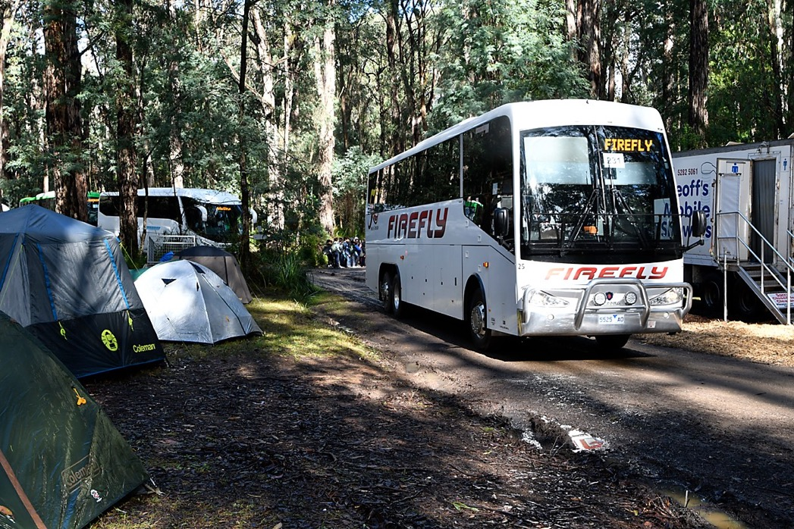
Monday
Getting on the bus at allocated pick-up spots
A long drive to Gilwell Park!
Unloading near your campsite
Setting up beds
Settling in
Notes:
Mon - Bus, set-up, walk around, BYO Lunch for Monday. Most buses arrive around 11am – 2pm. Time to set up beds in the tents, settle in.
For some, there will be entertainment at the Campfire Circle. This will happen each night, for one subcamp.

Slide 11
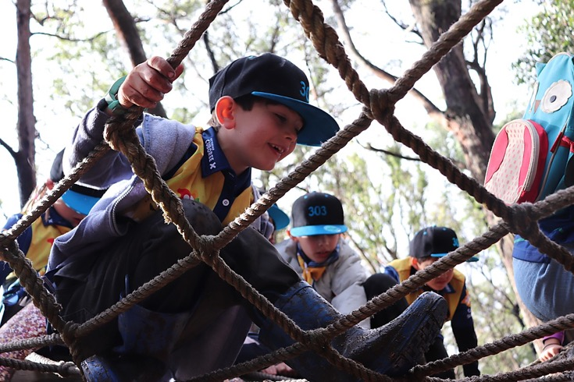
Tuesday, Wednesday, Thursday
Three days of activities
Two rotations per day between “bases”
Each base caters for around 500-600 Cubs at a time
Lots of Service Leaders (Venturers, Rovers, Leaders, Parents) helping to run these
Line leaders supervising their small group of Cubs
One offsite activity (1/2 day) buses to and from the venue
Notes:
Tue, Wed, Thu - 2 x activity bases. 1 offsite activity being planned.
Joey Day - Wednesday. Parents transports to/from Gembrook. A "taste" of Cuboree. Joey Leaders to attend with Joeys.

Slide 12
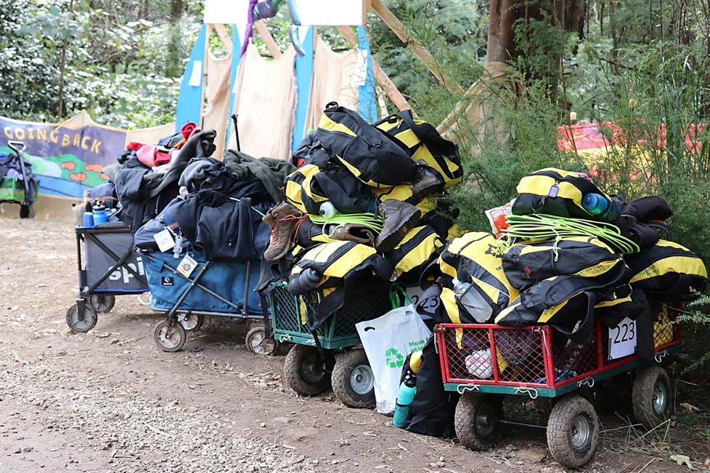
Friday
Packing up contents of tents
Possibly packing up some of the tents and other gear
Load on to the bus, and home!

Slide 13
Saturday/Sunday after
Parents come back on-site to pack up the camping site
This is a role for the parents; the leaders are exhausted after 5 days at camp!

Slide 14
What the Cub Scouts See
Camping with friends – setting up beds, keeping their tent tidy
Activities
Meals prepared
Helping clean up and keeping the campsite tidy
Swapping badges
Merchandise
Showers
1 muddy day - VERY OLD CLOTHES, rinse-down facility
Entertainment - 1 night at the campfire circle (by Subcamp)
Evening activities ("Gunyahs")
Activities are aimed at Cub ages (ages 8-11)

Slide 15
Wednesday – Joey Scouts Day
Notes:
This is a one-day event for Joey Scouts to travel to Gilwell Park and participate in Joey-specific activities.

Slide 16
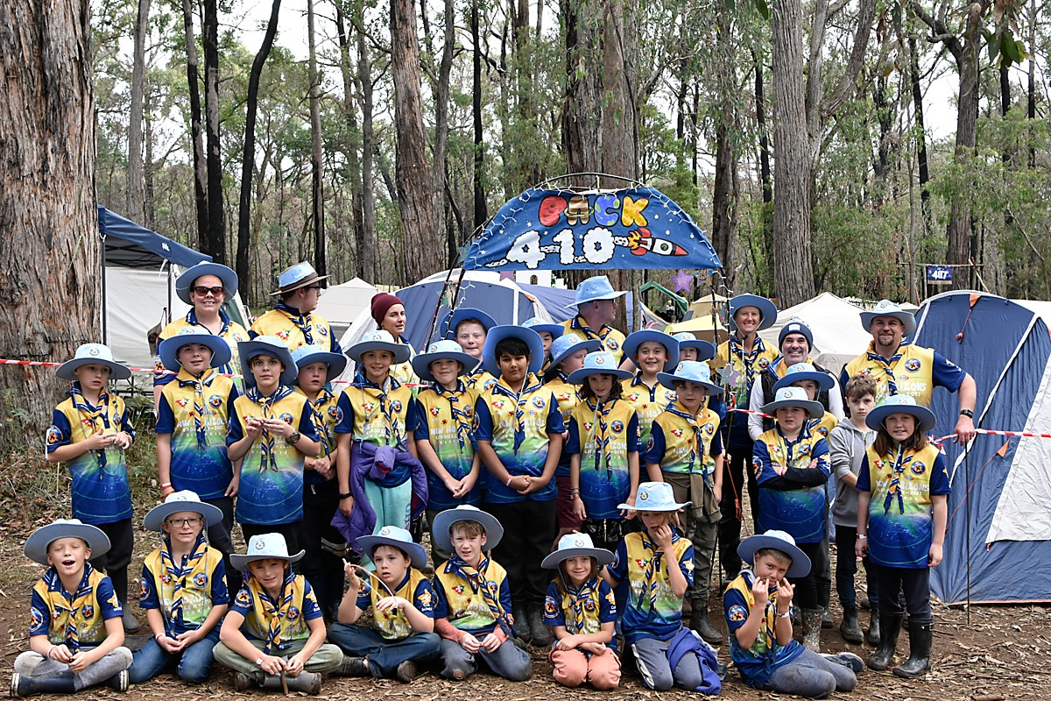

Slide 17
What Adult Roles Are There at Cuboree?
In the Unit:
Line Leader
Unit Akela
Unit Cooks
Carers
In Activities:
Service Leaders
In Directorates:
Service Leaders
Nominate your preferences on sign-up

Slide 18
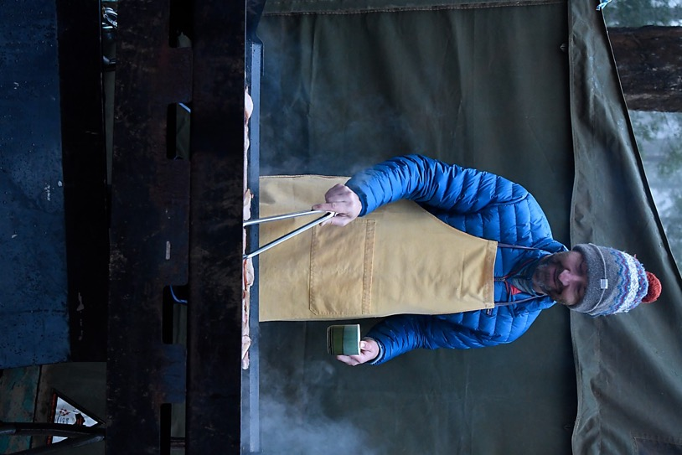
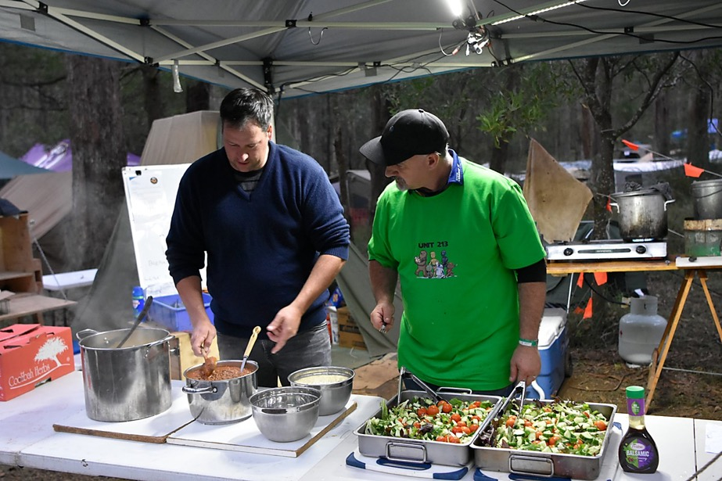
Unit Cooks
Notes:
This is a role for parents who want to come and help out.
They camp with the Camping Unit and help prepare meals for the Unit.
They can come for all 5 days, or part of the time if they can’t help for the full event.
Your Group and District will need parents to volunteer so there are around 3 adults cooking for the 5 days.
If coming for the full 5 days, you will travel on the Bus to and from Cuboree.

Slide 19
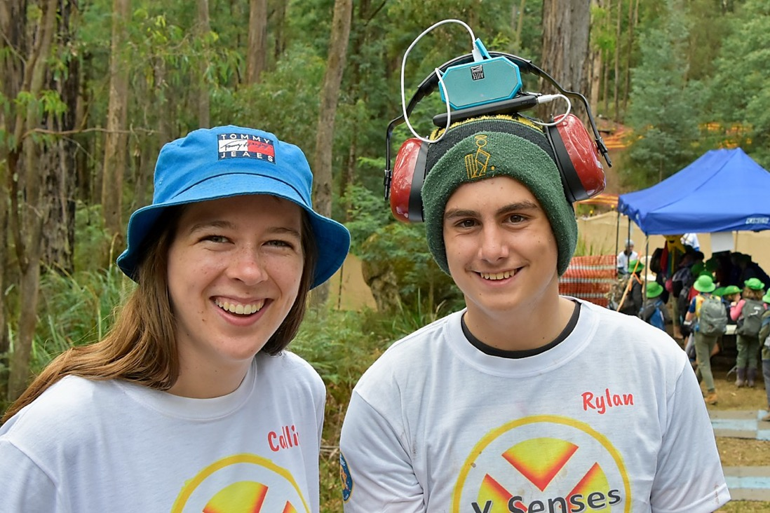
Service Leaders
Help organise the activities and functional areas at Cuboree
Guide, lead and support at the activities
Camp with their service team

Slide 20
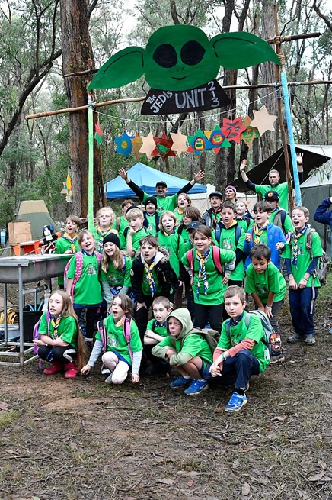
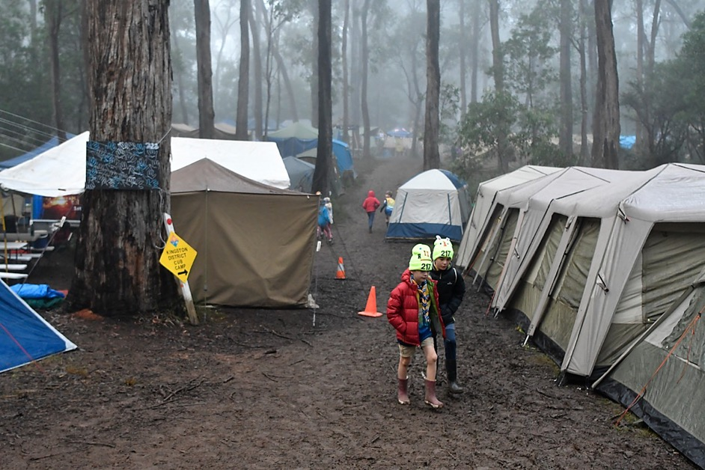
Your Camping Unit
Notes:
Sufficient Tents to fit your Cubs, Leaders and helpers in the campsite.
Separate tents for youths and adults.

Slide 21
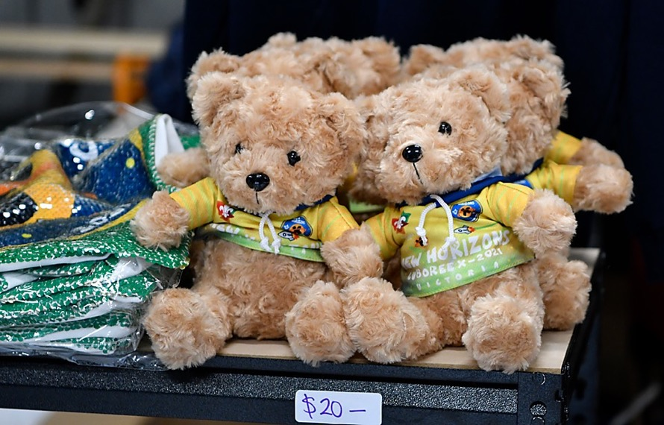
Merchandise
Provided:
Polo Shirt
Scarf
Cuboree badge
There are items to buy at the Merchandise shed
You might design a badge for your Camping Unit!
You might collect and swap badges with other Cubs!
Notes:
Cubs can bring some money. Suggest money is kept by the leaders in labelled bags/envelopes, so kids don’t lose it.

Slide 22
Cost
Cub Scouts $400
All other Roles $200
Included
Bus Transport to and from Cuboree, all meals (Monday evening to Friday lunchtime), three full days of activities, a night-time concert, tents and campsite (supplied by your Group and District), A Cuboree shirt, scarf and Cuboree badge set. Plus amazing memories!

Slide 23
Key Dates
Date | Action
June 30 2023 | Cub Applications close
July 31 2023 | All other Applications close (hard date!)
August 2023 | Cuboree O Day
Approx 2 weeks prior | Bus Transport finalised

Slide 24
Signing up!
Notes:
We are mailing out a set of 2 posters to each Group. It will go to the Cub Leader, or if no Cub Leader, the Group Leader.
Encourage Cubs and parents to put down their name if they think they will attend.
To sign up, parents need to complete an online application. They need to generate a PIN (emailed to them) then login and fill in details.
A “head and shoulders” photo is needed. Passport style, but can be from a phone or camera.
The application needs to be APPROVED by the Group Leader. If there is a concern about an attendee, Cub Leaders and the GL should discuss this before approving.
What support could be put in place to help that person? Will they cope with Cuboree (4 nights away from home)?

Slide 25
Time for Questions!
cuboree@scoutsvictoria.com.au

