Slide 1
Welcome we start at 9:30am

Slide 2
Please take your seat, we will start in 5 minutes

Slide 3
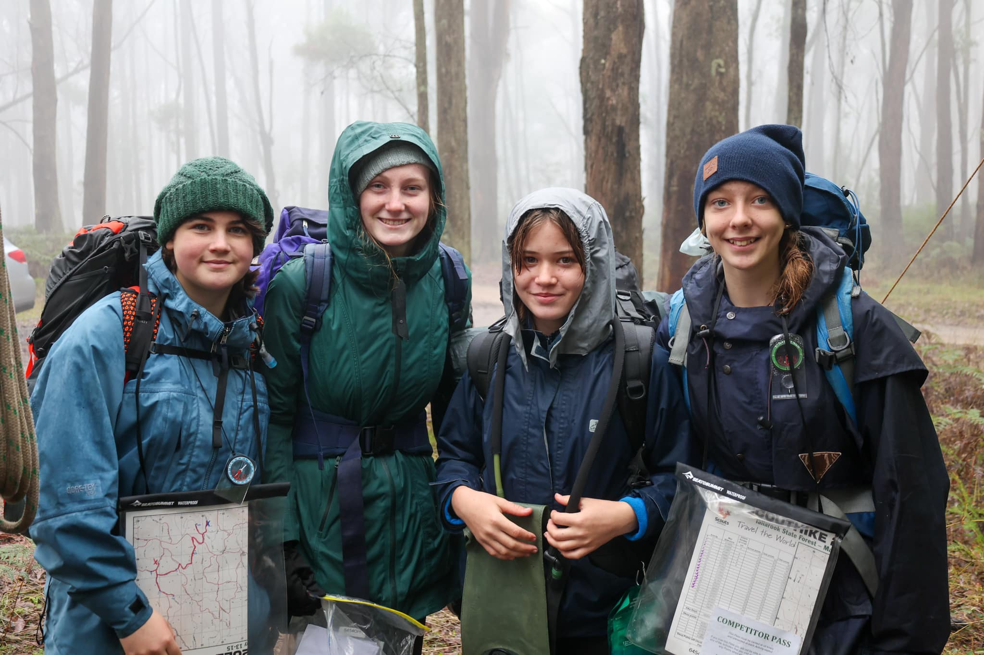

Slide 4
Opening Parade

Slide 5
Acknowledgement of Country
We acknowledge the Traditional Owners of the land on which we are meeting. I pay my respects to their ancestors and Elders, past and present. We are committed to honouring Australian Aboriginal and Torres Strait Islander peoples’ unique cultural and spiritual relationships to the land, waters and seas, and their rich contribution to society.

Slide 6
Welcome
Thank you for giving Scouting another day
Overview of the agenda for the day

Slide 7
Housekeeping
Please put your phone on silent
Toilets
Where to go in an emergency
Take notes and photos – no filming, please
The food hall, coffee vans and lunch
Displays

Slide 8
Welcome
Rod Byrnes
Chief Commissioner

Slide 9
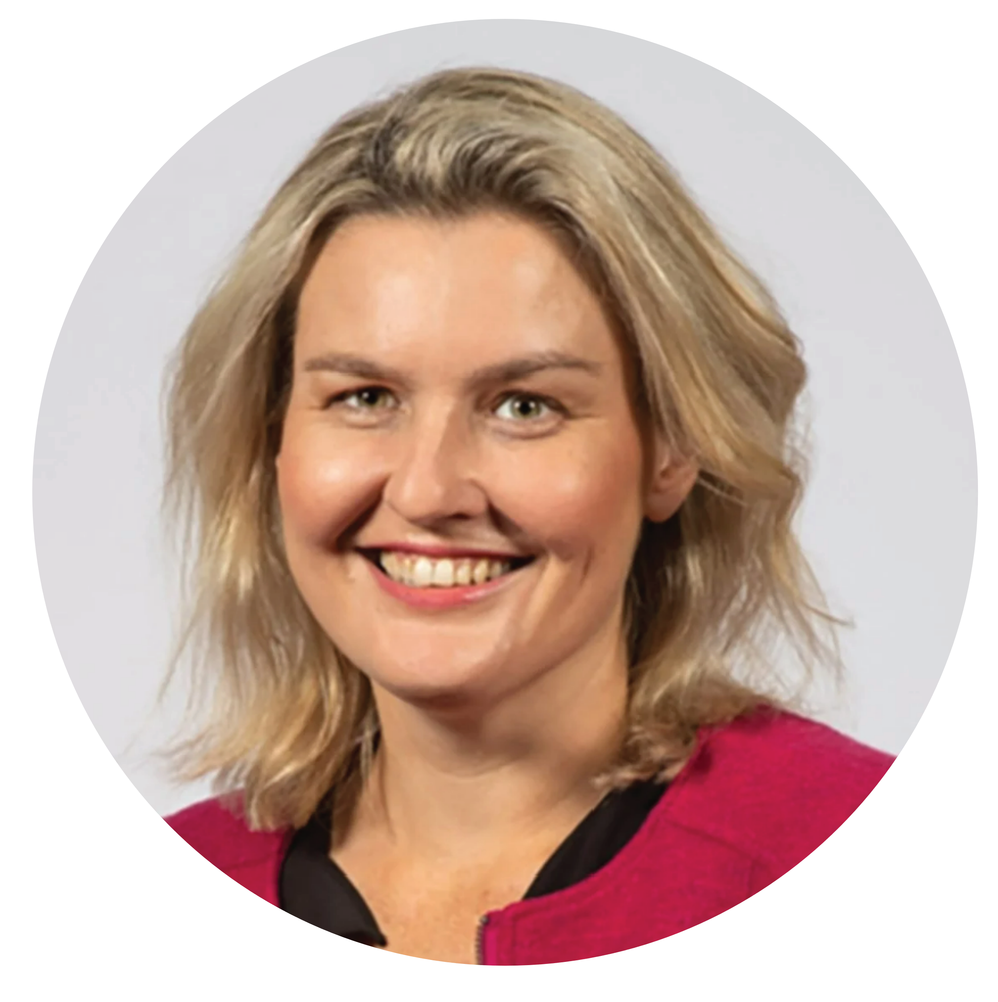
Special Guest
Lauren Kathage MP
Member for Yan Yean

Slide 10
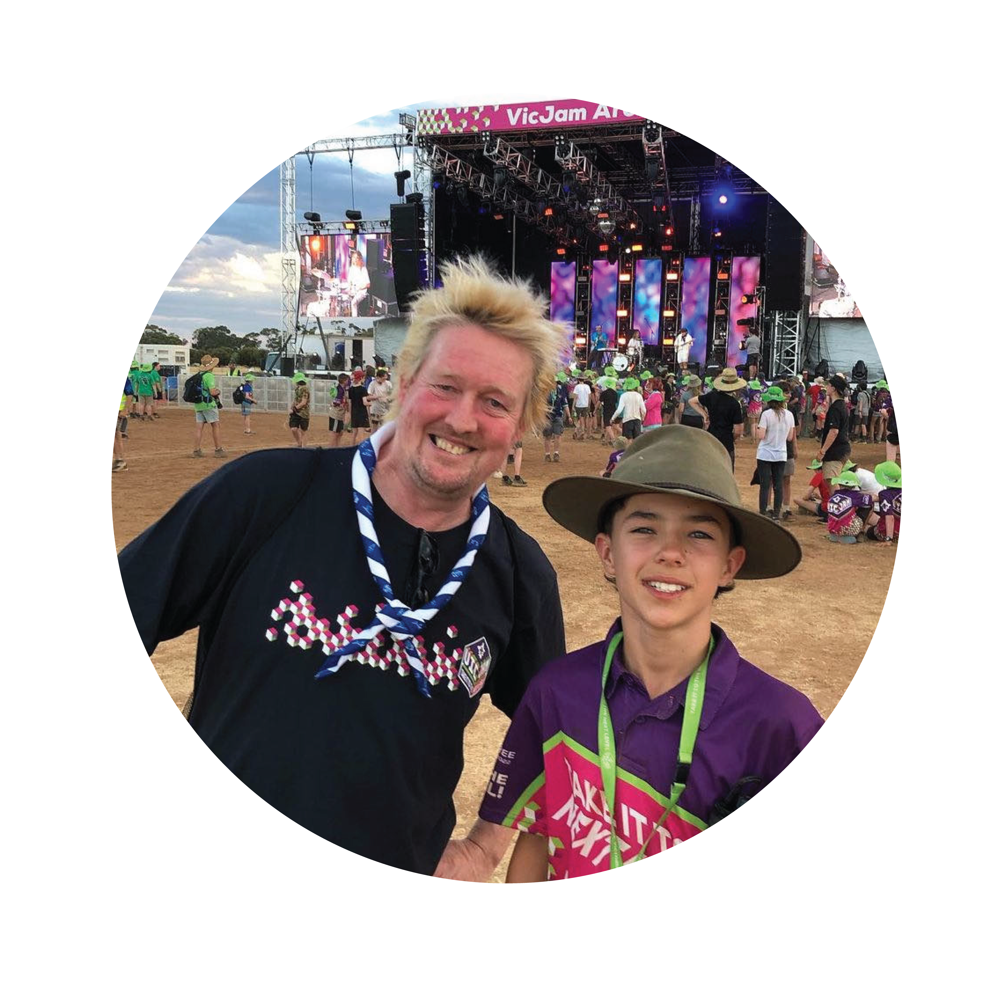
Special Guest
Lord David Robert Baden-Powell

Slide 11
Gratitude Scavenger Hunt
Shake the hand of someone wearing your favourite colour (I know we are all in uniform – we like a challenge)
Shake the hand of someone from your Scouting community that you appreciate the work of (and let them know the what, why, when of your choice)
Shake the hand of someone from the wider Scouting community

Slide 12
Let’s get into the action
Return to your seats

Slide 13
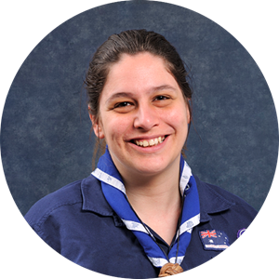
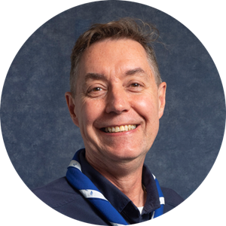
Please Welcome
Rod Byrnes
Chief Commissioner
Daniella Taglieri
Deputy Chief Commissioner

