Slide 1
Recruitment + Retention = Growth

Slide 2
Retention = Quality Programming with Good Communication
Notes:
Morris will be talking to us about programming later today.

Slide 3
Measurements
Median length of membership
What prompts members to leave?
How can we keep them longer?
Notes:
There are three measurements of retention

Slide 4
Median by Section
Joey Scouts = 0.9 years
Cub Scouts = 1.6 years
Scouts = 3.5 years
Venturers = 6.5 years
Rovers = 10 years
Overall = 2.1 years

Slide 5
Median by Region
Bays = 2y, 2m
Gippsland = 2y, 1m
Geelong = 2y, 1m
Lerderderg = 2y, 1m
Loddon Mallee = 2y
Melbourne = 2y
Mt Dandenong = 2y, 2m
Northern = 2y, 1m
Plenty Valley = 2y, 1m
West Coast = 2y, 1m
Western = 2y, 1m

Slide 6
Measurements
Churn = members who join AND leave within one census year.
What causes it?
How can we improve it?
Notes:
There are three measurements of retention

Slide 8
Measurements
Linking = members who drop off between Sections.
What causes it?
How can we improve it?
Notes:
There are three measurements of retention

Slide 10
Recruitment = Conversion
Notes:
Our data tells us that the recruitment struggle is actually a conversion struggle.

Slide 11
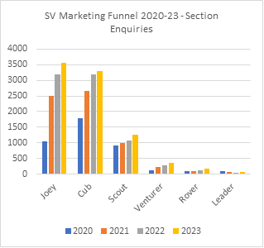
Recruitment
Notes:
This graph demonstrates an increase in enquiries through our website. For example; 2021 – 2022, there was an 20.5% increase in enquiries. In comparison the annual growth of population in that time was 1.85%

Slide 12
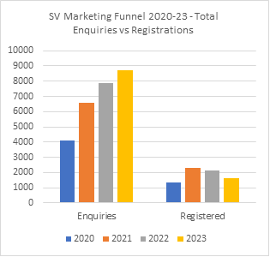
Recruitment
2022
Total Enquiries: 7,895
Total Registered: 2,122
Conversion Rate: 26.88%
Notes:
This graph shows the out of 7,895 enquiries, we actually registered 2,122 (approx. 27%)

Slide 13
What is stopping the conversion?
Delayed response to enquiry – or no response
Poor communication
Not feeling welcomed
Boring program
Choosing not to join

Slide 14
ENQUIRY
TRIAL
JOINING
Notes:
Family Welcome Pack
Timely communication and information with quality programming

Slide 15
Enquiry
We ask all Group Leaders to respond and finalise the enquiry within 7 days.
By finalising the enquiry, you are telling us that you have made contact.
Any enquiry not finalised after 7 days will be followed up by Scouts Victoria.
You can finalise these enquiries directly from the email or your workflow in Extranet.
While it is often the Group Leader who contacts new enquiries, you could consider asking a parent or supporter to manage that initial contact. While it has a consistent need, the task itself is quite contained.

Slide 16
Trialling
First impressions matter!
A family is likely to make a judgement based on what they can see and hear in their first few minutes.
Make that first impression count.
Notes:
Welcome Person
It is a good idea to have someone who isn’t the Section Leader meet the new youth member on their first night. Section Leaders are also trying to get the night going, check in with youth and families and are generally just busy people. A member of your Group Support Committee is perfect for this role. Someone who can take the time to spend 10 -15 minutes chatting with new parents and ensuring the youth member is supported and ready to engage. The Journey Guide role might be useful as a starting point to creating this in your Group.
Youth Mentor
Do you have youth members who support new people on their first few weeks? Perhaps consider starting a youth mentor role. Depending on your Group, this could be your Patrol Leaders, a Unit Leader or even a stand-alone role. Having a peer support a new member assists to reduce the anxiety and provide peer support and more opportunities for youth leadership.

Slide 17
Joining
Once they have decided to join,
what do you do now?
How do you integrate them
into the fabric of your Group?
Notes:
Welcome letter – what happens now?
Consider including the following:
Who is who in your Group? How does a new family know who are the Leaders of their Section? Or the Group Leader?
Expectations and Unit Code of Conduct
Communication channels
Logistics such as costs, uniform, Operoo
The current program
There is an example in Appendix 4
Parent Welcome
Have you considered a specific parent welcome letter? Perhaps sent a month after their child has started. There is an example in Appendix 5.

Slide 18
Summary
Retention = quality programming with good communication.
Recruitment = friendly people welcoming new faces with good sharing of information.

