Slide 1
Operoo 101

Slide 2
Session Overview
Updating your Group details
Staff – Adding, assigning and removing
Eforms – Creating, managing and archiving
Using Operoo for communications
Question time
NB: Above tasks all need to be completed on a desktop computer

Slide 3
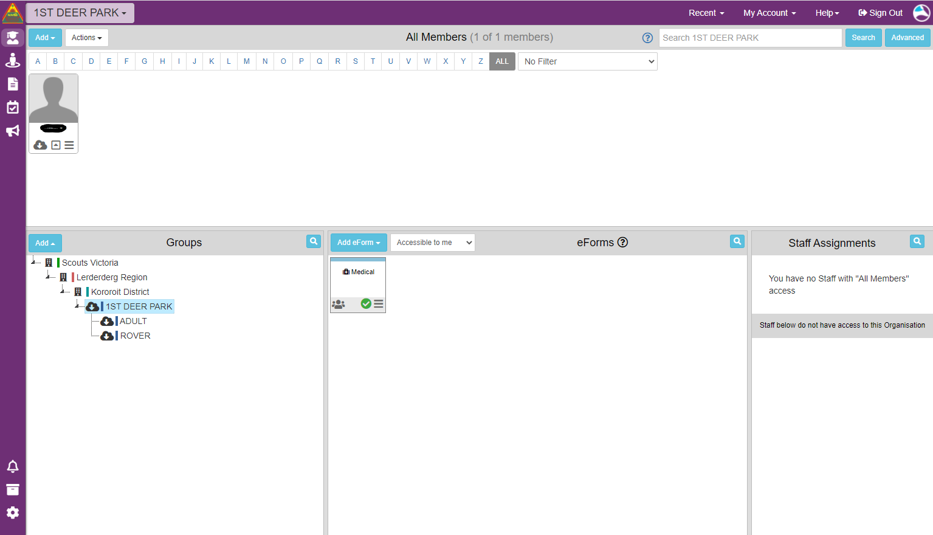
Updating Group Details
To update Group details you will need to be the administrator* for you Group/Formation
When you log in as an administrator this is the view you will get
*Administrator = LIC of Group/District/Region

Slide 4
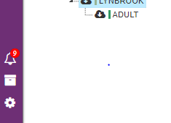
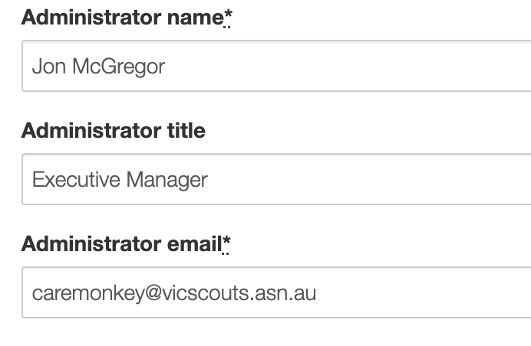
Many Groups are still sending information from the Executive Manager and an old email address.
This should be your name, the title of your role (ie Group Leader) and the generic Scouts Victoria email for your Formation.

Slide 5
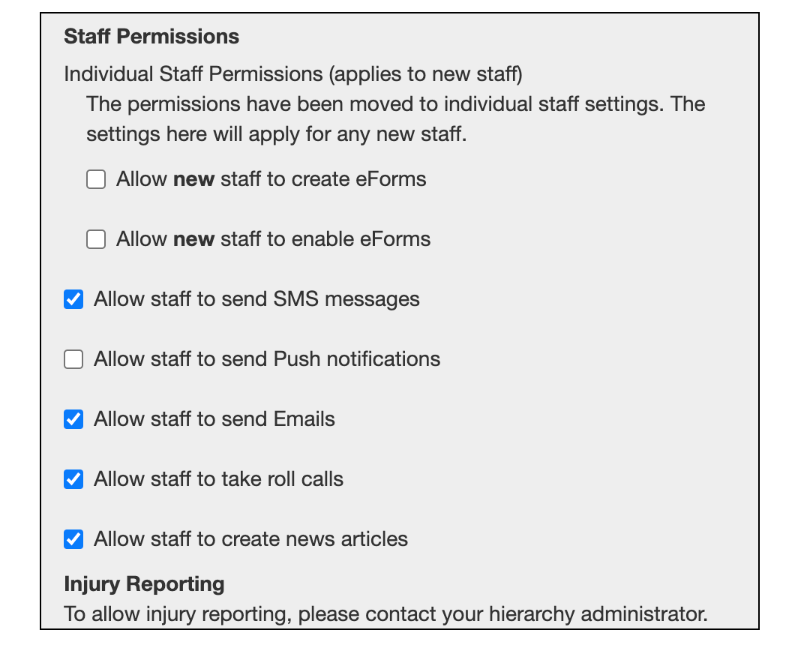
A bit further down the Group settings page is the Staff permissions section
To allow your Staff (Leaders) to be able to create and enable eForms you will need to make sure this is ticked
Don’t forget the Save button

Slide 6
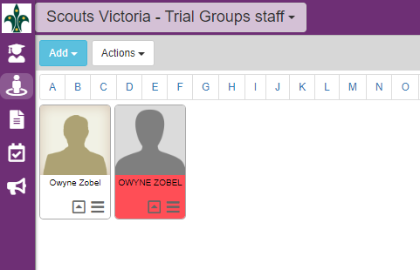
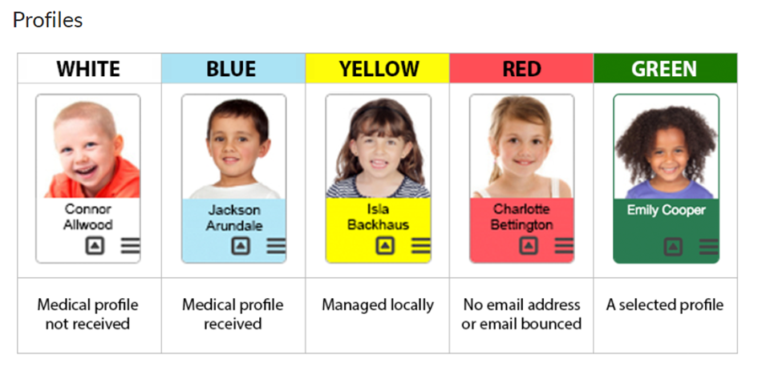
Staff
We first need to check if a Leader has already been added as a staff in Operoo and if there are any outstanding issues with this before we add a staff.

Slide 7
As one of these staff profiles is appearing red – that indicates an issue with the email.
To fix this we need to edit the profile.
Click on the 3 lines (hamburger)

Slide 8
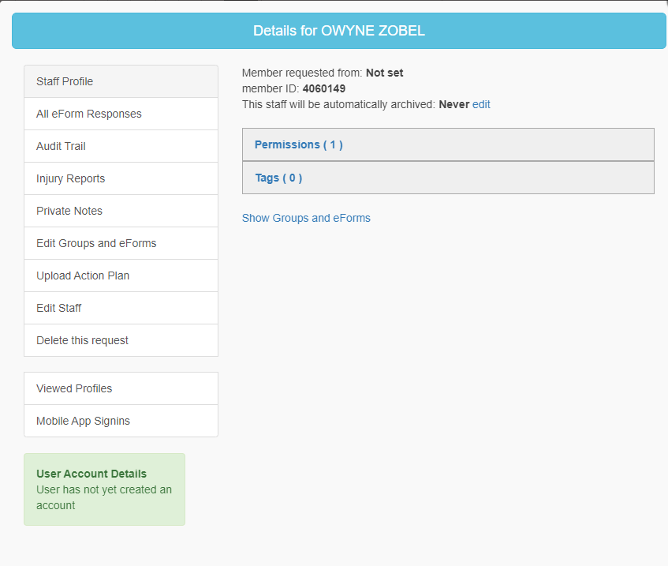
A pop up screen of the details will appear
You can see that the Member Request From = Not Set
We need to click on Edit Staff and then update the email address
Notes:
To add a carer to a section
Click on the staff icon
Select add
From the list select with add a single staff or add multiple
To add the staff member you will need to add the name, email address (same as the one they already have on Operoo) and The ID number which is their membership number.
We are not adding a medical profile, we are adding a permission level

Slide 9
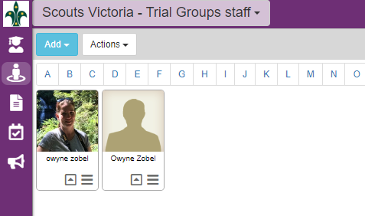
Once the email is updated the profile colour will change to White or Blue and you are good to go
Now remember before we saw how to update to allow for new Staff to be able to create and enable eForms?
For some Staff who were already added prior to a change around this in Operoo you may have to update these permissions individually
Click on the 3 lines (hamburger)
Notes:
To add a carer to a section
Click on the staff icon
Select add
From the list select with add a single staff or add multiple
To add the staff member you will need to add the name, email address (same as the one they already have on Operoo) and The ID number which is their membership number.
We are not adding a medical profile, we are adding a permission level

Slide 10
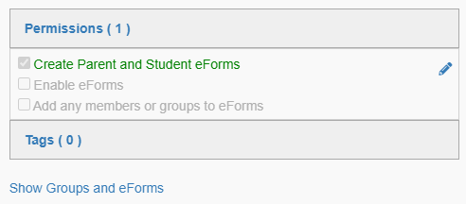
We can see that this staff member has 1 permission
By clicking on this we can see what that permission is
And we can edit these permissions for individual staff (Leader) if necessary
Just click the pencil and then tick or untick the appropriate boxes
Notes:
To add a carer to a section
Click on the staff icon
Select add
From the list select with add a single staff or add multiple
To add the staff member you will need to add the name, email address (same as the one they already have on Operoo) and The ID number which is their membership number.
We are not adding a medical profile, we are adding a permission level

Slide 11
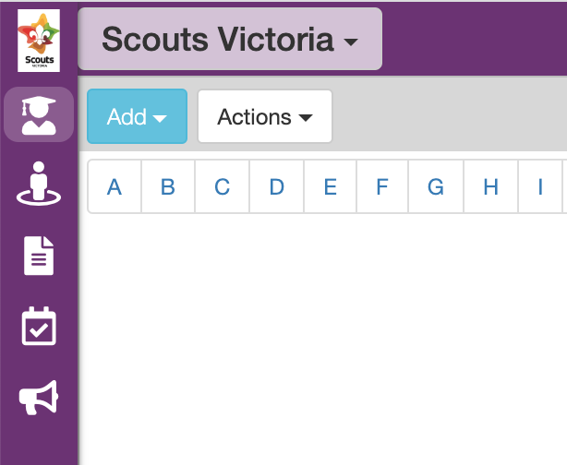
Adding Staff
This should show as your Group/
District/Region
Staff in Operoo need to be added and removed manually by an Administrator
This is not automatic based on a Leaders role in Extranet
We are not adding a medical profile, we are adding a permission level
We first need to go to the Staff section in Operoo
Notes:
To add a carer to a section
Click on the staff icon
Select add
From the list select with add a single staff or add multiple
To add the staff member you will need to add the name, email address (same as the one they already have on Operoo) and The ID number which is their membership number.
We are not adding a medical profile, we are adding a permission level

Slide 12
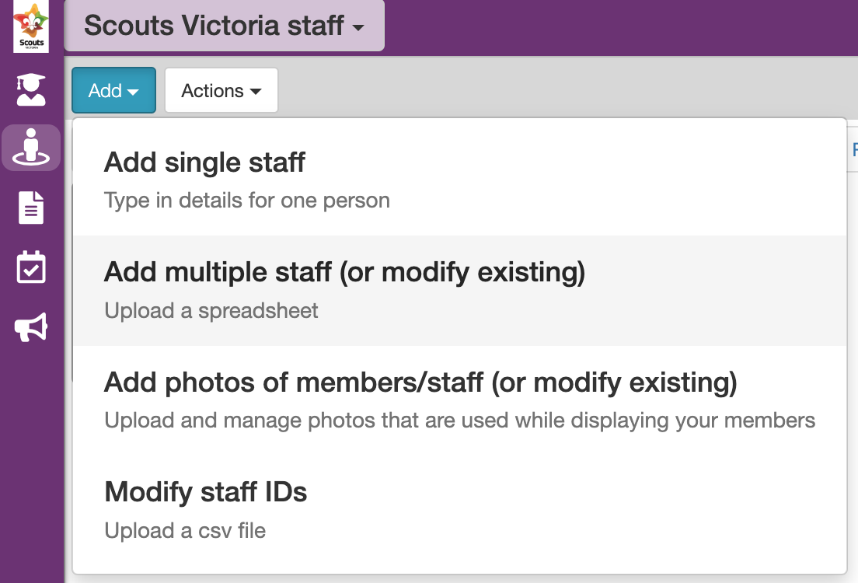
Staff = in staff area of Group/
District/Region
Before adding a staff profile you will need the following details:
Members Name
Email Address (same one they already use for Operoo)
Membership Number
Notes:
To add a carer to a section
Click on the staff icon
Select add
From the list select with add a single staff or add multiple
To add the staff member you will need to add the name, email address (same as the one they already have on Operoo) and The ID number which is their membership number.
We are not adding a medical profile, we are adding a permission level

Slide 13
Adding Staff
Fill in the name, member number and email address
* If you forget to add the email address, you will still be able to add the staff profile but the member will not be able to access any details
Click Save
Notes:
To add a carer to a section
Click on the staff icon
Select add
From the list select with add a single staff or add multiple
To add the staff member you will need to add the name, email address (same as the one they already have on Operoo) and The ID number which is their membership number.
We are not adding a medical profile, we are adding a permission level

Slide 14
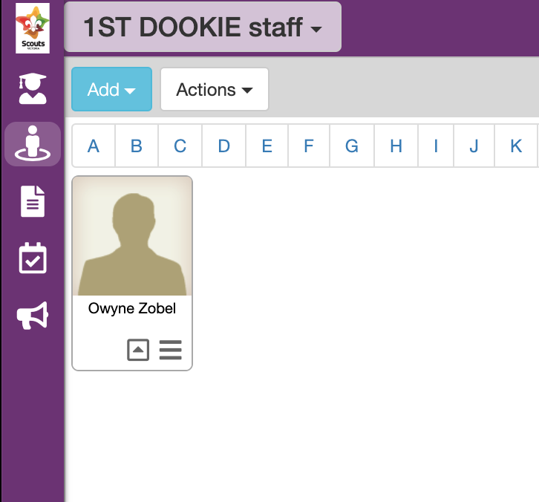
Now that we have added the Staff we need to assign them to the relevant Section.
To do this we need to go back to the members page.
Staff you have added will appear here
A white or blue profile is good and a pink/red profile means that there is an issue with an email address
Notes:
Once added, Select the profile and it will turn green
Click on the 3 lines
Tick the section you would like to add the carer to.
This is the same process you will need to use if you want to add a carer to an eForm such as a district or regional event

Slide 15
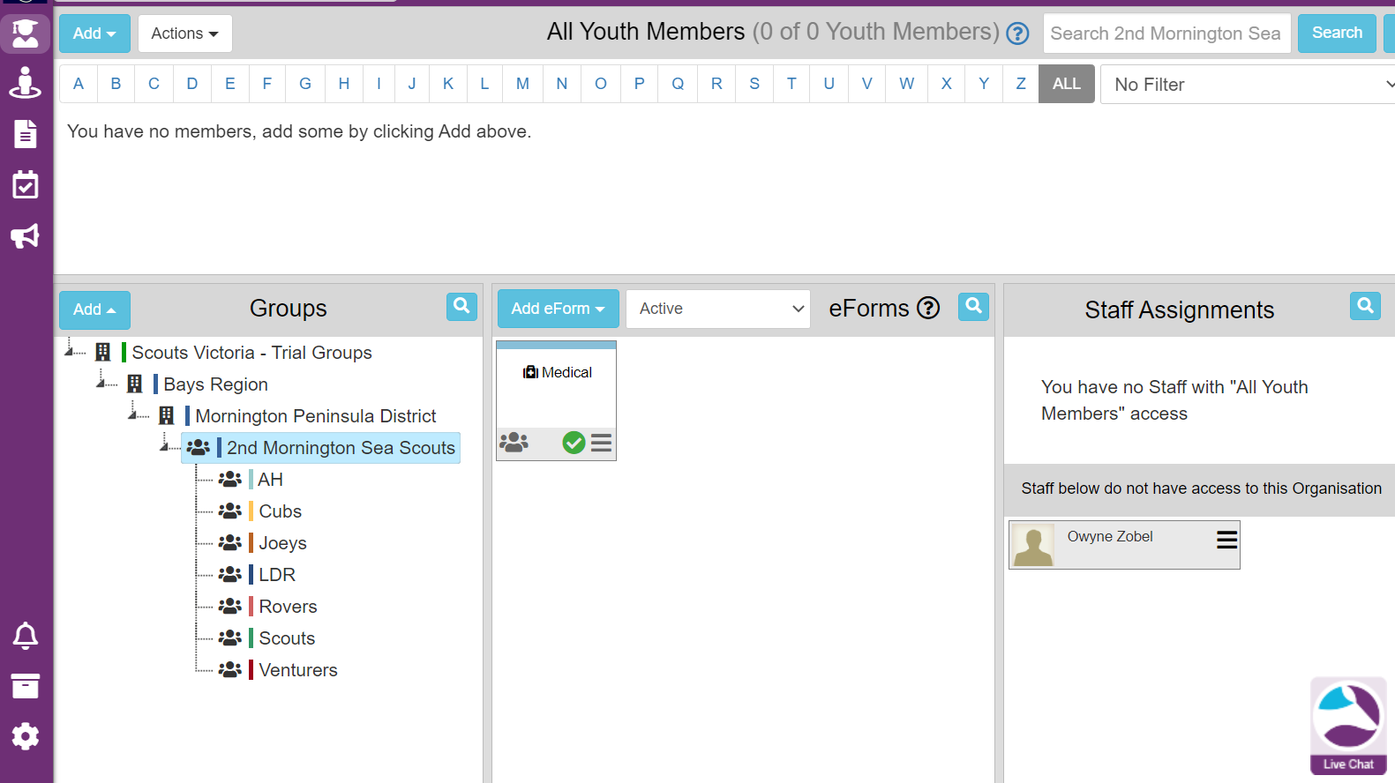
Assigning Staff
We can now see the staff we added in the staff assignments Section
Notes:
Once added, Select the profile and it will turn green
Click on the 3 lines
Tick the section you would like to add the carer to.
This is the same process you will need to use if you want to add a carer to an eForm such as a district or regional event

Slide 16
Click on the three lines (hamburger) on the staff member you wish to assign
Notes:
Once added, Select the profile and it will turn green
Click on the 3 lines
Tick the section you would like to add the carer to.
This is the same process you will need to use if you want to add a carer to an eForm such as a district or regional event

Slide 17
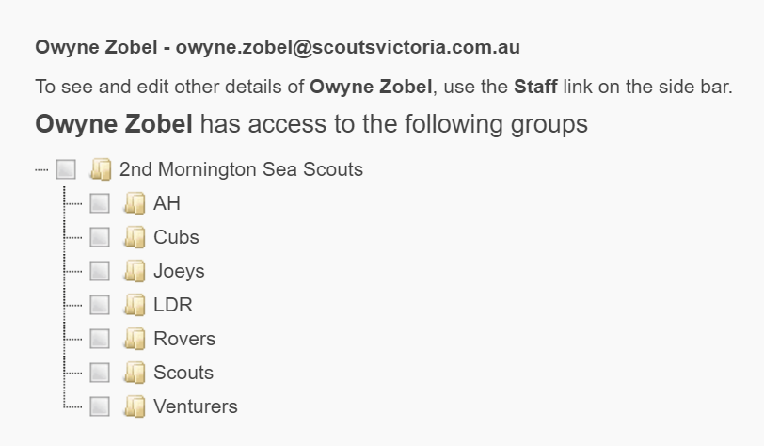
When the pop up screen appears, tick the relevant section you wish to assign the staff member to.
Notes:
Once added, Select the profile and it will turn green
Click on the 3 lines
Tick the section you would like to add the carer to.
This is the same process you will need to use if you want to add a carer to an eForm such as a district or regional event

Slide 18
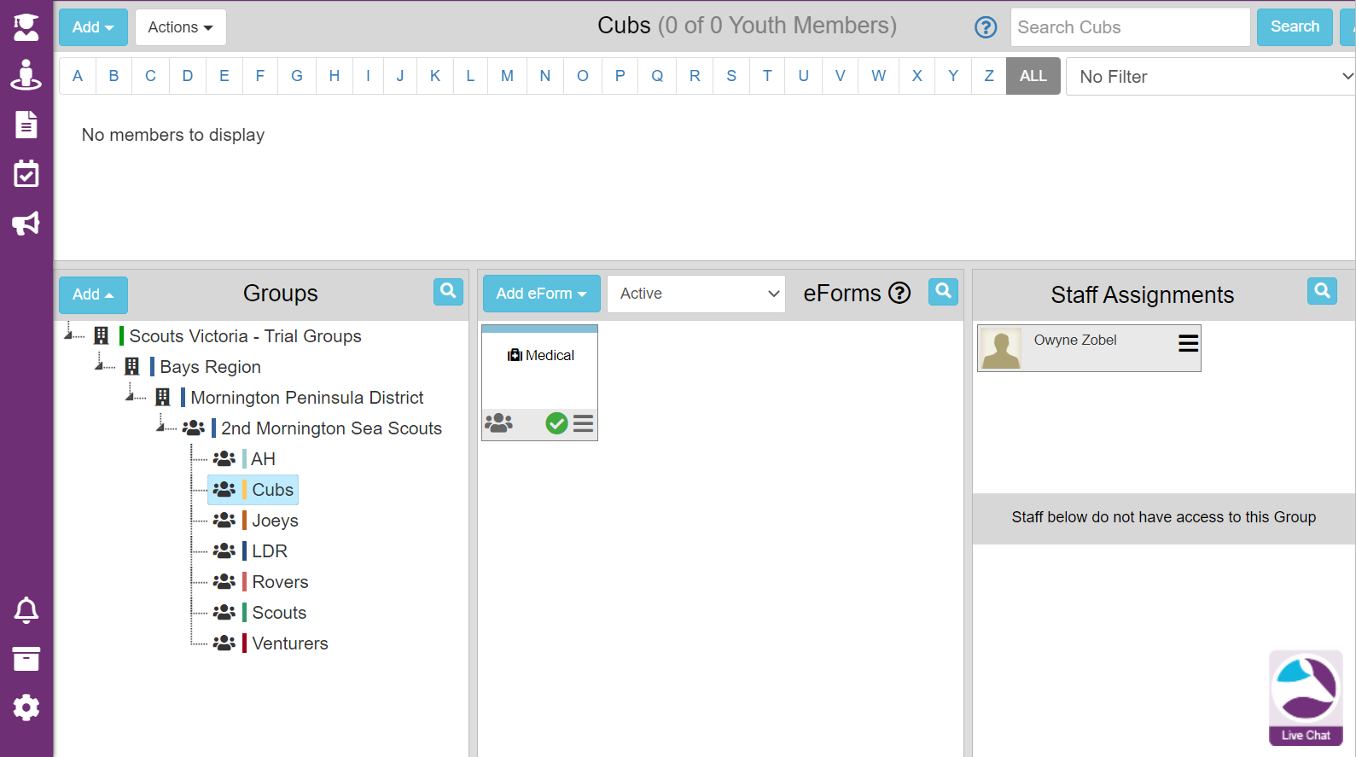
We can now see the staff member has been assigned to the Cub Section
Notes:
Once added, Select the profile and it will turn green
Click on the 3 lines
Tick the section you would like to add the carer to.
This is the same process you will need to use if you want to add a carer to an eForm such as a district or regional event

Slide 19
Removing Staff
This should show as your Group/
District/Region
Staff in Operoo need to also be removed manually by an Administrator
This is not automatic based on a Leaders role or retirement in Extranet
We are not removing a medical profile, we are removing a permission level
We first need to go back to the Staff section in Operoo
Notes:
Once added, Select the profile and it will turn green
Click on the 3 lines
Tick the section you would like to add the carer to.
This is the same process you will need to use if you want to add a carer to an eForm such as a district or regional event

Slide 20
Click on the three lines (hamburger) on the staff member you wish to remove
Notes:
Once added, Select the profile and it will turn green
Click on the 3 lines
Tick the section you would like to add the carer to.
This is the same process you will need to use if you want to add a carer to an eForm such as a district or regional event

Slide 21
When the pop up window appears we then need to click on Archive this Staff
A pop up will ask if you are sure you want to do this
Click the tick box and then the Archive button
Notes:
Once added, Select the profile and it will turn green
Click on the 3 lines
Tick the section you would like to add the carer to.
This is the same process you will need to use if you want to add a carer to an eForm such as a district or regional event

Slide 22
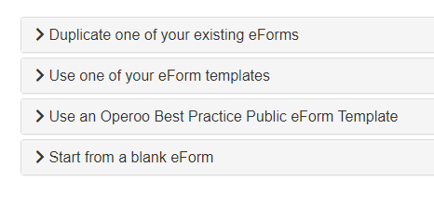
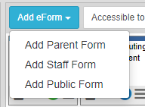
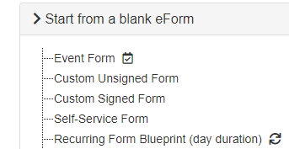
1
Setting up an eForm | Administrator For Administrators
3
2
4
Notes:
Working through each stage, a GL can easily put together a form for an event.
Once you are happy with it go into Member Selection section on the form
From here you can either :
Drag and drop/Manual - Drag and drop the individual members or group on the eForm
All members- all received and not received profiles will be assigned to the eForm Linked to groups - link the eForm to one or more groups
The for will not start dsending email’s out until it has been enabled.
Before you enable the form we recommend sending out a test email to your own inbox
The full instruction on how to Create, Add members, test, enable and archive can be found on the Operoo website, by searching how to create an eForm.

Slide 23
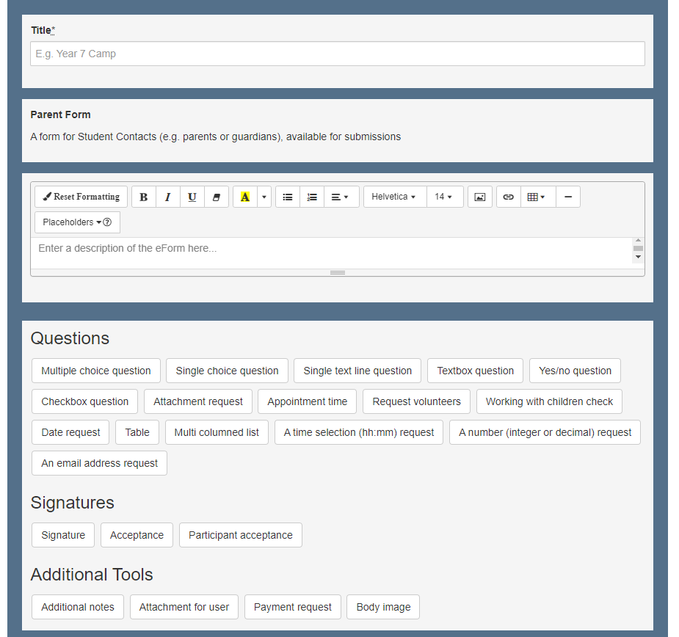
Filling in the Form
Here we add in a title for our event/camp/activity.
I like to include the location and date where possible
You can enter whole documents like a flyer, gear list etc or you can add in questions for your members to answer if you want.
You can also leave all of this blank if you are just wanting this to be a place holder of profiles for an event.
Don’t forget the SAVE button at the bottom
Notes:
Working through each stage, a GL can easily put together a form for an event.
Once you are happy with it go into Member Selection section on the form
From here you can either :
Drag and drop/Manual - Drag and drop the individual members or group on the eForm
All members- all received and not received profiles will be assigned to the eForm Linked to groups - link the eForm to one or more groups
The for will not start dsending email’s out until it has been enabled.
Before you enable the form we recommend sending out a test email to your own inbox
The full instruction on how to Create, Add members, test, enable and archive can be found on the Operoo website, by searching how to create an eForm.

Slide 24
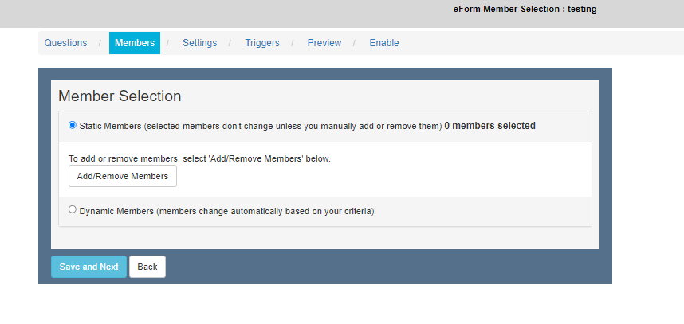
Member Selection
Here we leave the selection as Static Members – We will return to adding member to the eForm later.
Click SAVE and NEXT button

Slide 25
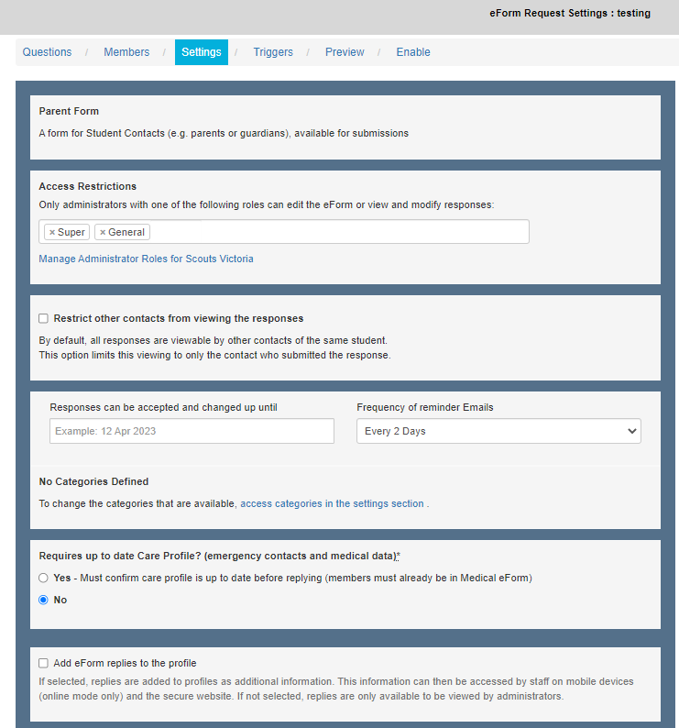
Settings Page
This is the settings for the eForm and determines who can see it and how often the members will receive notifications about it.
There are two main things to note on this first bit:
Frequency of Email reminders
Up to Date Care Profile

Slide 26
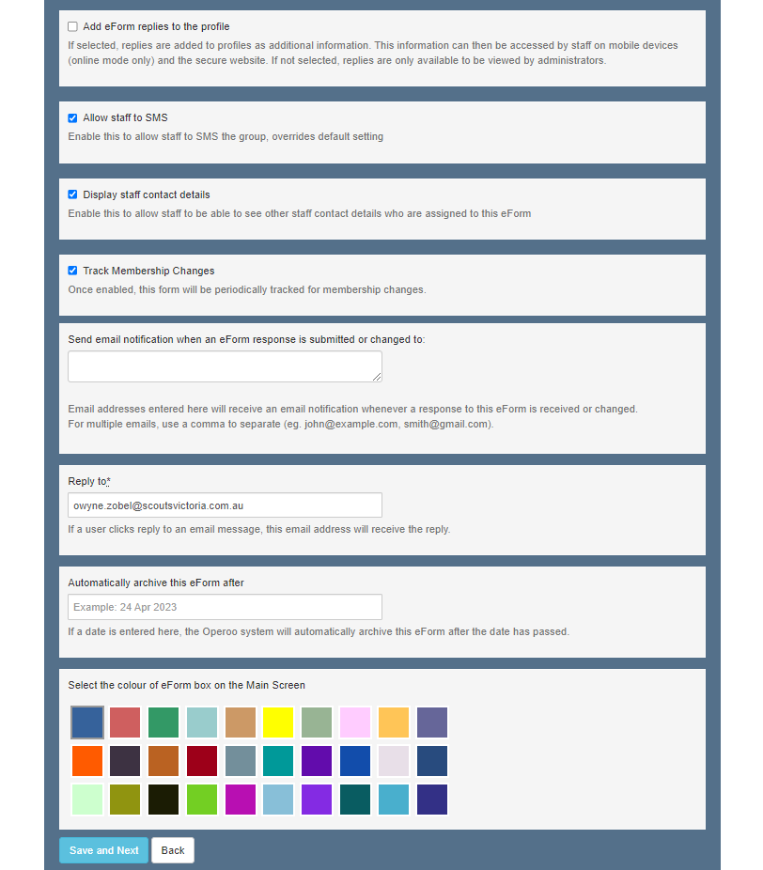
Most of these settings you can leave as is but feel free to adjust if needed.
Main points to make sure you have the right information for are:
Email notification and eForm responses
Reply to*
Automatically archive eForm after
And don’t forget to choose a colour for the eForm
SAVE and NEXT

Slide 27
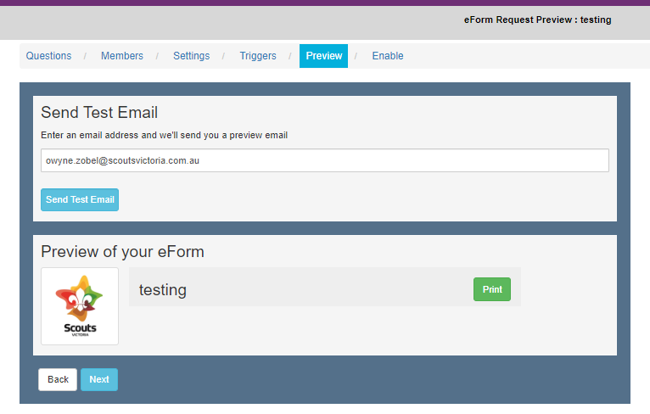
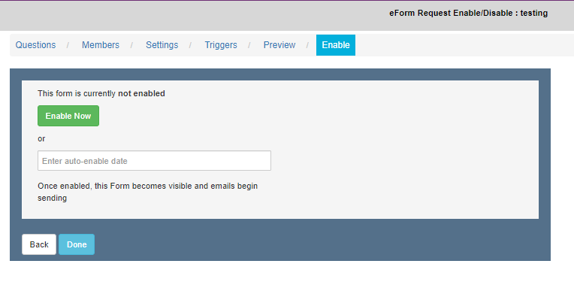
Finishing up the eForm
Notes:
If you have a list of all the youth members registration numbers of those attending a DC can create an event and bulk upload the attendees
Select the hamburger on the from you would like to add the members too:
Check the form is set to Drag and Drop in the members selection

Slide 28
Admin view when eForms created

Slide 29
Alternative Solutions for District, Region and State Events
Each group creates an eForm
Each group adds the designated camp first aider to the eForm as a staff
Not all leaders need access to all youth’s files
You may need to reach out to the level above ie District, Region or State depending on who is attending to create the eForm
Large events may require you to send a list of Members names and member number to your GL, DC, RC etc to bulk add members to an eForm

Slide 30
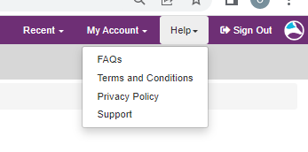
Where do I go for help?

Slide 31
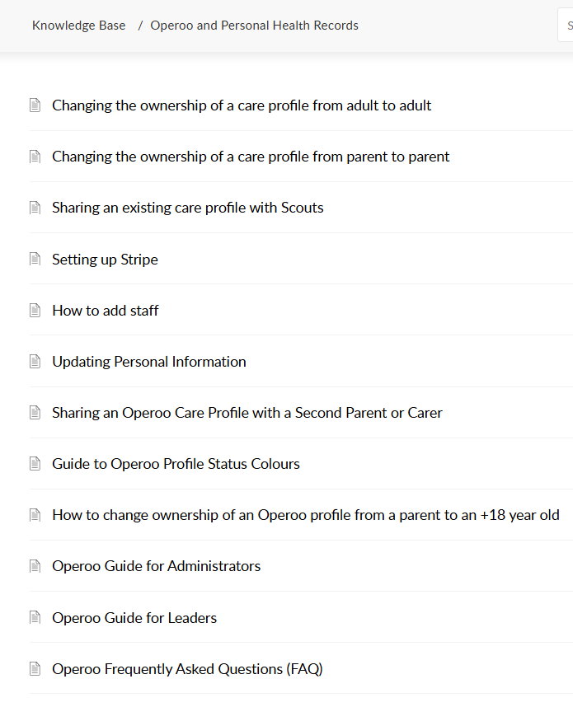
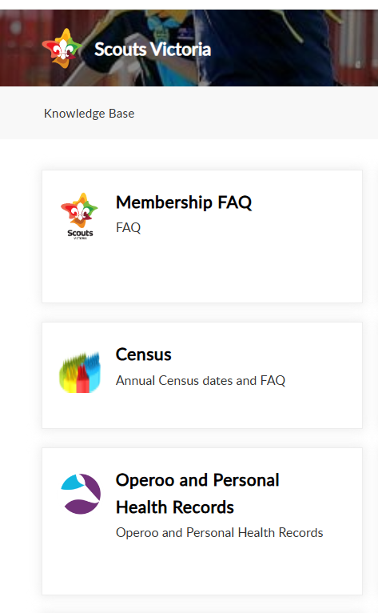
Where do I go for help?

Slide 32
Questions

Slide 33
Thank you for your time today We know it can be complicated Check out the FAQ’s on the Scouts Victoria website and please email any questions to memberservices@scoutsvictoria.com.au
Notes:
Once added, Select the profile and it will turn green
Click on the 3 lines
Tick the section you would like to add the carer to.
This is the same process you will need to use if you want to add a carer to an eForm such as a district or regional event

