Slide 1
Adventurous Activities
Matty McKernan
Assistant Chief Commissioner

Slide 2
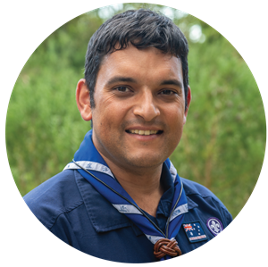
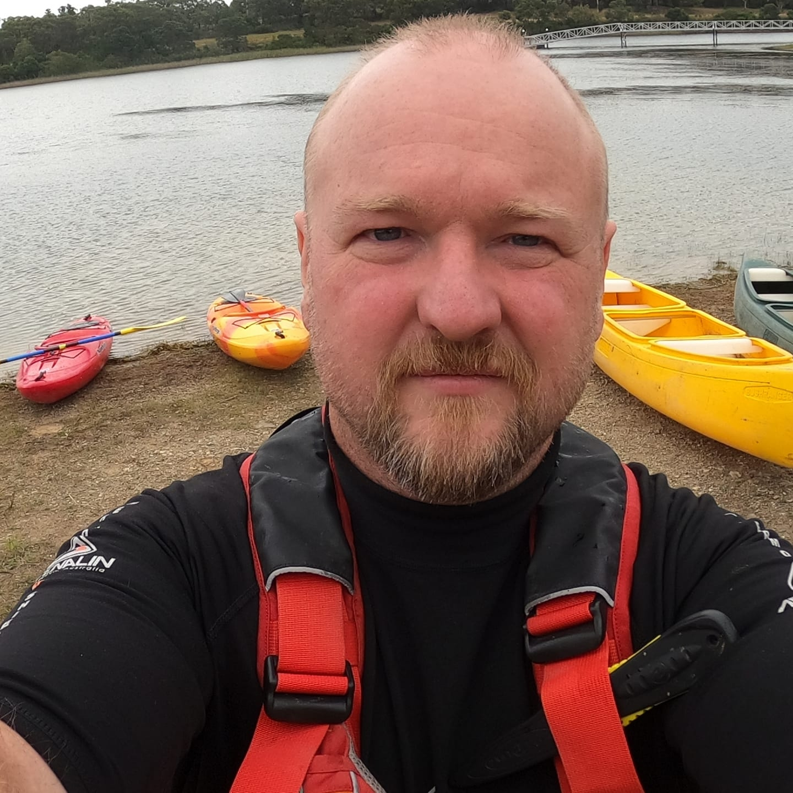
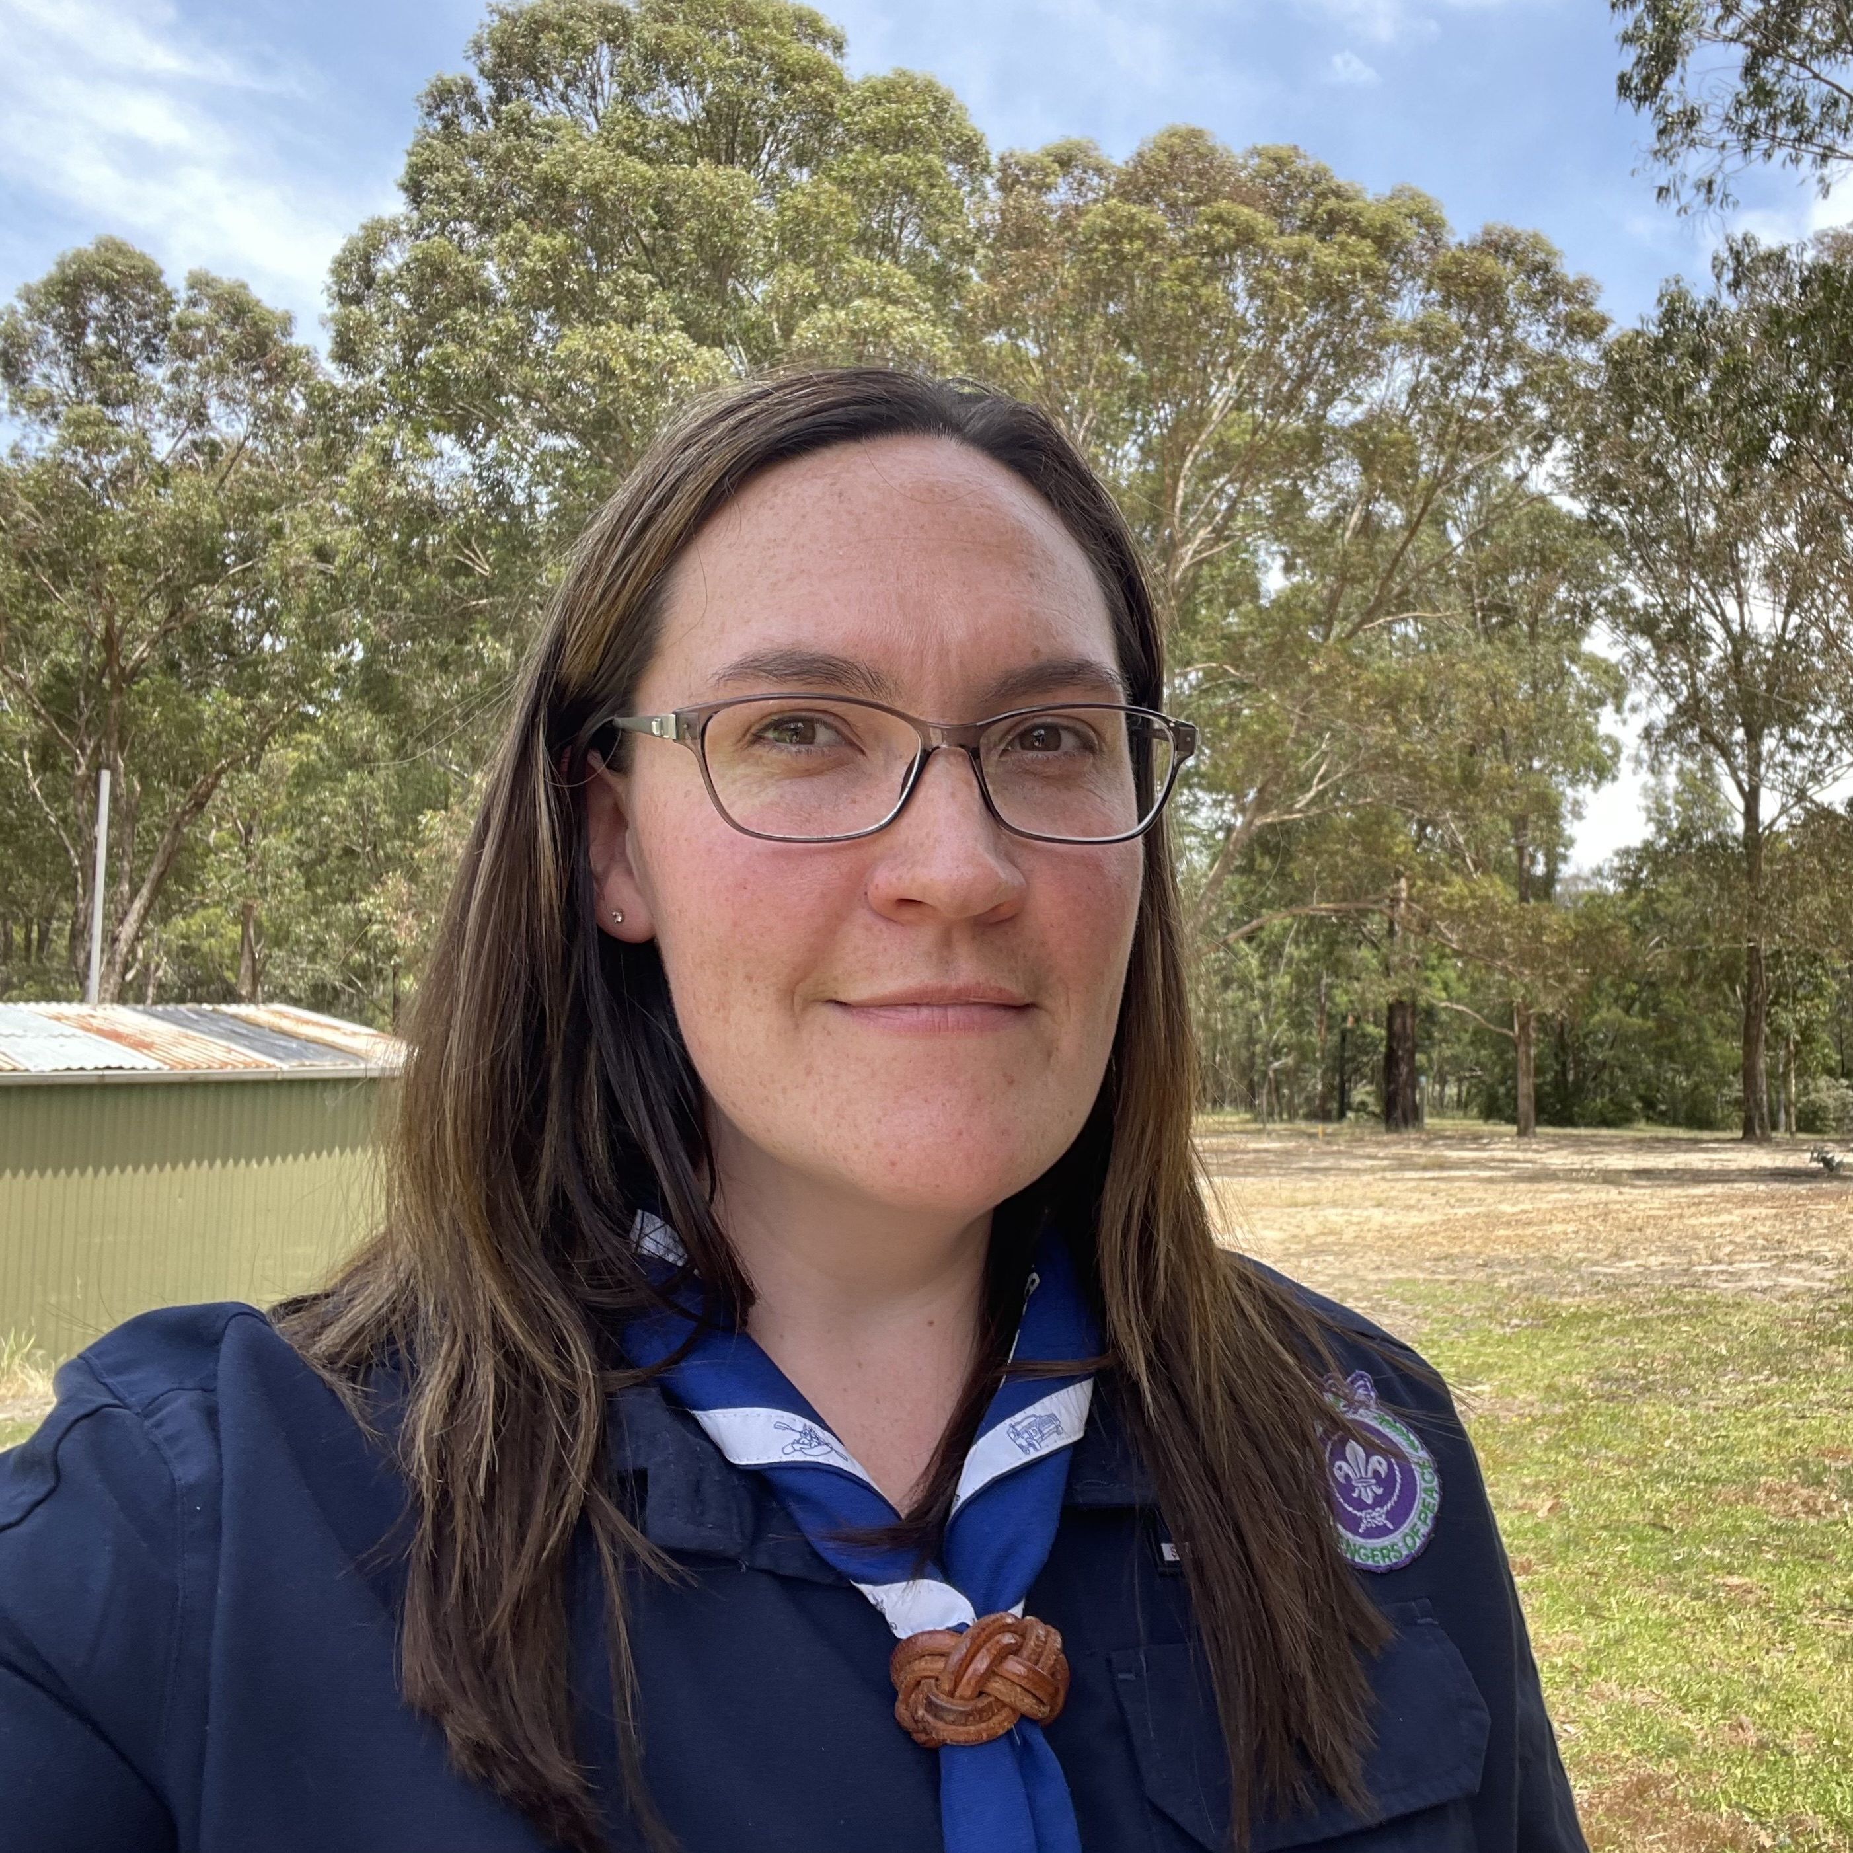
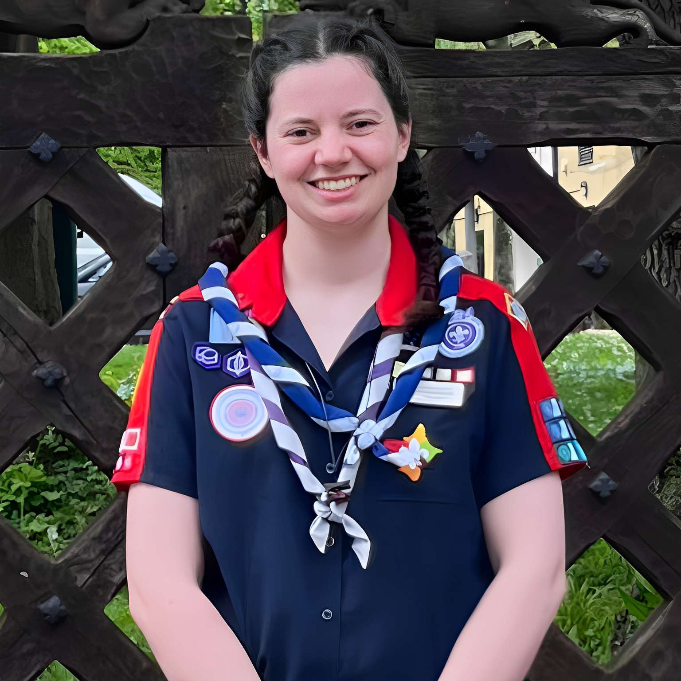
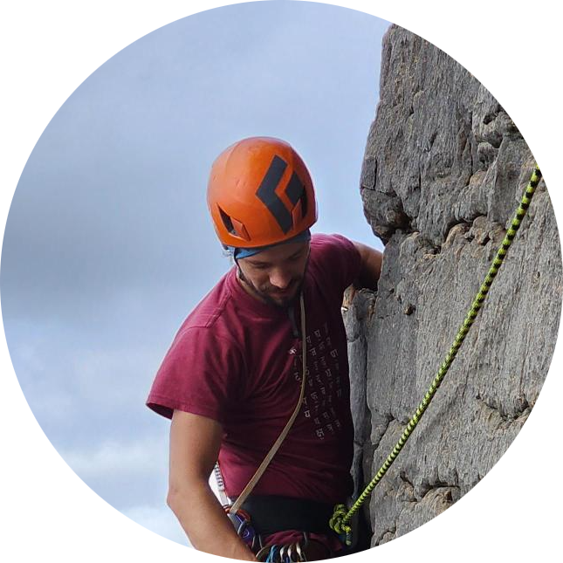
The Team
Mathew McKernan
Assistant Chief Commissioner - Adventure
Scott Rosicka
State Commissioner - Adventure
Narelle Lowdell
State Commissioner – Outdoor Adventure Skills Leader Support
Jacinta Swift
Youth Commissioner
Bob Edwards
Project Officer

Slide 3
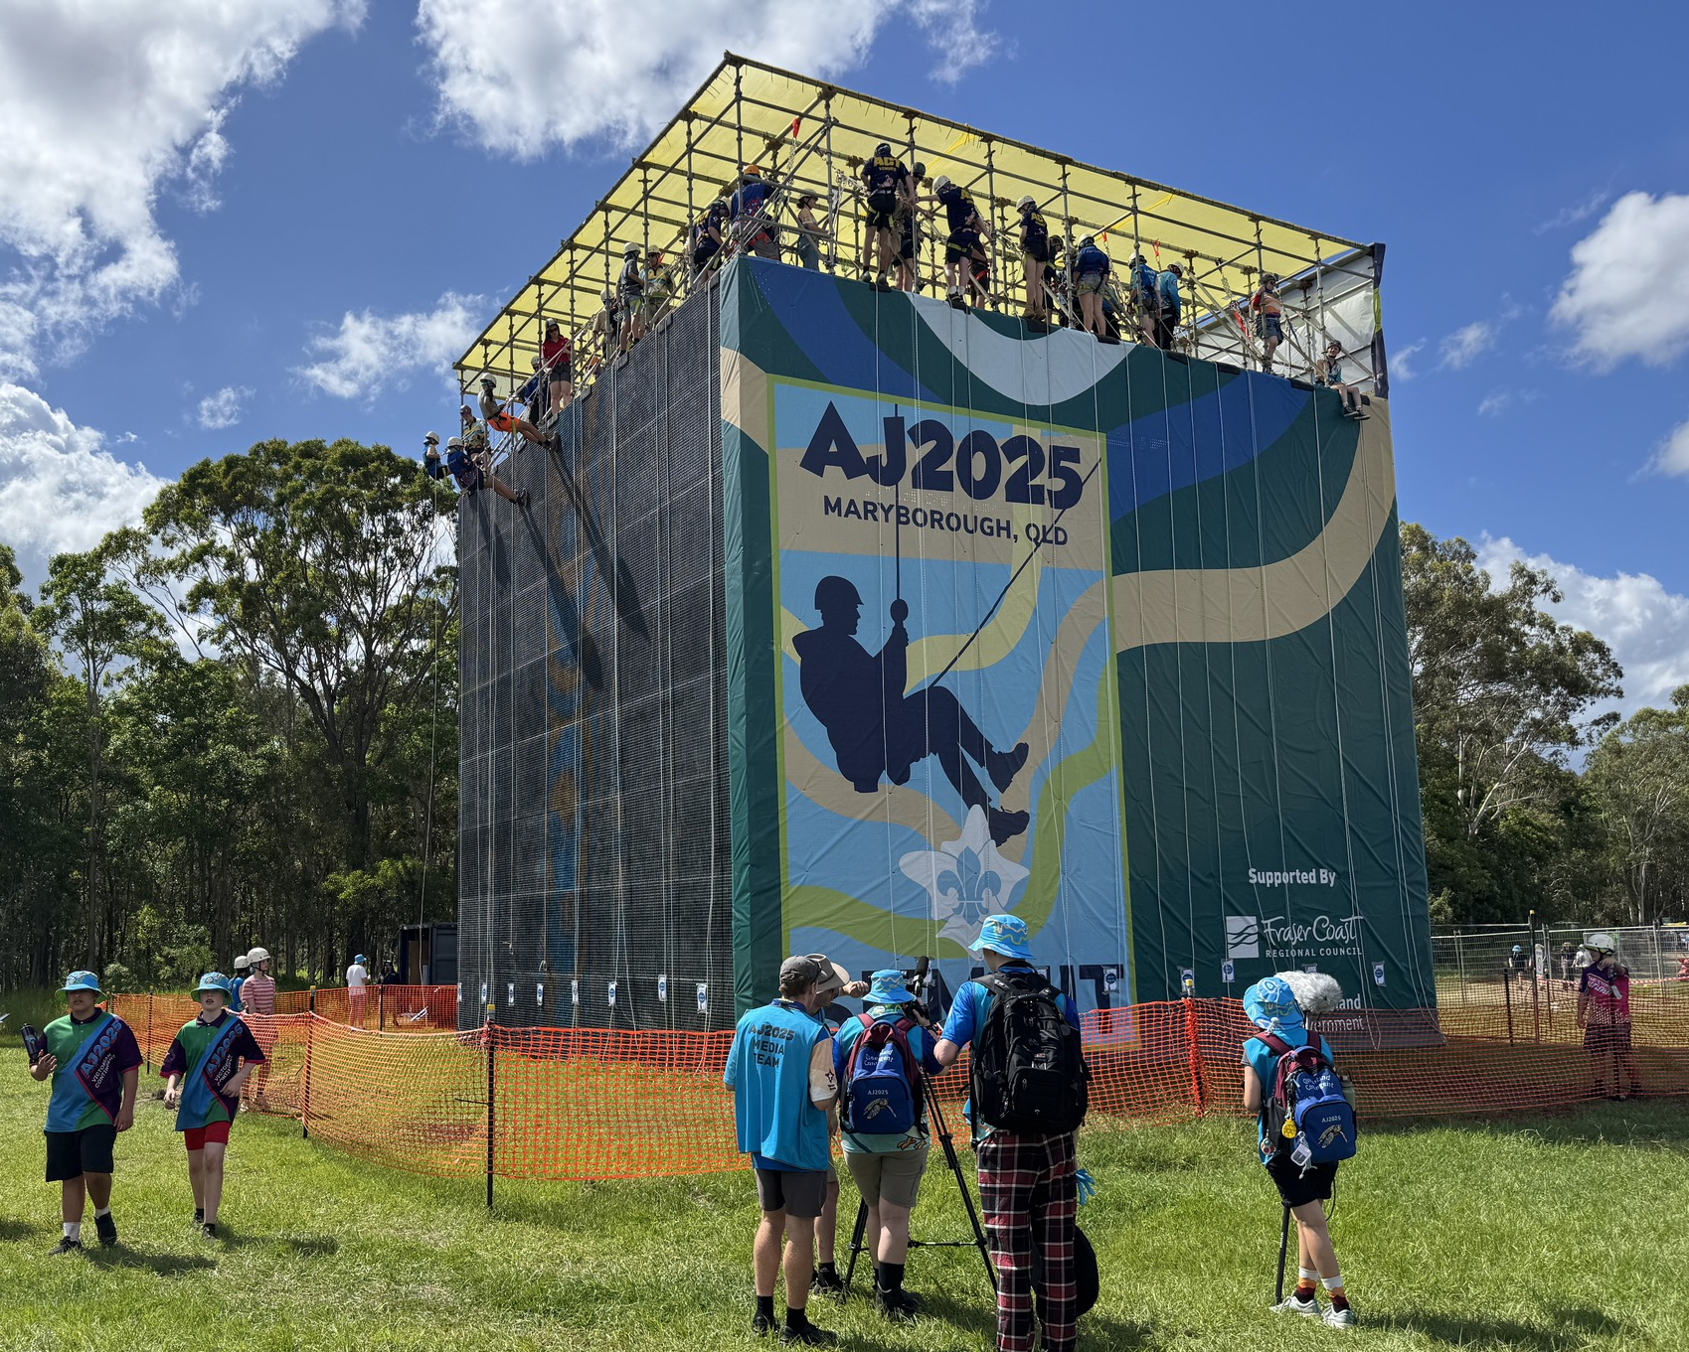
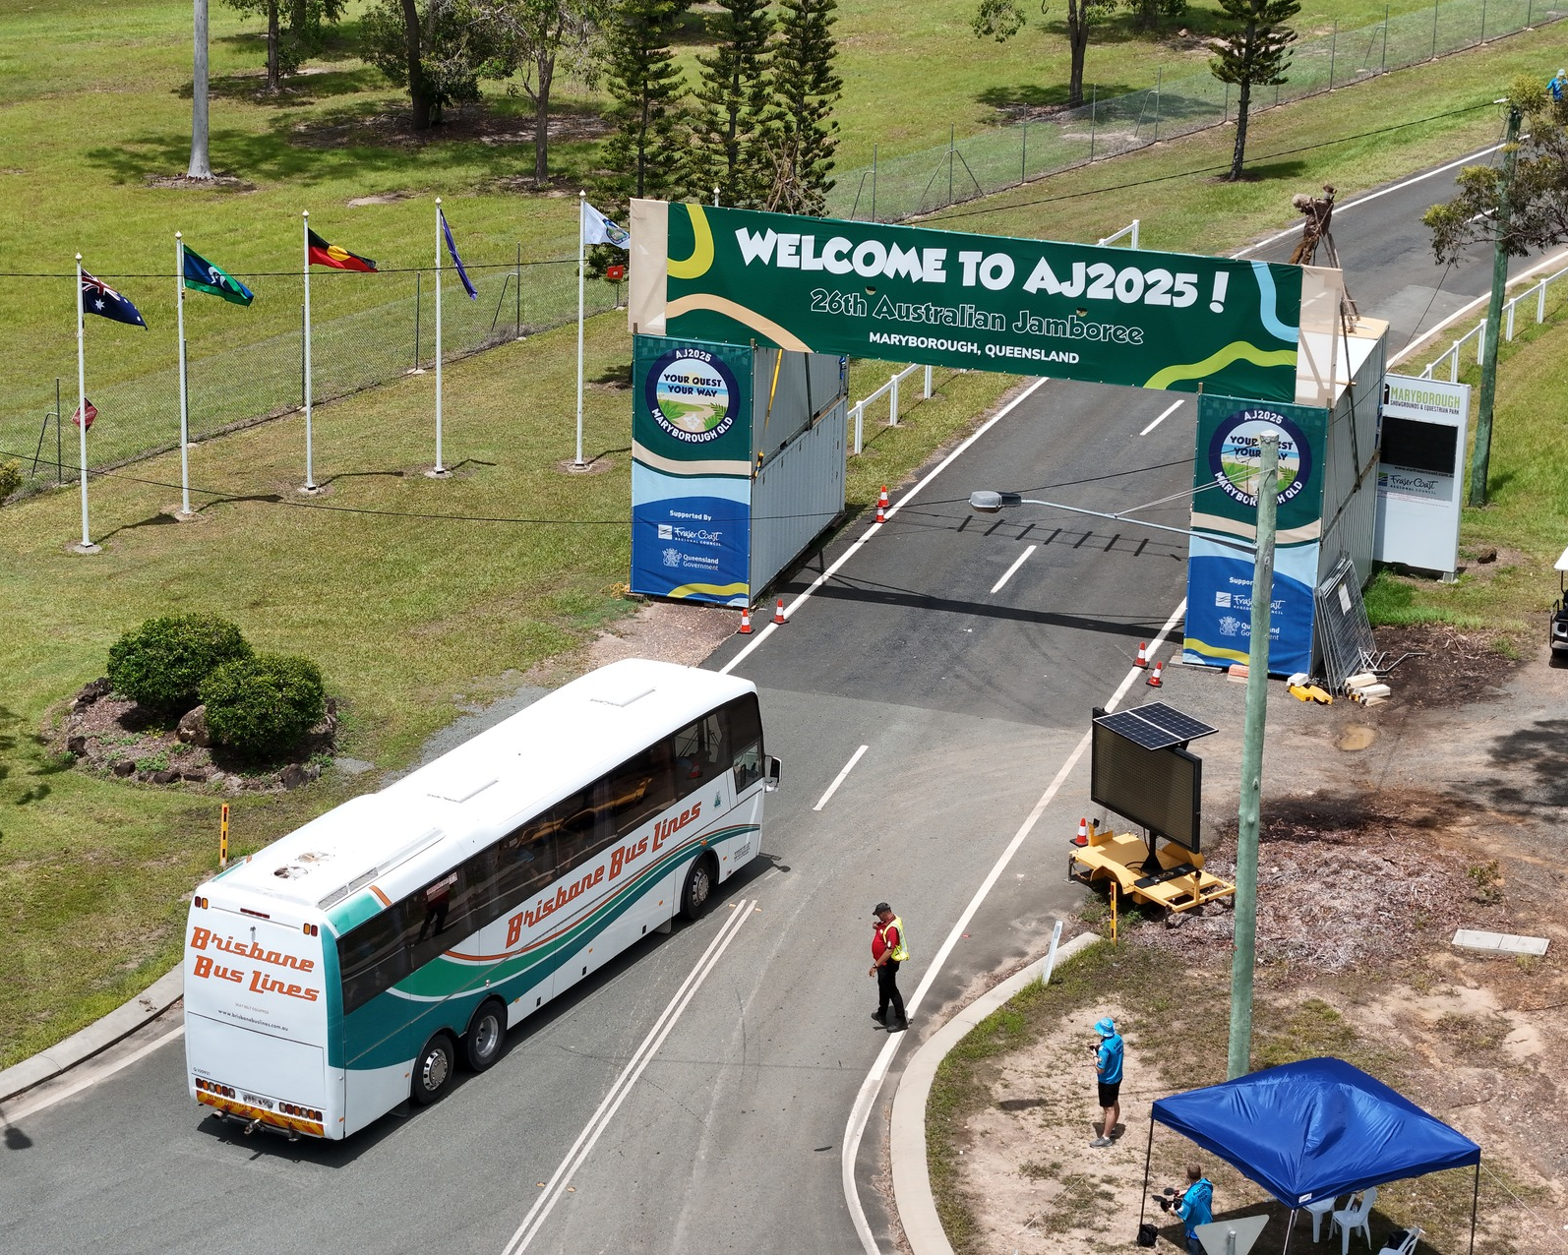
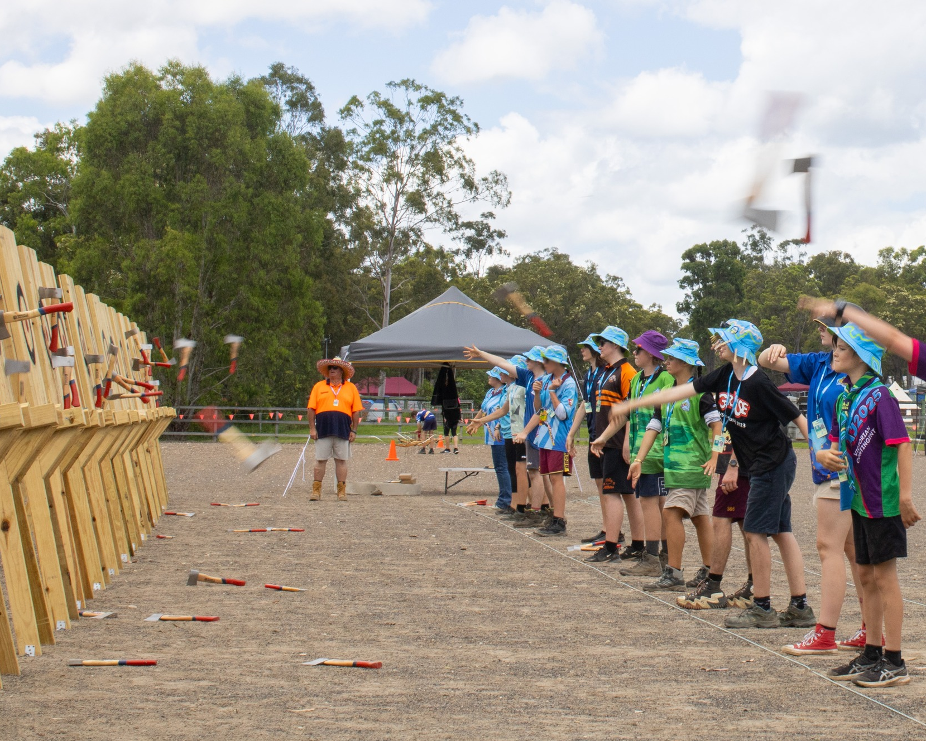
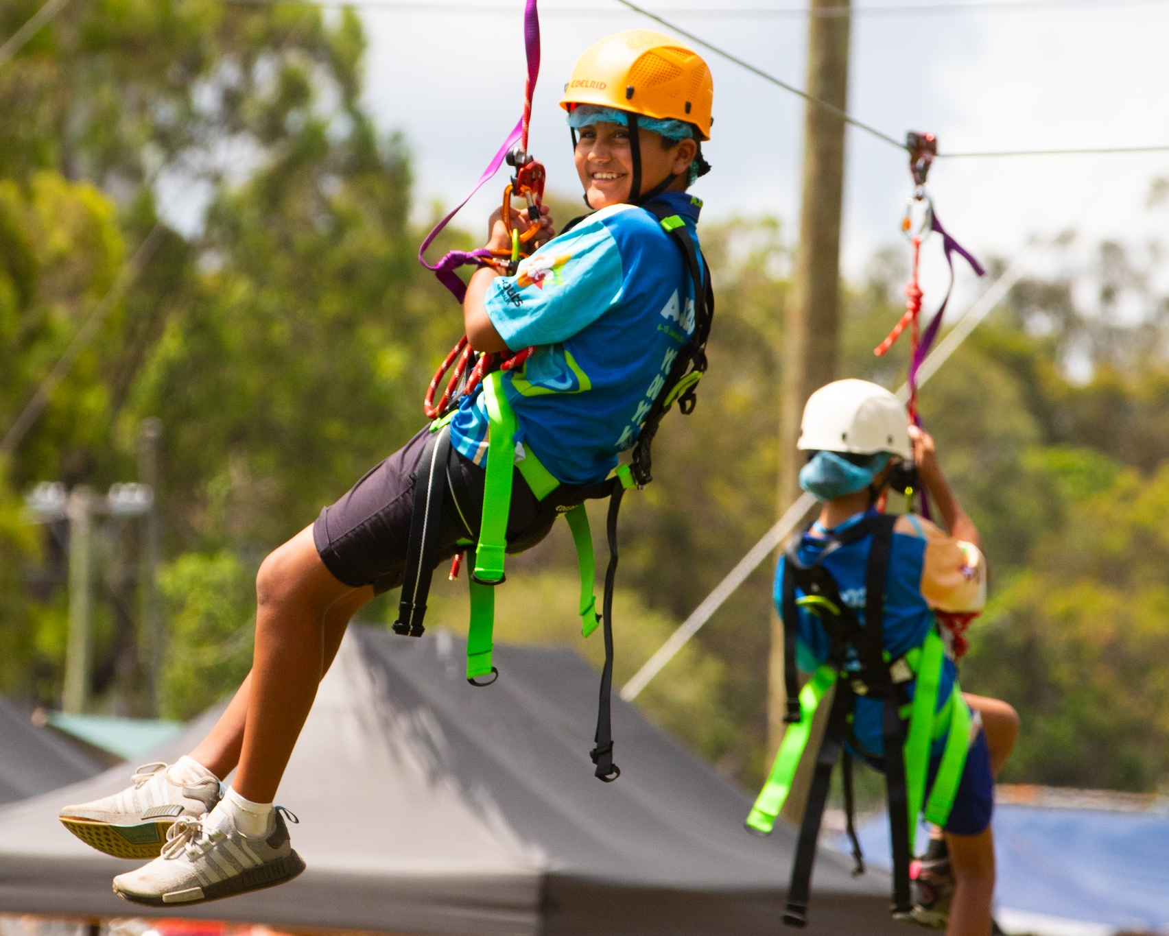
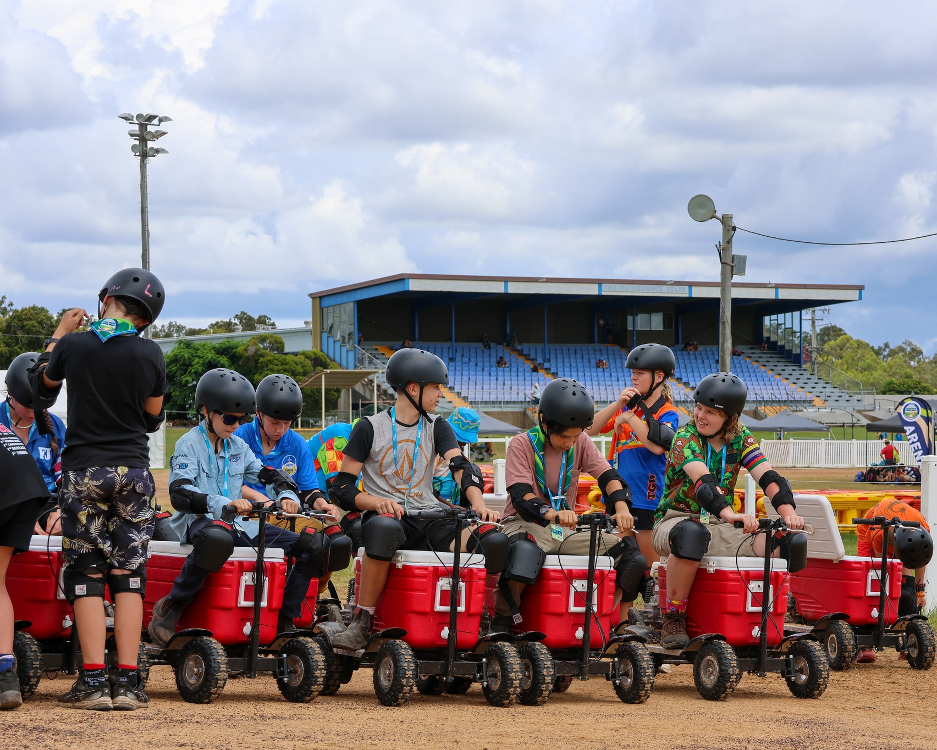
Notes:
A huge thank you to everyone for their efforts at Jamboree. It was undoubtedly trying conditions for Victorians – heat, humidity, rain, all after a long bus trip. Hearing from some of our Adventurous Activity Teams and leaders about the work they put in delivering an amazing experience for youth – is a massive undertaking. 400 youth per session on abseiling, day in and out – repeated safety checks, supporting youth on what may be their first experience at heights, and keeping that smile going for all that time is nothing to shy away from. Thank you.

Slide 5
"The program actively encourages youth to try new things and almost anything they can think of can be
achieved."
"Running lots of activities and camps, making it look like fun and peer to peer encouragement.""
Notes:
1- Youth comments (joey/cub)
2 – youth comments (scouts)

Slide 6
"Providing Support at Major Events and thus providing experiences for youth to extend their adventure."
"Having OAS puts adventurous activities at the core of the program and we can provide a whole
range of opportunities for youth."
Notes:
1- Leader of youth comment
2- Leader of adult comment/activity leader

Slide 7
The Strategy
Developed in late 2023
Implementation kicked off in 2024
Delivery to date focused on increased access to Adventure

Slide 8
Back of hand maths…
ASA requires OAS Level 5 in various skills
200 Scouts per year complete their ASA
We need around 400 places in OAS 4 and 5 per year at a minimum
…and that’s not considering those who start and don’t finish – or go along for the ride
And so many of our leaders have been baselined and we’re not increasing our capacity fast enough – our 2-3 year Leader lifecycle is quickly diminishing our capacity even further
Notes:
5th dot point may be supported by survey page 7 -

Slide 9
What can I do?
Launched in 2023
Reviewed and 2nd edition about to be released
Simplification of requirements, improved alignment to program delivery in Victoria
I am a “Certificate of Proficiency Leader” – keep it simple please
Notes:
Draft on the wall for your review and strong criticism.
We want to publish this in the next 1-2 weeks. Over 40-50 hours of work has gone into this document to improve it. Please be nice!

Slide 10
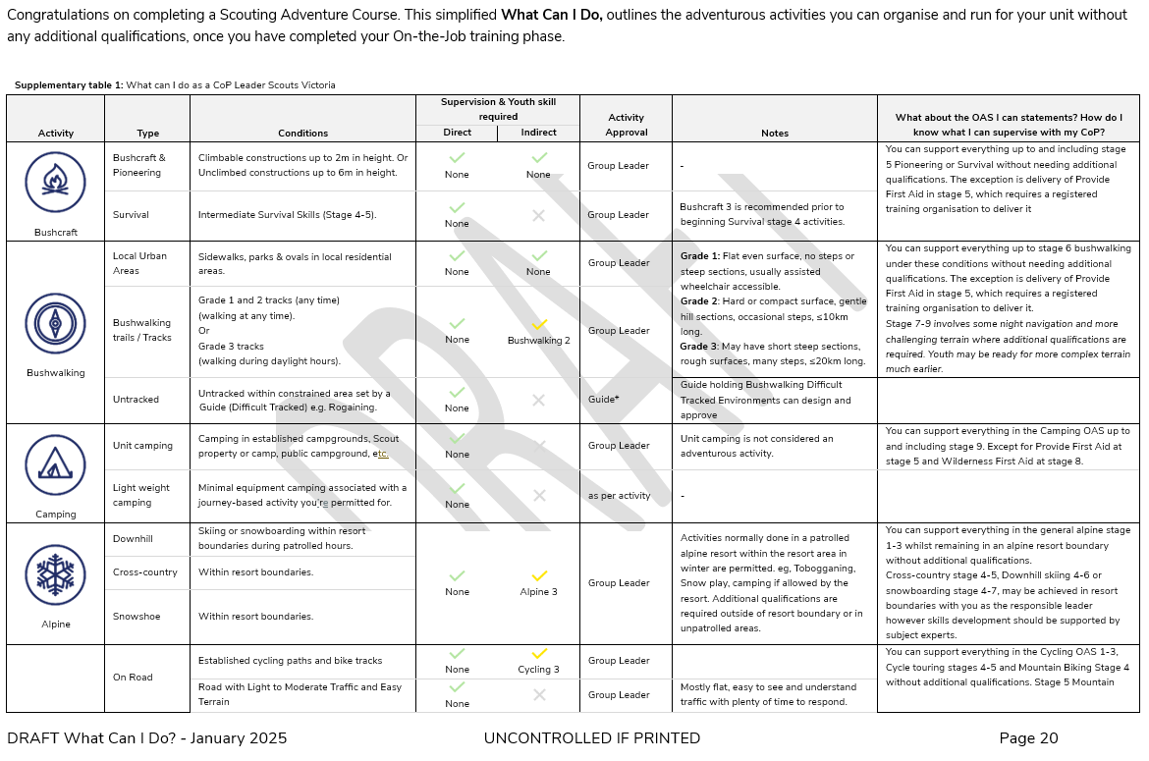

Slide 11
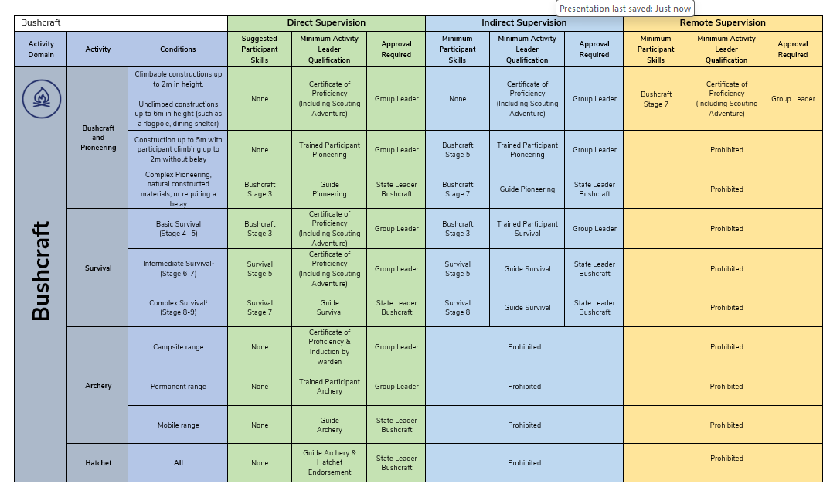
What Can I Do?
Suggested Participant Skills
More CoP level
Approvals toward a local level

Slide 12
Adventure for All
We’ve had a heavy focus on expertise driven by competency [through qualifications]
Improvements to “What can I do?”
Introduction of Standard Operating Procedures – “Specific Guidance”
Available in Program Navigator

Slide 13
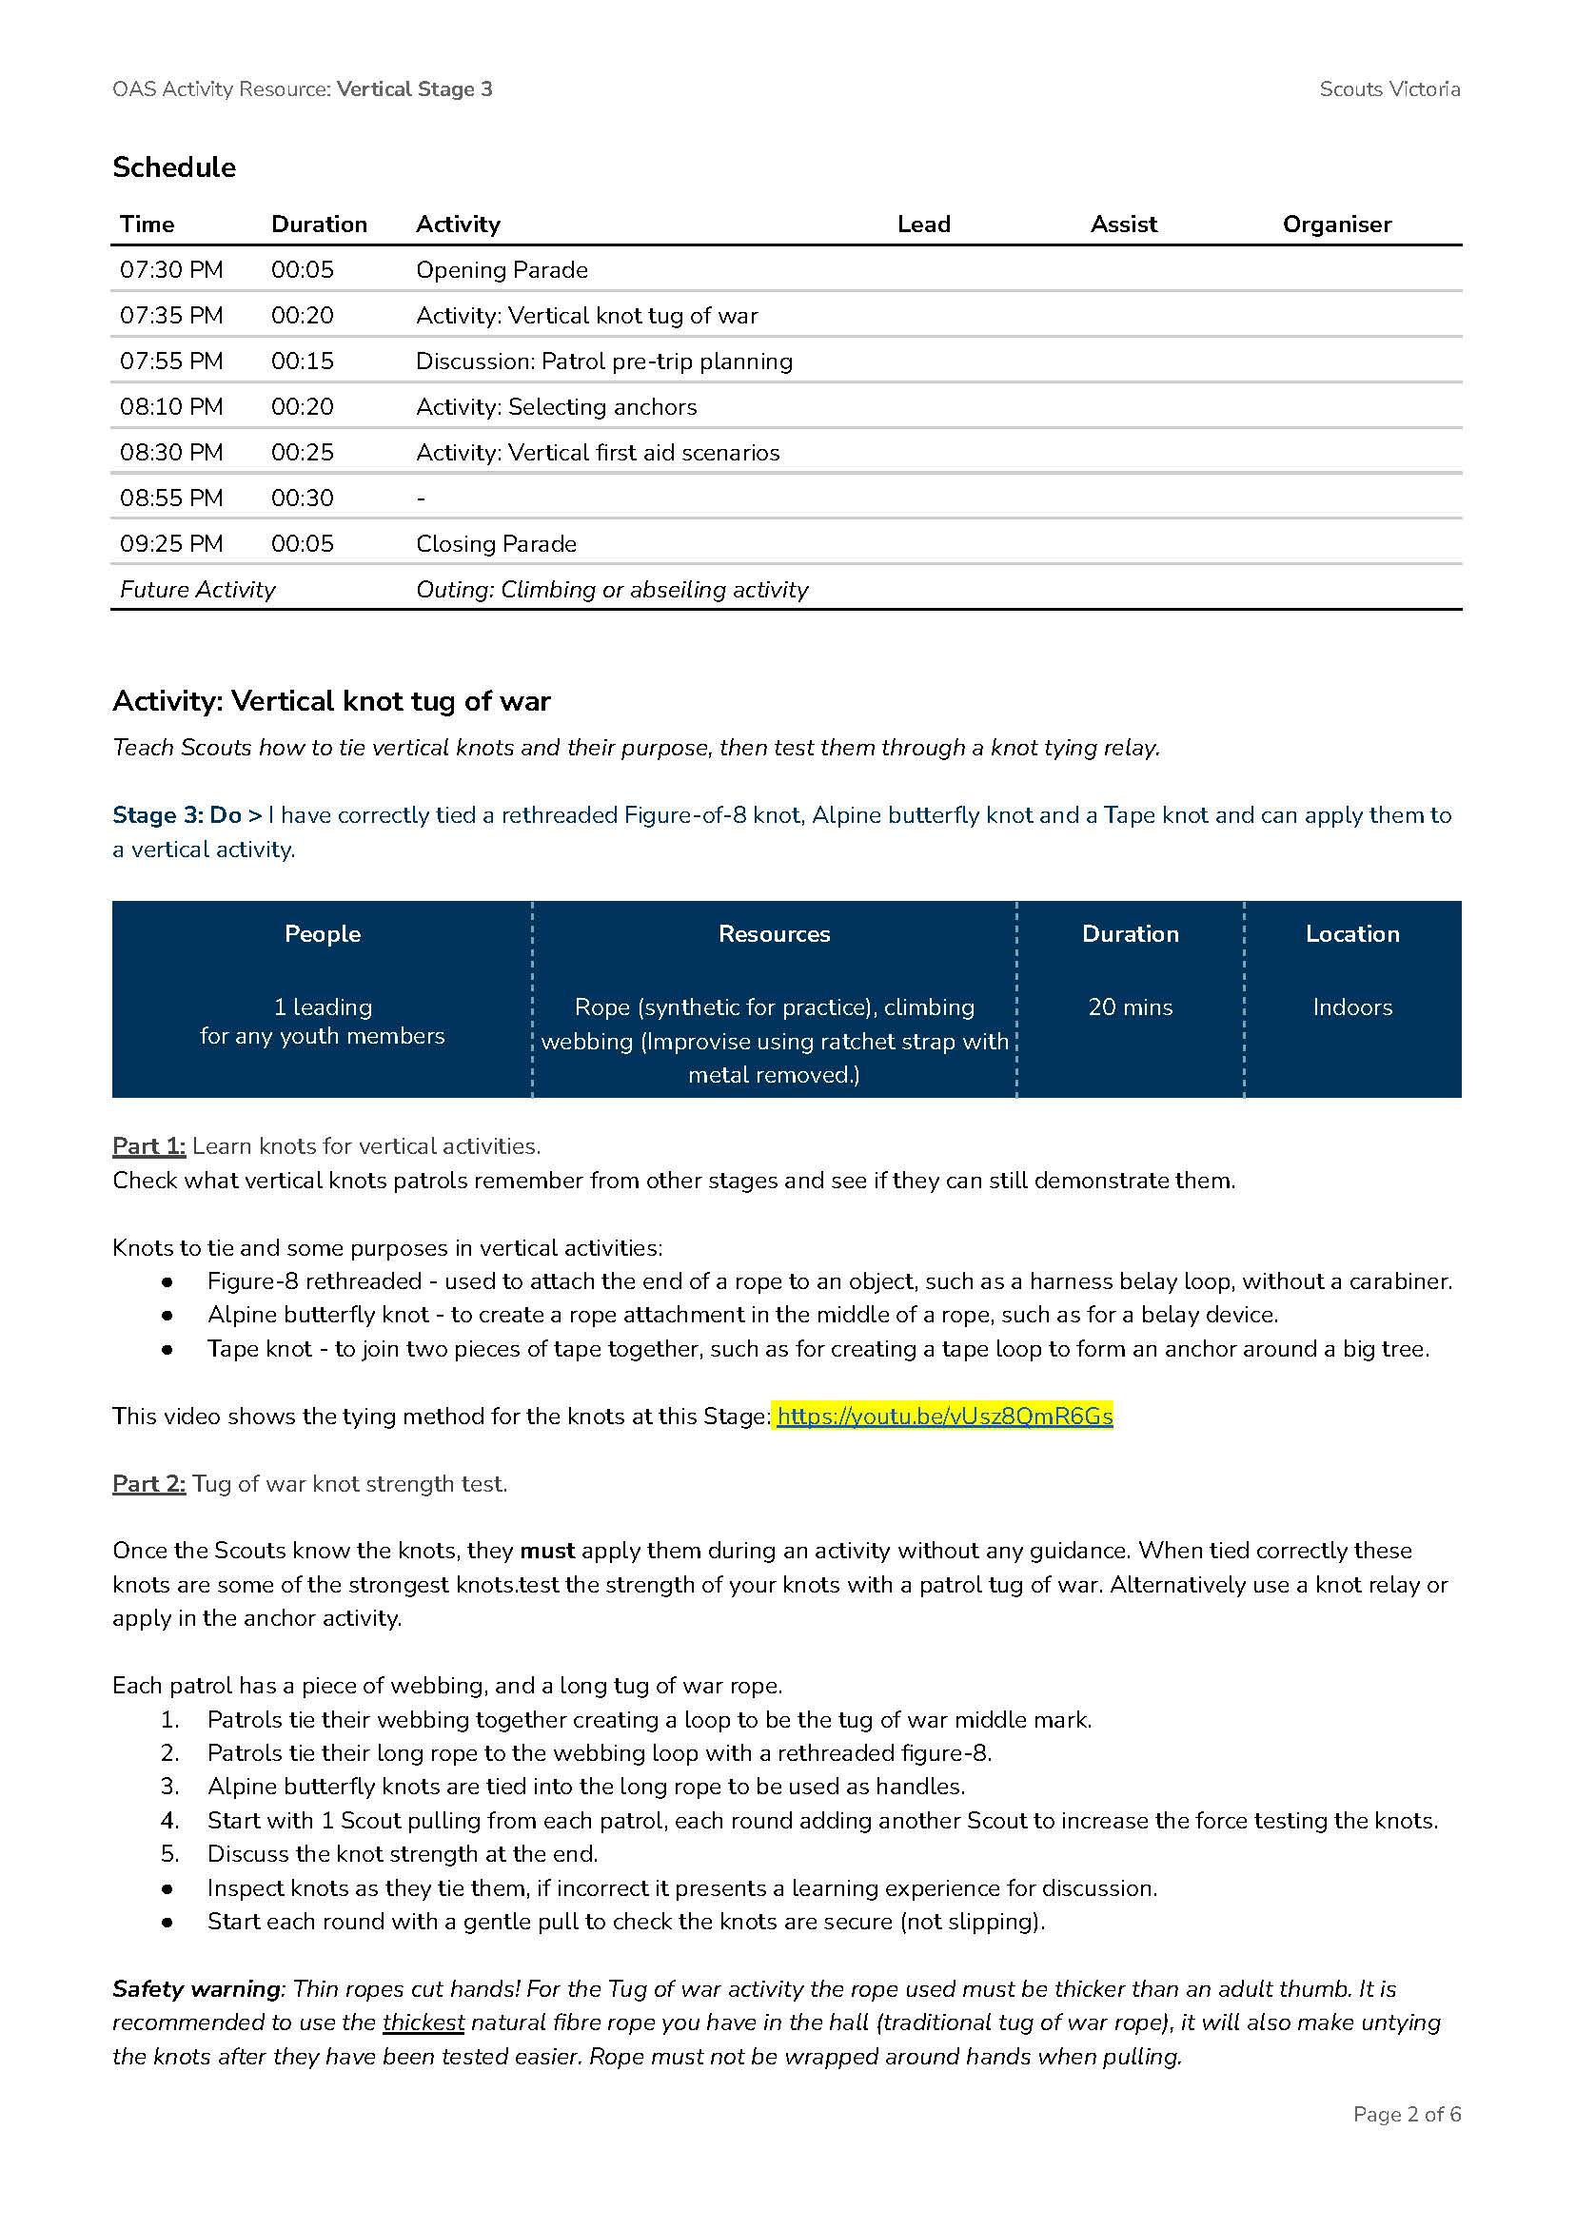

Slide 14
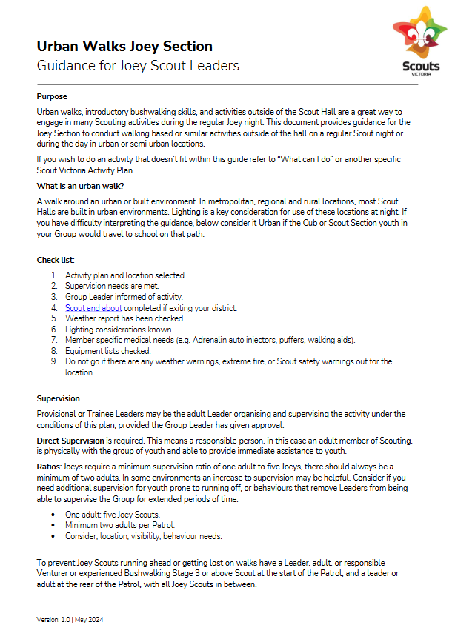
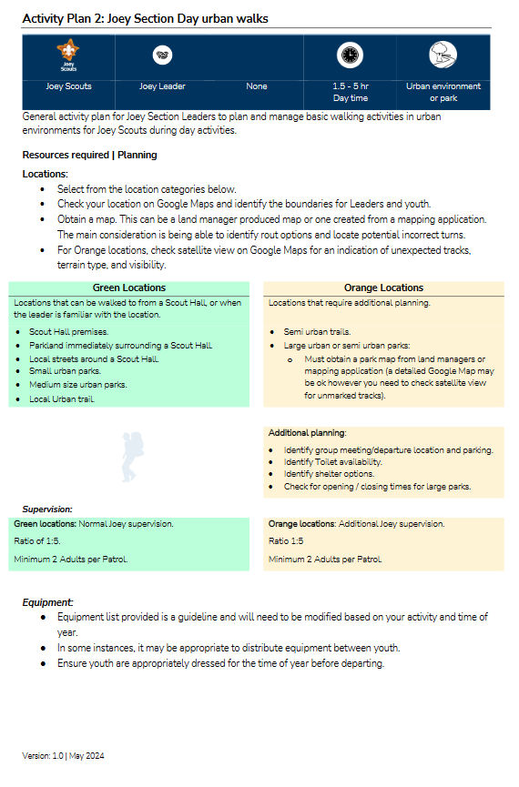

Slide 15
Course Calendar
Standardised for 2025
More than 200 courses and activities, providing about 5000 places
Bundled together on the Events Page, or by Activity Type on the Team Page

Slide 16
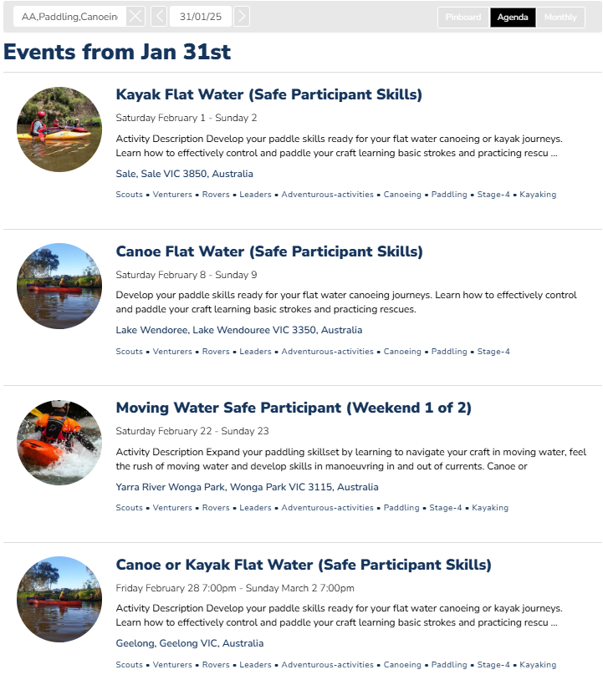

Slide 17
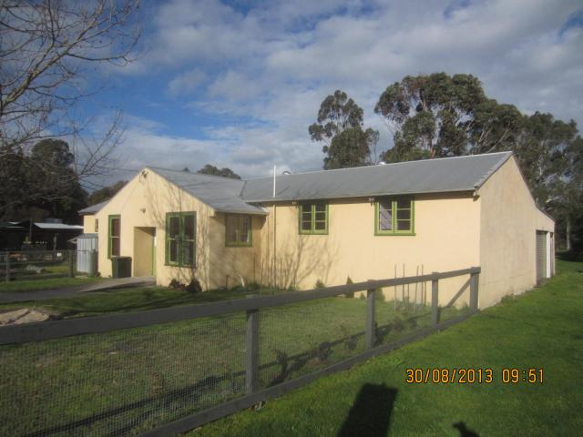
Foster Adventure Centre
Centre for marine/sea based activities:
Sea Kayaking
Scuba diving
Equipment and overnight accommodation
Wilsons Prom, Corner Inlet Marine Park and many others
Notes:
Let by Mark Woodfield, Kerryn Newbegin. We want more access to sea activities beyond just Geelong.

Slide 18
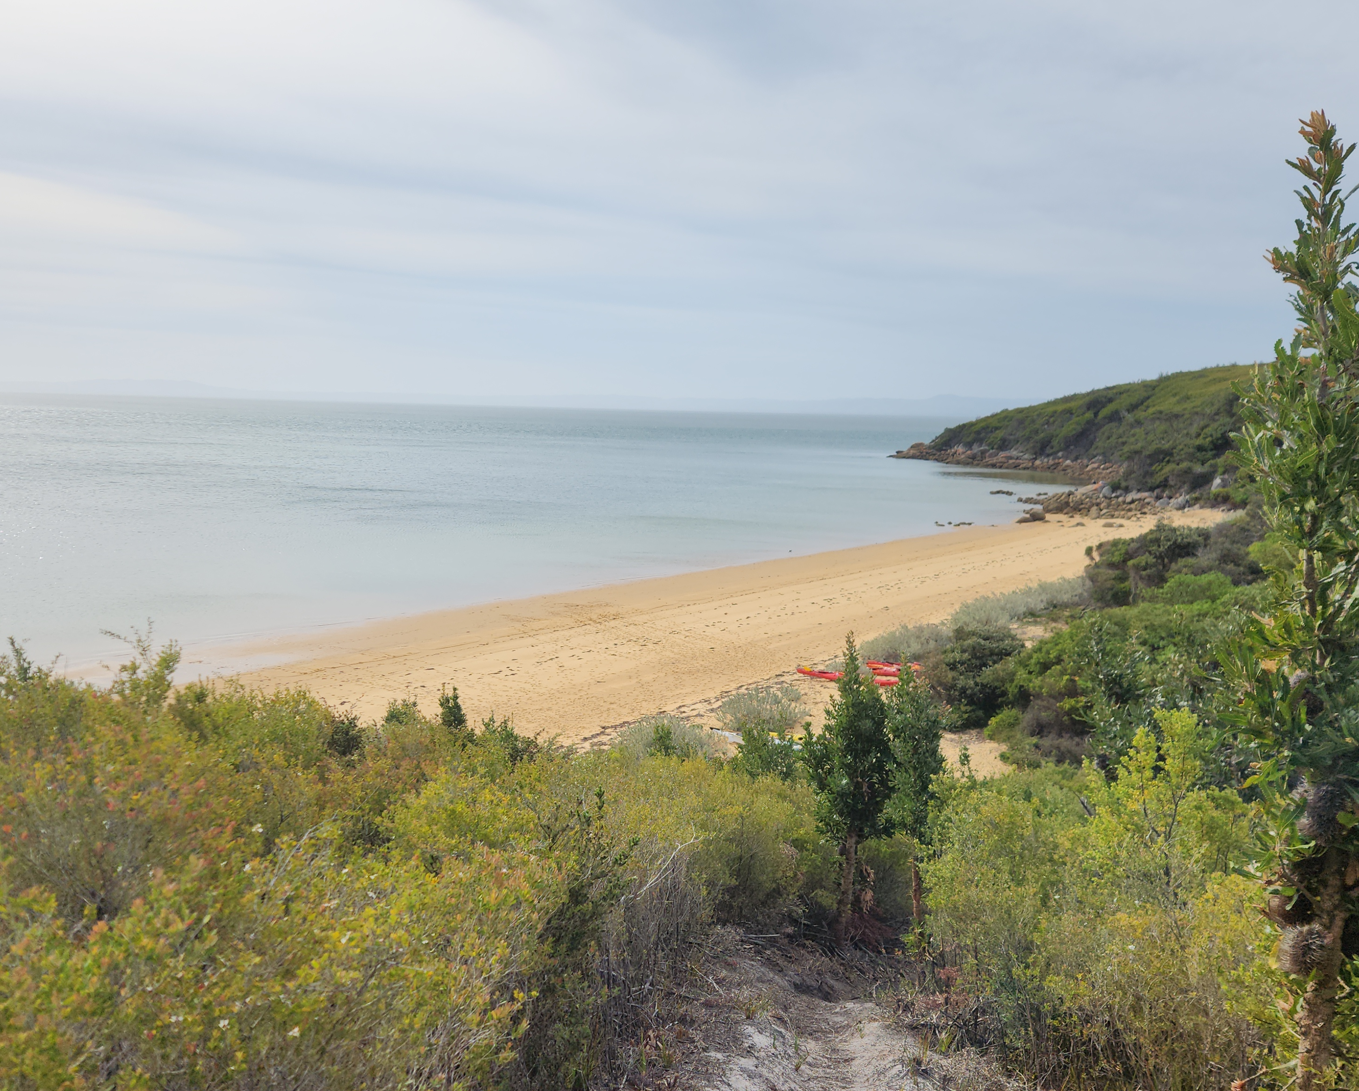
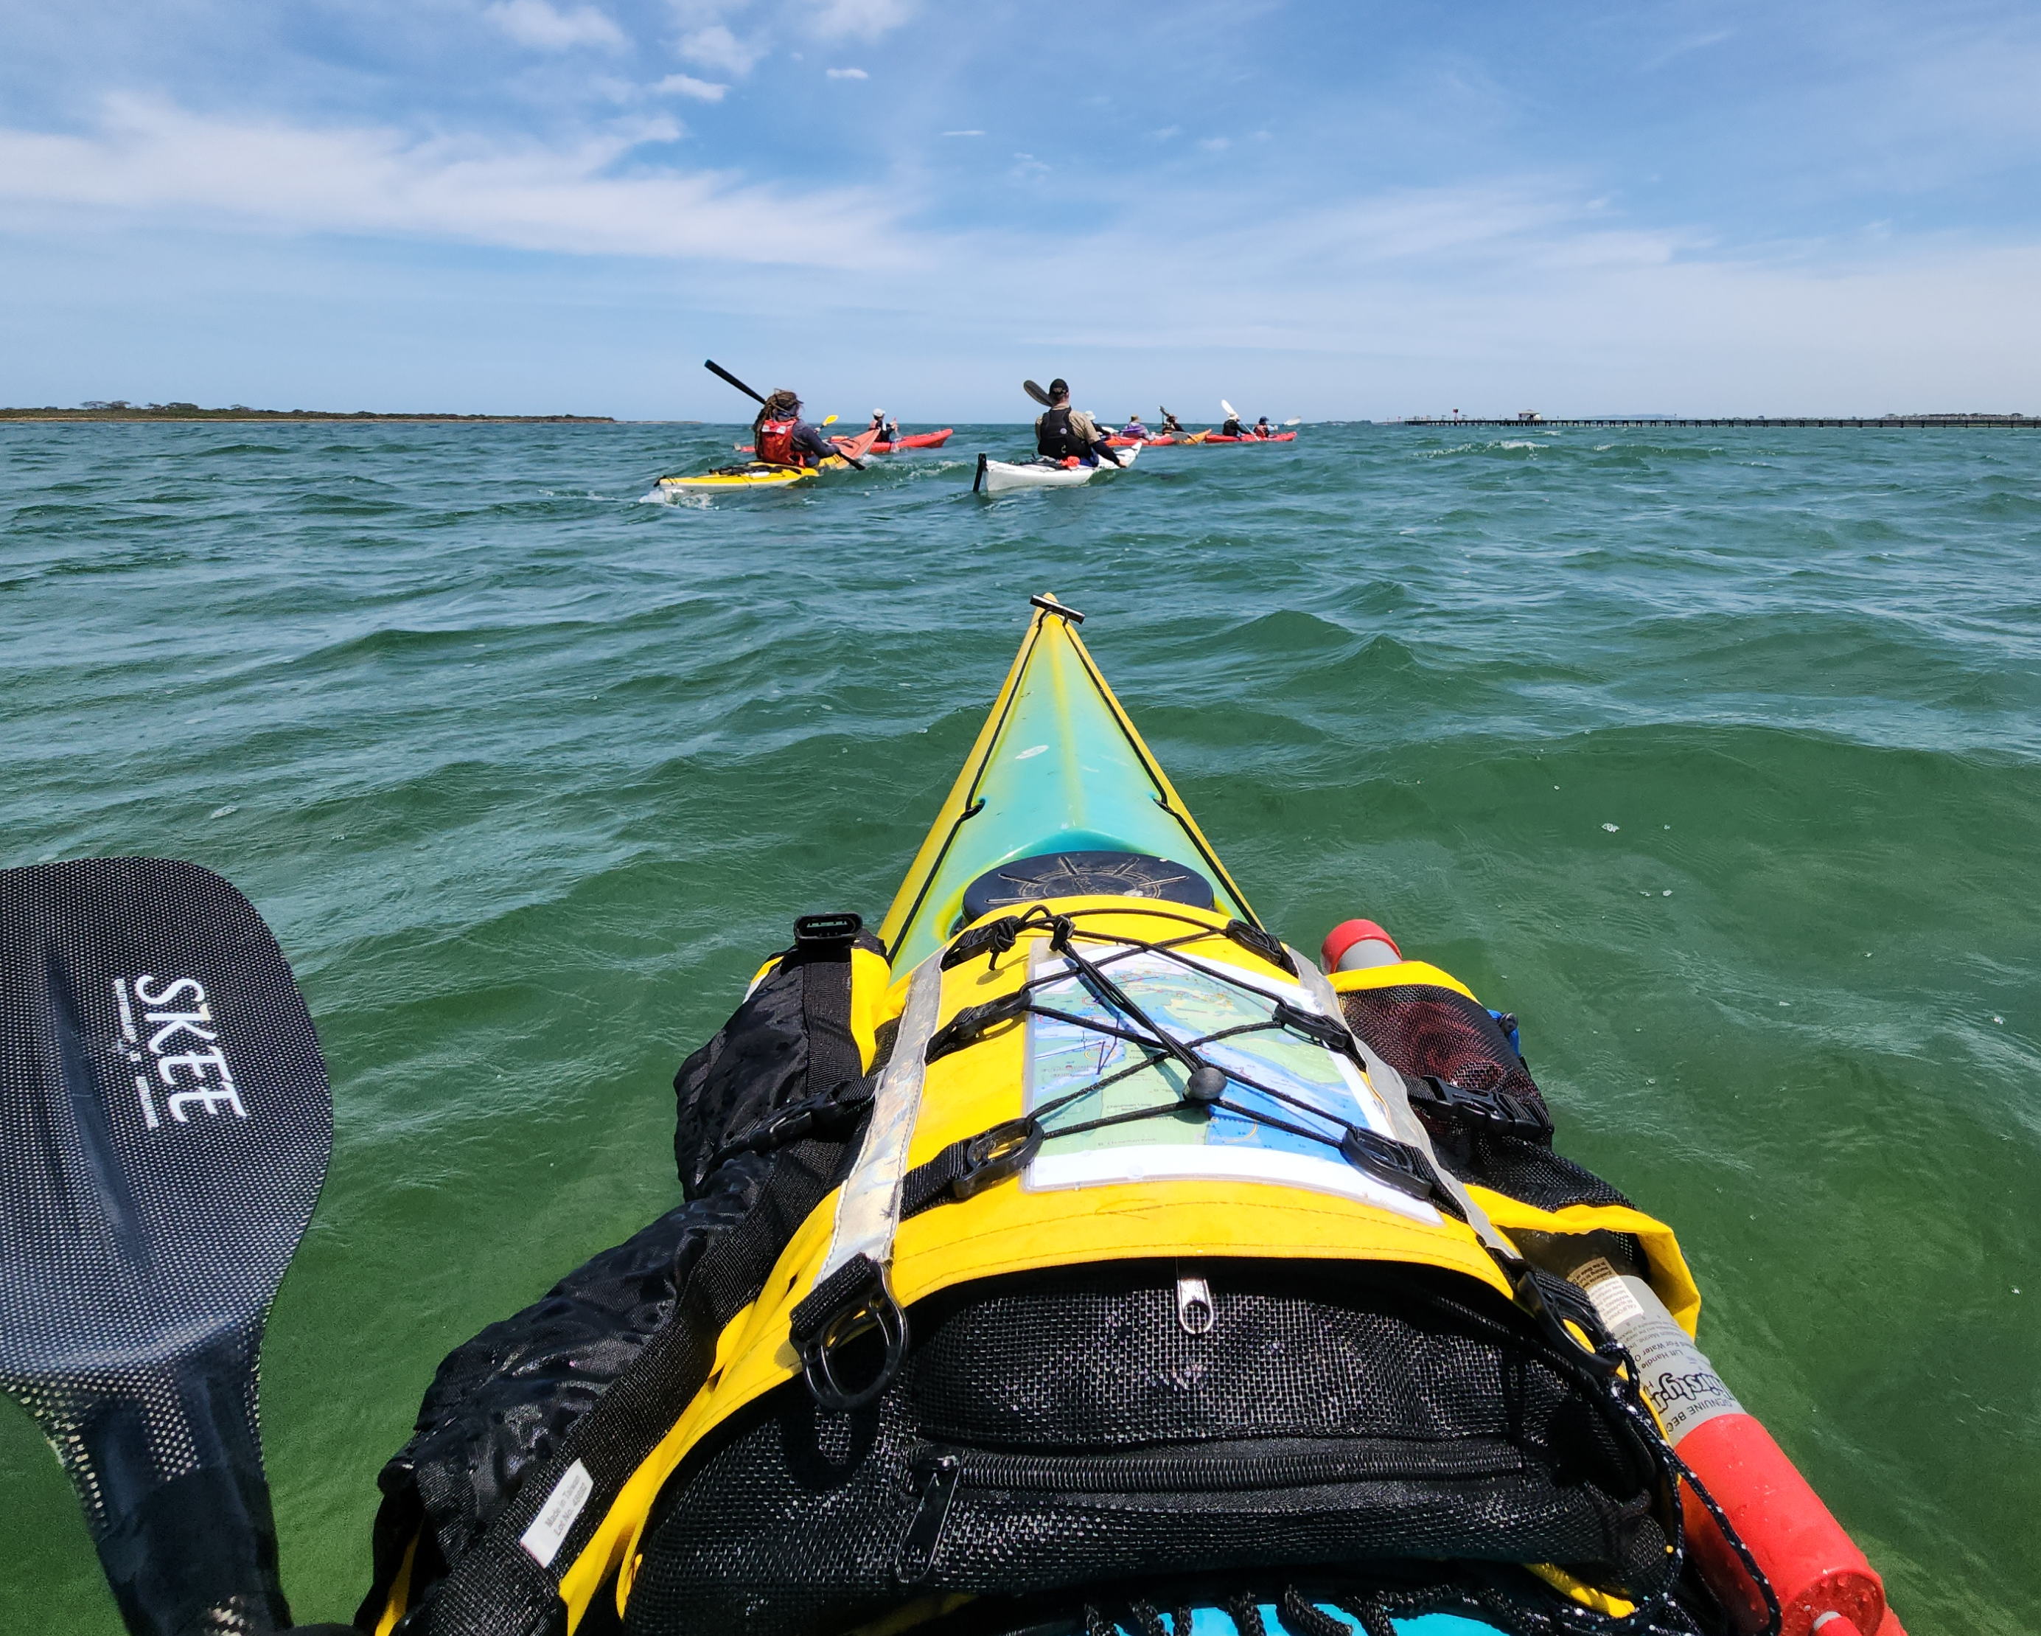
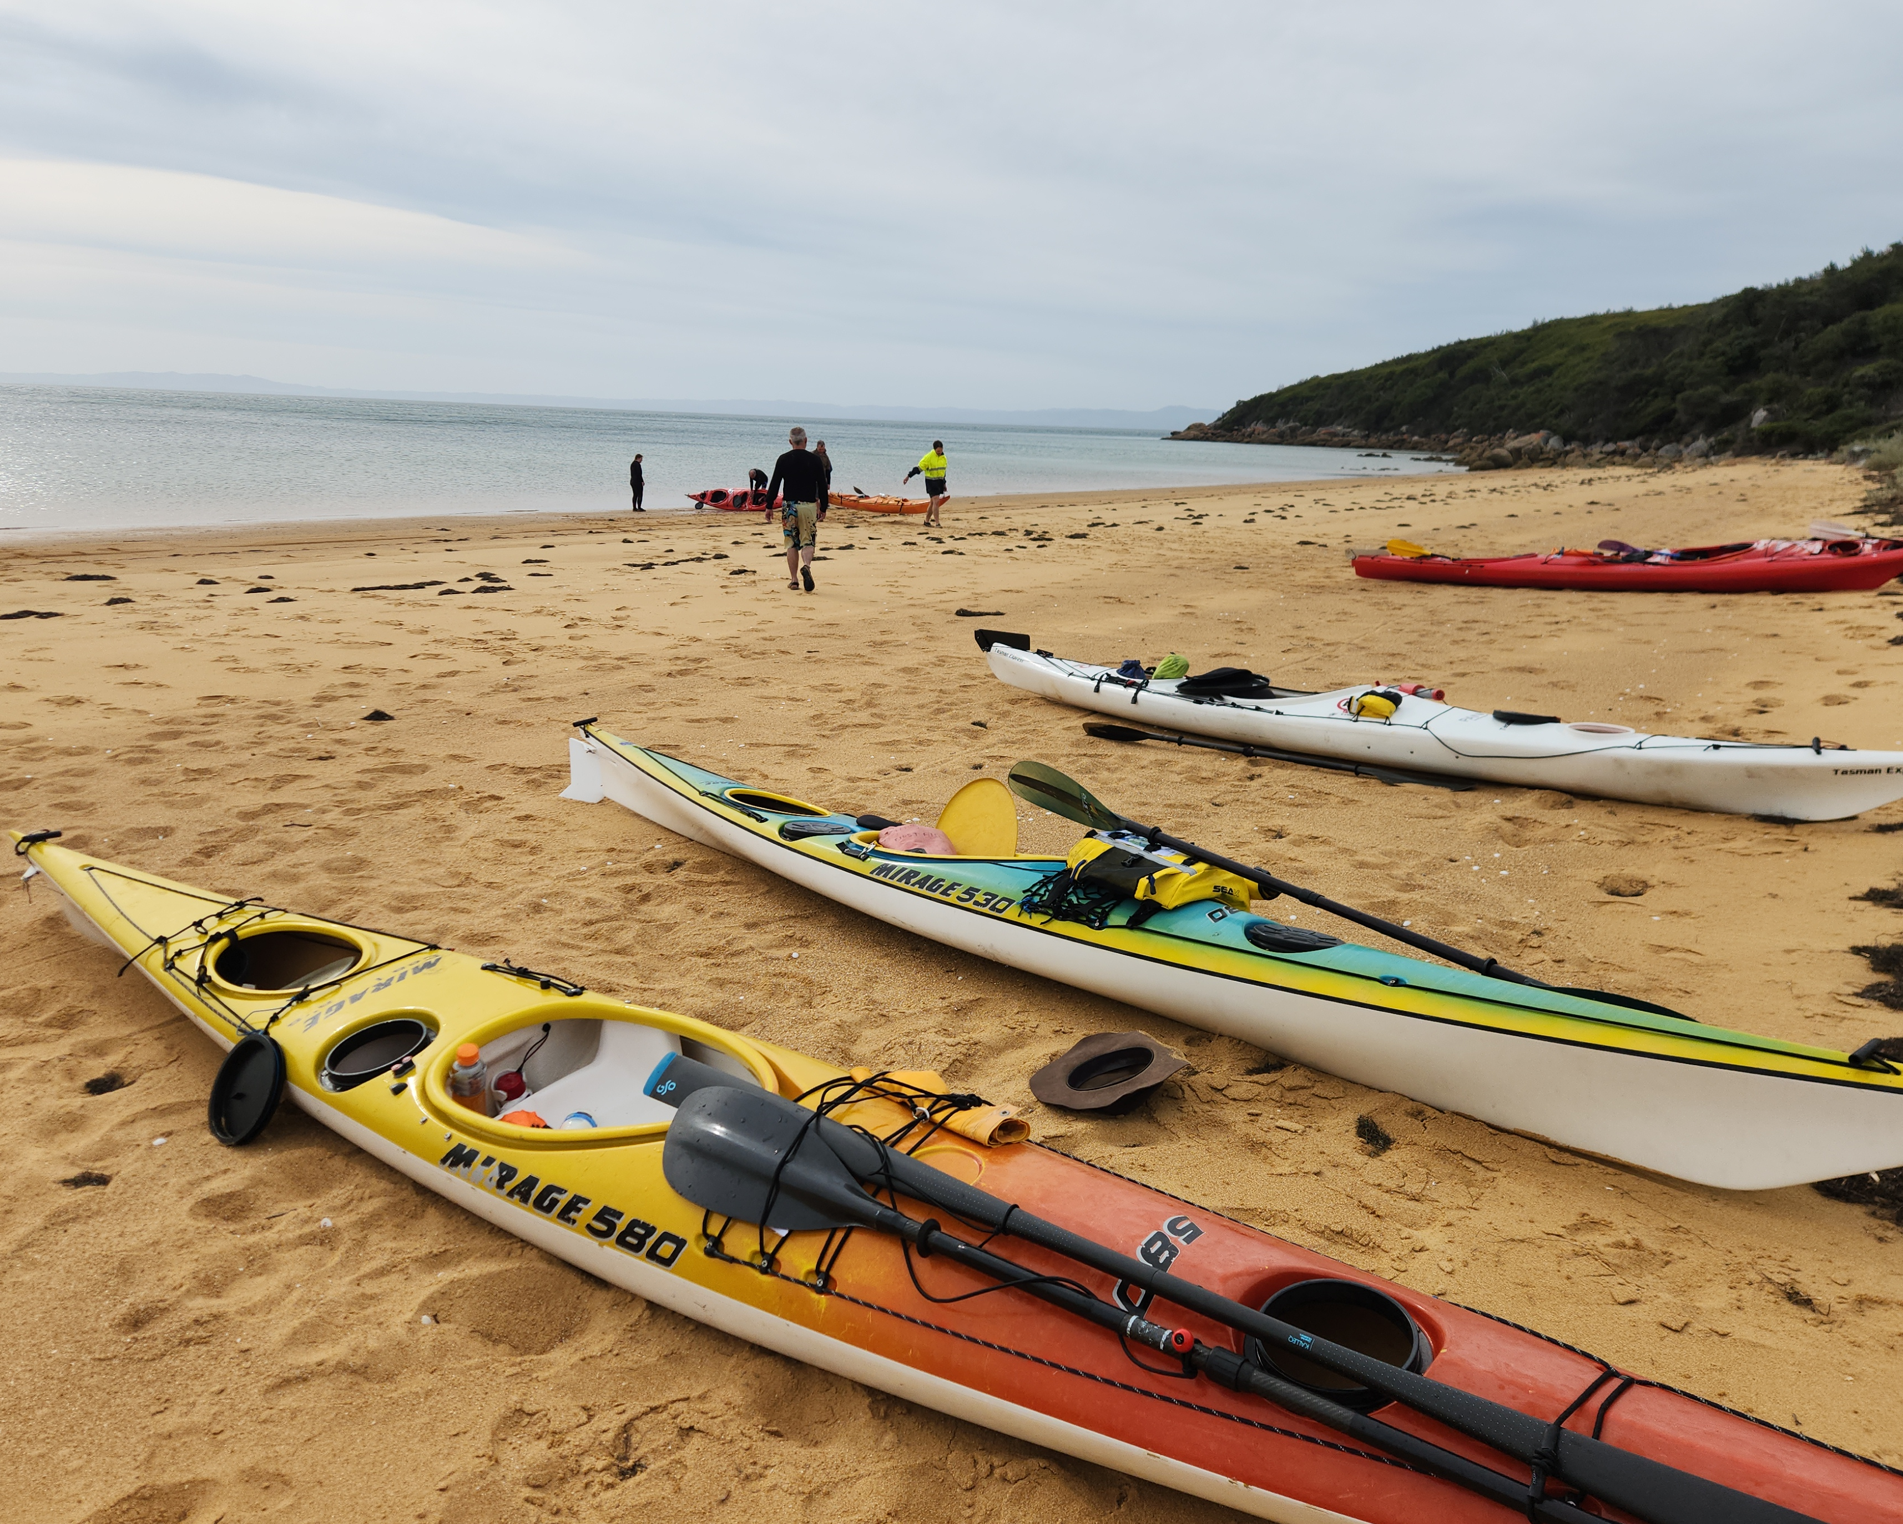
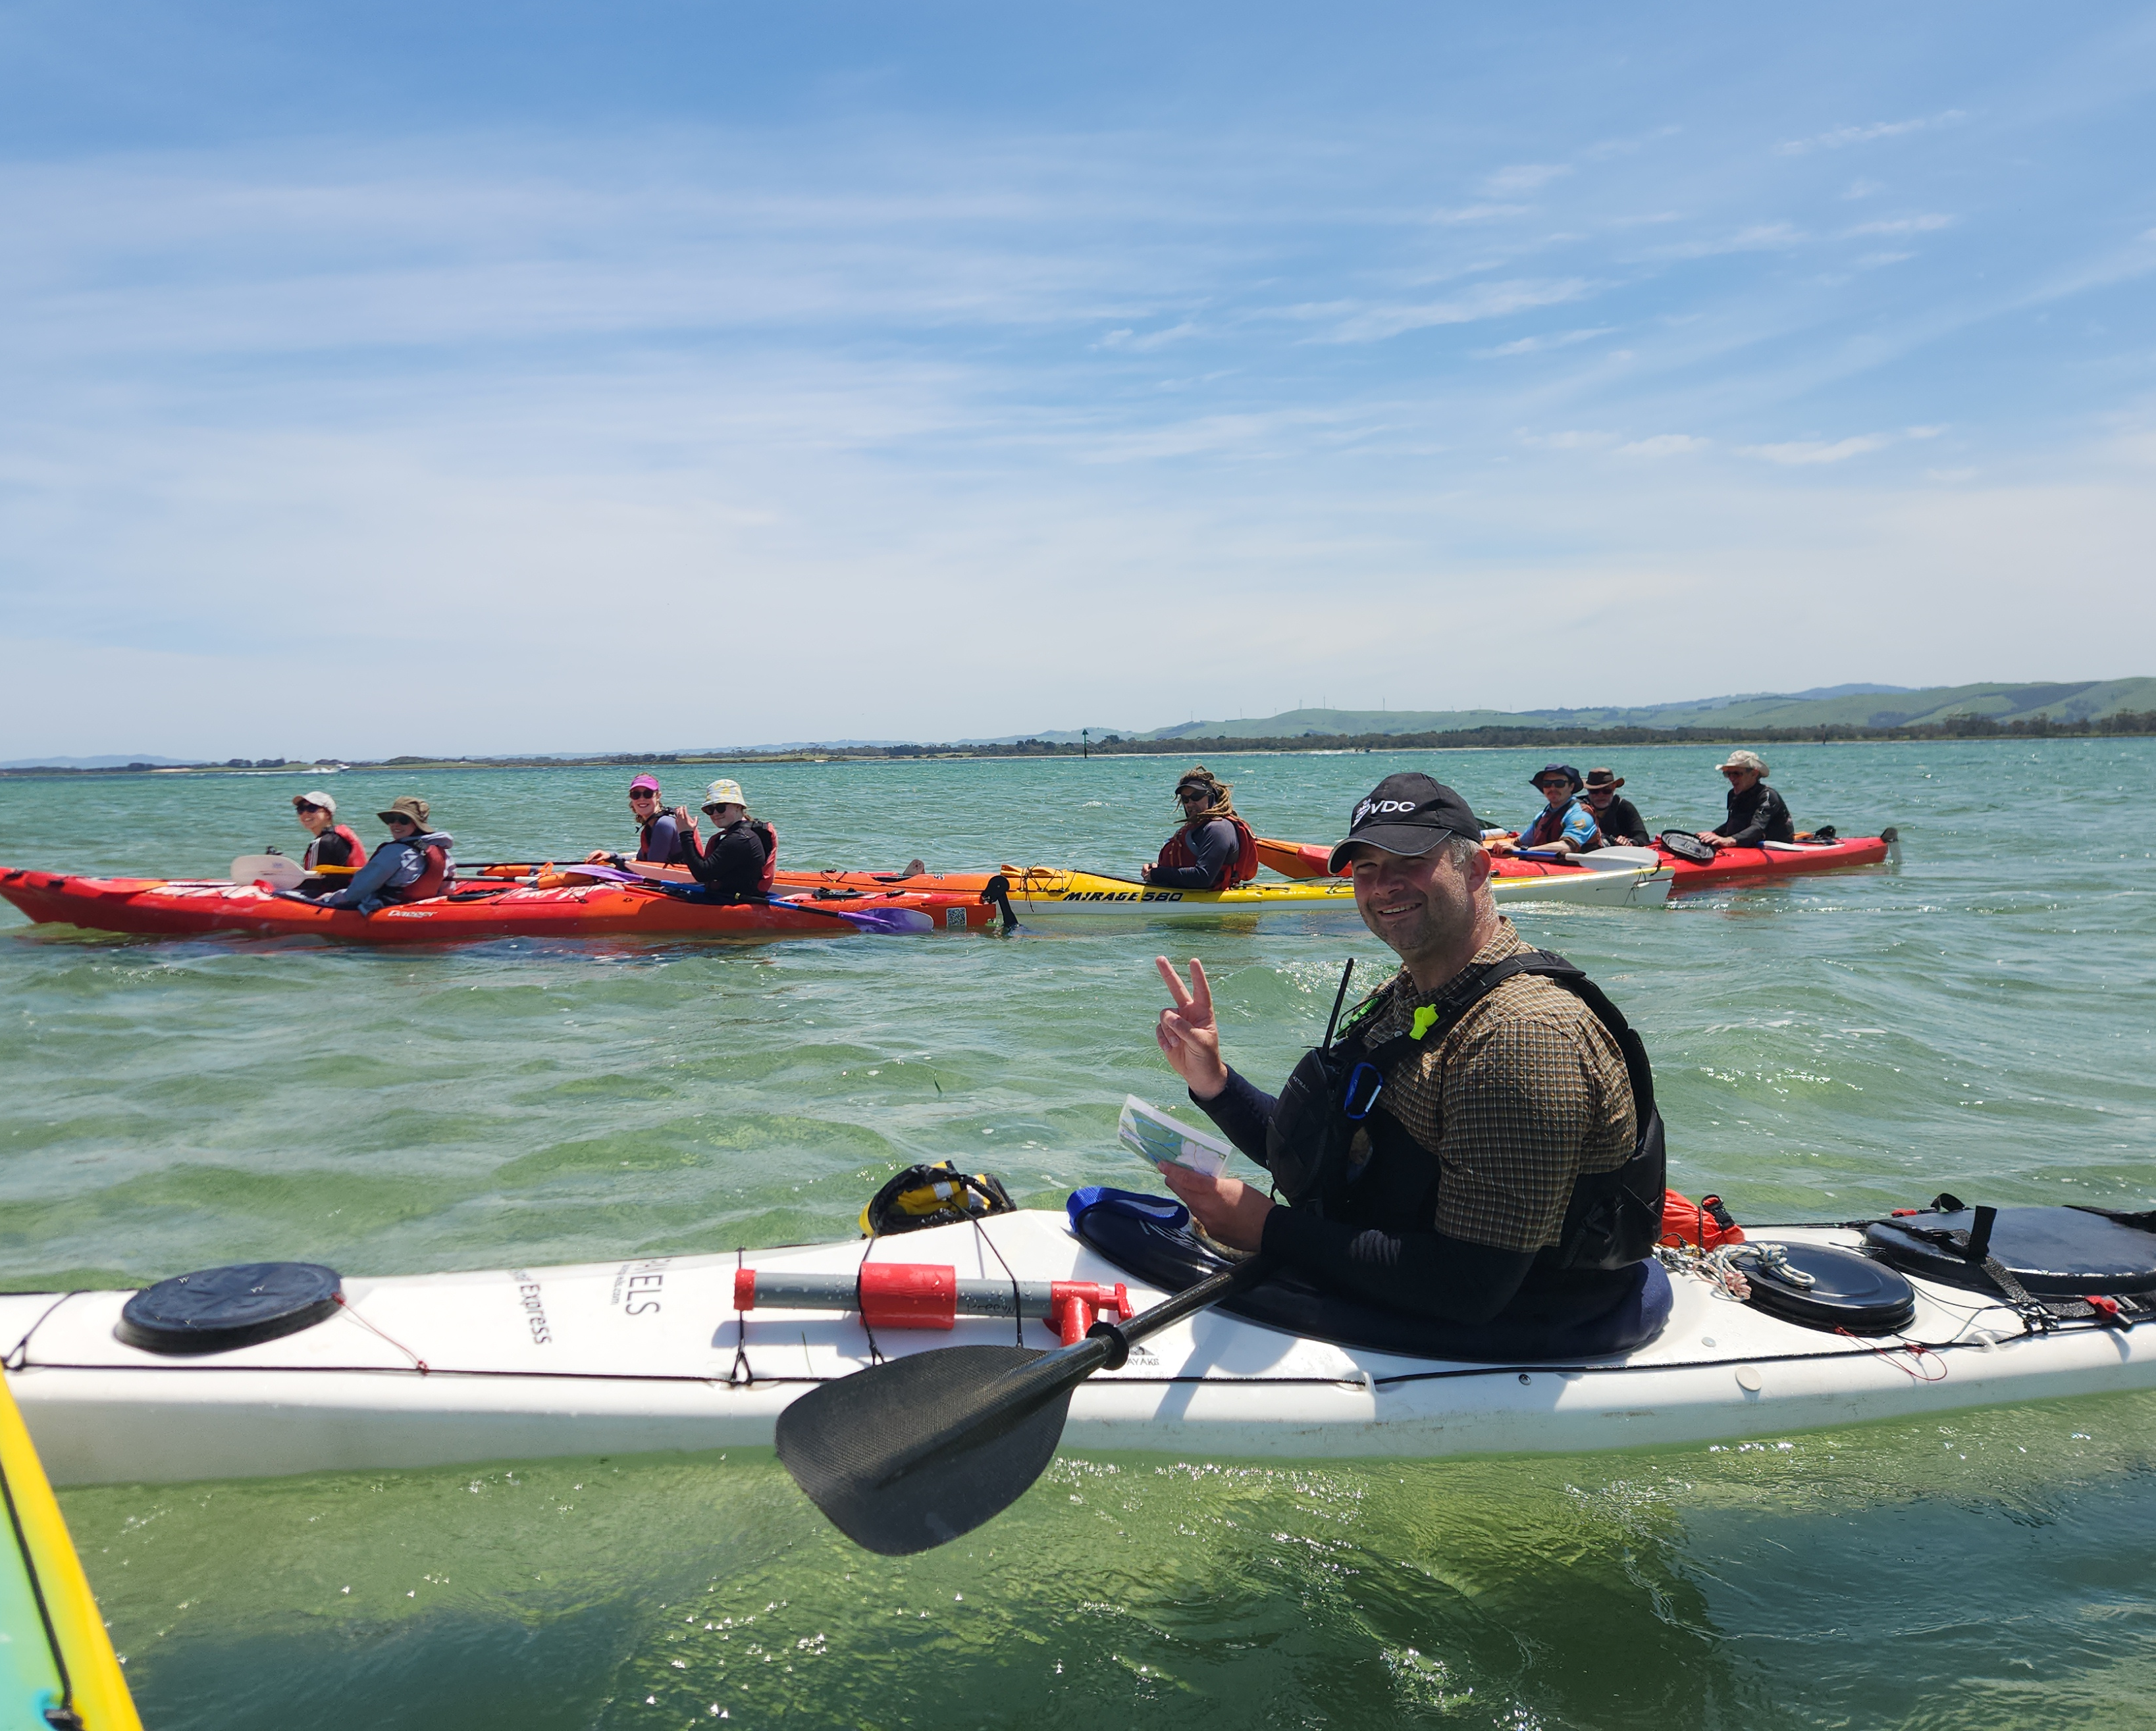
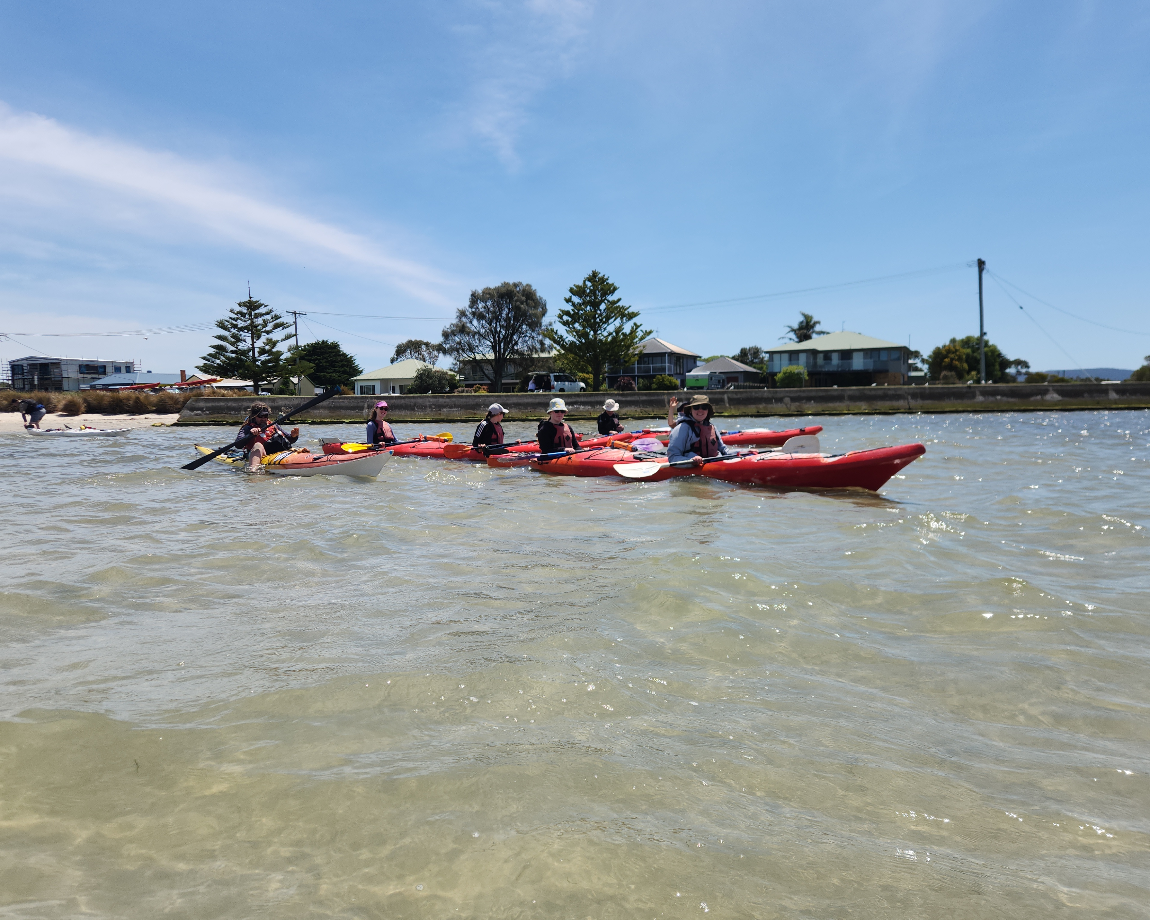
Notes:
Photos from a Corner Inlet

Slide 19
Further Initiatives
Communities of practice
Recognition of proficiency
Trained Participant pathways for youth members
Improvements to activity and events booking
Scout Scuba Centre

