Slide 1
Program
Matty McKernan
Assistant Chief Commissioner

Slide 2
Last year we talked about the ingredients of retention in a Unit
Our exit surveys and successful Units tell us that we need to ensure:
Something big to look forward to
Activities ready to go after holidays
Good communication of the program
Behaviour is managed
Getting to know the next section is normal
Young people feel they own their program
Notes:
We know that when the program is great, and it’s well communicated, young people stay in Scouting and get the life-changing benefits of the Scouting program.
It doesn’t happen by accident though – it takes focus from Units, Unit Councils, section leaders and Leaders of Adults.
Last year we talked about the ingredients of retention in a Unit, informed by Units who are doing it really well (and some of our exit survey data). We’ve added to this a bit. This is a great reminder.
[Feel free to comment in brief on some of this list, but don’t do it in detail – assume that most of the audience has heard it before].

Slide 3
Last year we talked about the ingredients of retention in a Unit
Our exit surveys and successful Units tell us that we need to ensure:
Young people can fail, but adults make sure there’s a back-up
Activities are specifically used to get build relationships
Young people see themselves achieve
Adults champion the Achievement Pathways and provide inspiration, not a blank piece of paper
Family are involved
Notes:
[Feel free to comment in brief on some of this list, but don’t do it in detail – assume that most of the audience has heard it before].

Slide 4
This year we’re talking about tools to support with this:
Program Navigator
Unit Program Planner
SIA ideas
#OutsideIn25
Quality Scouting Challenge and Quality Scouting Award
Notes:
This year, we want to spend some time talking about the tools that have been developed that will support Units to retain members through great program.
We’ll quickly cover:
Program Navigator
Unit Program Planner
SIA ideas
#OutsideIn25
Quality Scouting Challenge and Quality Scouting Award

Slide 5
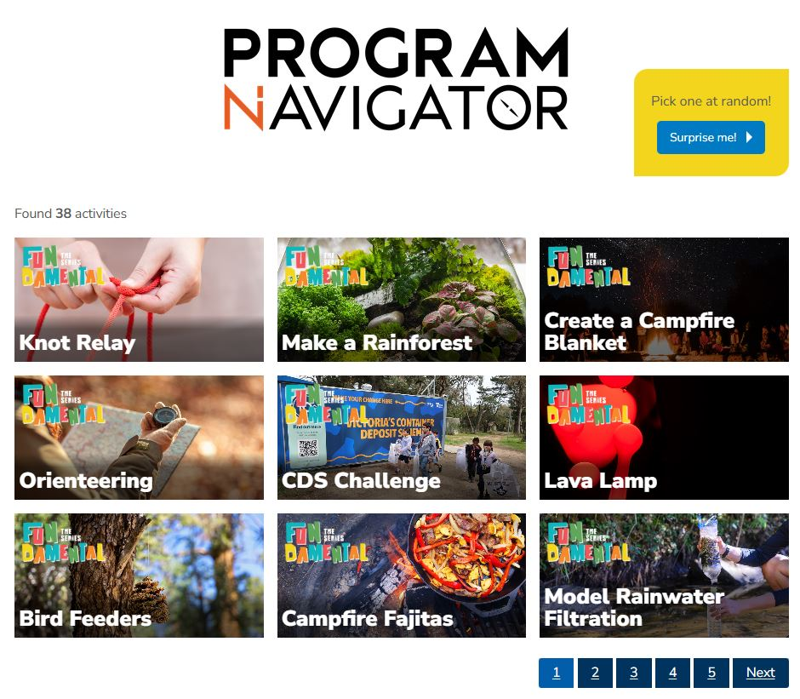
(Re?-)launching the Program Navigator!
Notes:
The Program Navigator is a fantastic new tool that provides the building blocks for an adventurous, fun, challenging and inclusive Unit program.
It has ideas and resources for Unit nights, Unit weekends, and personal challenges like Special Interest Areas.
Every Unit and Unit Council should be able to put together a great program starting with the Navigator, and adding their own ideas and additions. Some Units may not need it week to week, but might use it to fill a gap in the program or find an idea for a tricky Challenge Area.
You can filter by section suitability, location, and by some of the program elements.
We’re uploading more and more activities, and there’s an email address for you to send your own activities for uploading.
You can access the Program Navigator through a button at the top of the Scouts Victoria website.
The Program Navigator also links to the Unit Program Planner template, which your Units can download and adapt.

Slide 6
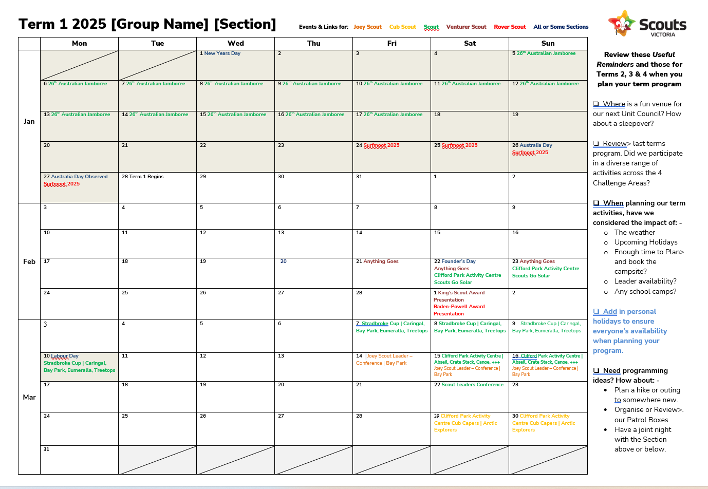
Program Planner and SIA ideas
Notes:
Here’s a snap of the Unit Program Planner on the left. In addition to the link from the Program Navigator, it’s also available in the Program Resources part of the Scouts Victoria website.
It’s loaded with the 2025 state events. Check it out for a reminder of when the synchronized Cub campfire is, or personal development courses, the Joey Scout Leader conference, or Mudbash.
Units can trim out the bits that aren’t relevant, and use it as the basis for their long term programming. We hope that Units will use this to pick some big state activities for their program, but also build a routine of long term planning for big Unit adventures that young people can look forward to.
This planner also includes lots of program planning tips and tricks. It also includes a great resource with lists of Special Interest Area awards, which we know lots of Units are needing. This resource has been around for a while but has been hard to find. We will be updating this with loads more SIA ideas that we gathered late last year.

Slide 7
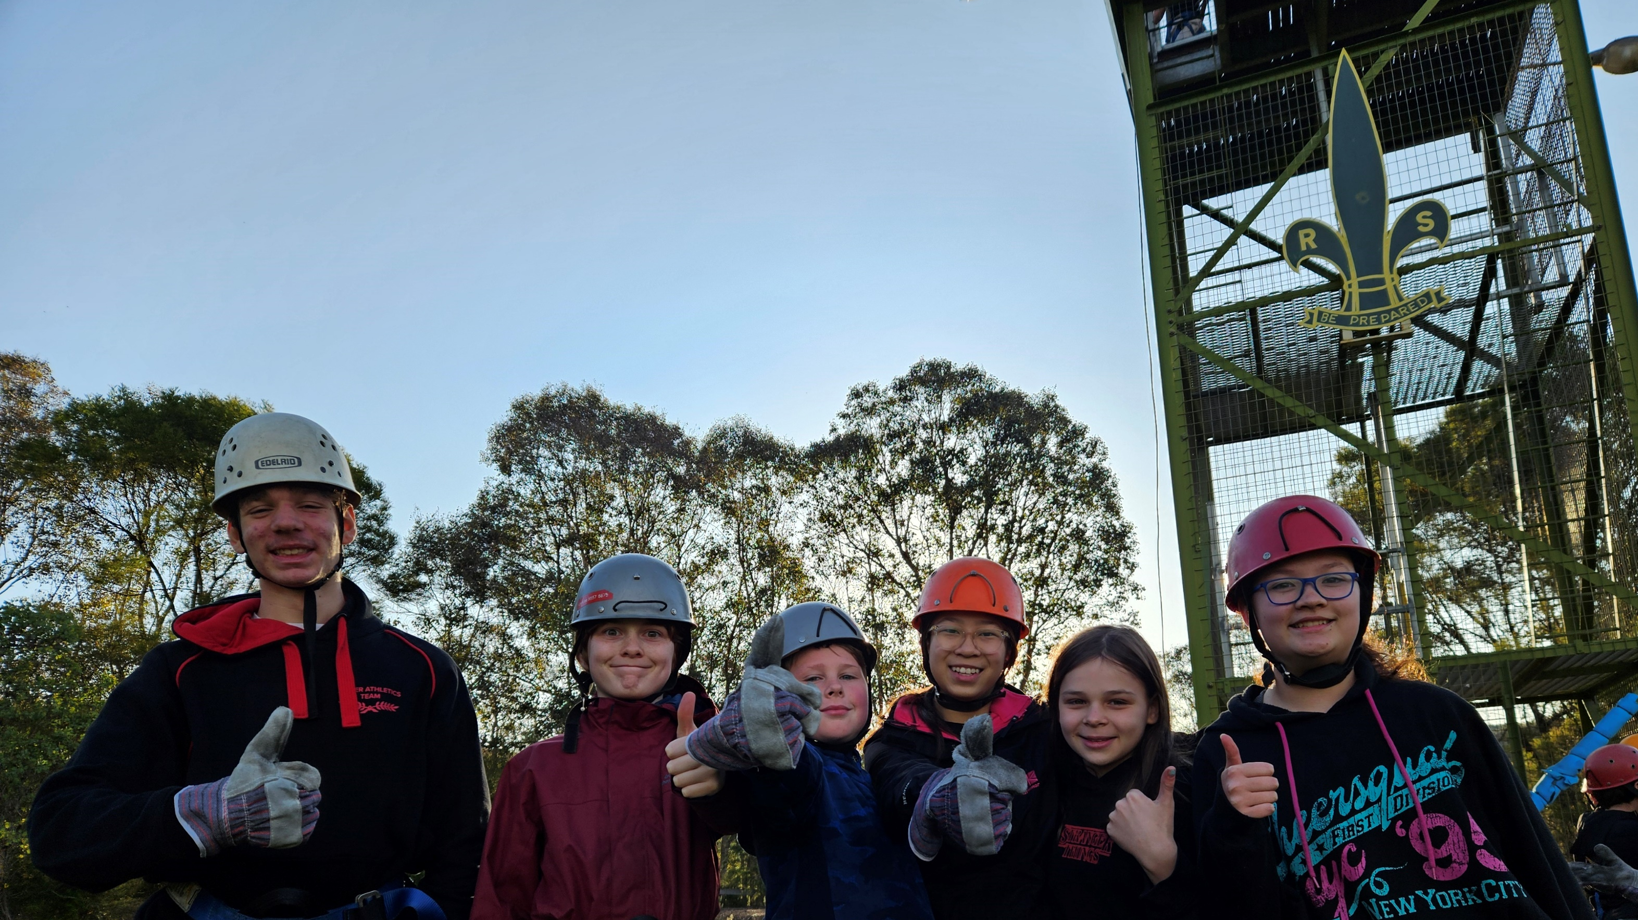
#OutsideIn25
Notes:
Nationally, we’re rolling out a campaign to have more outdoor adventure in 2025
At Scouts, nature is the main setting for learning
2025 is the year for our Units to get outside for new adventures!
We’re encouraging every Unit to support its members to set and achieve new goals in their Outdoor Adventure Skills
Our aim is to get young people trying new things in the outdoors this year

Slide 8
#OutsideIn25 bucket list
A challenge for every Unit to plan and complete amazing outdoor adventures in their 2025 programs This could look like:
How could you share and promote #OutsideIn25 in your District/Region?
Including more outdoor challenges in term programs
Completing OAS progressions in new areas
A big adventure for the Unit or Patrol to look forward to
Notes:
A big part of the campaign is a call to action for Units to set their bucket list for 2025.
This can include getting more adventure into the weekly program, trying out some new OAS areas, and thinking of a big adventure that the Unit can work towards.
The big Unit adventure could be something stretches their OAS skills. But it could also be something that’s a meaningful adventure for the Unit, like a big public transport journey or roadtrip, or an international service project – whatever gets your Unit excited and stretches their possibilities outside.

Slide 9
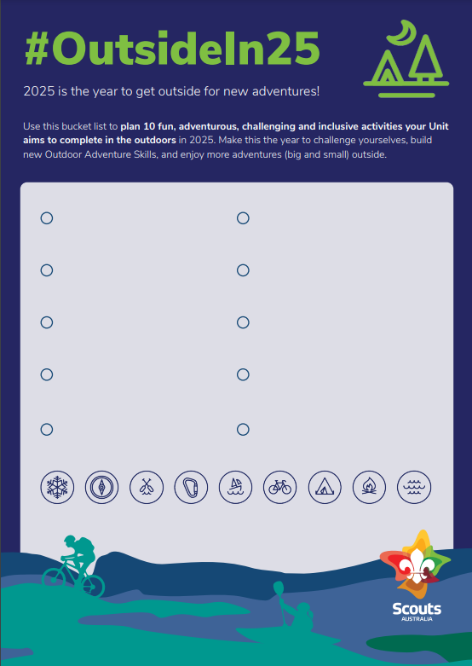
Here’s what the bucket list poster looks like
You can find this linked in the last Be Informed and on the Scouts Australia website
Notes:
Here’s what the bucket list poster looks like
You can find this linked in the last Be Informed and on the Scouts Australia website

Slide 10
Supporting Quality Scouting!
“
If you take the…
”
Quality Scouting Challenge
Quality Scouting Award
for great Unit program delivery
for retaining members in Scouting
Notes:
We’ve rebooted the old Quality Scouting Award to keep retention and program quality front of mind in Units.
Many Units should now have received a badge for their retention result at the 2024 Census – these Units kept 70% of their members within Scouting from one census to the next.
We’re now coming around to the 2025 census, so gearing up again to celebrate some great census results.
It’s one thing to congratulate retention once it happens, but it doesn’t help is with ‘how’ to achieve the retention.
That’s why we’ve now set up a Quality Scouting Challenge that all Units can complete over 2025, which will hopefully put them in the best position to hit 70% retention in next year’s census.

Slide 11
Quality Scouting Challenge
Quality Scouting Award
Complete requirements for a diverse program with good Unit management
Retain 70% of Unit members within Scouting from one census to the next
Recognises great Unit program delivery (that will drive retention)
Recognises retention
Launched at the start of the year (or end of the previous year), and awarded in Term 4
Awarded after census
Notes:
So to restate the logic – if your Unit completes the Quality Scouting Challenge, we think they should retain members and achieve the Quality Scouting Award.

Slide 12
Take the 2025 Quality Scouting Challenge!
The Quality Scouting Challenge involves some simple requirements that Unit Councils can tick off for the Unit, that are tailored for each Section.
Challenges relate to
Unit Council gatherings
Unit Code of Conduct
Planning the program
Communicating the program
Unit weekend activities
Activities outside the Hall
Big adventures with other Units
Working in Patrols
Activities that support linking
Every Unit can achieve the Challenge!
The prize is…. TBC
Notes:
The Challenge covers things like:
Unit Council gatherings
Unit Code of Conduct
Planning the program
Communicating the program
Unit weekend activities
Activities outside the hall
Big adventures with other Units
Working in Patrols
Activities that support linking
It’s tailored for each section, and it replaces some of the State Commissioner Awards we had in some sections.
The prize is… a surprise, including to the organisers. Once we’ve got a prize identified we’ll promote it hard.
This award isn’t something elite, it’s the basic, pretty old-fashioned routines and behaviors that Units need to succeed. It’s a simple process to complete – the Unit Council can keep a poster up or a digital equivalent, and put a date against the challenges they complete. There’s no review process – it’s up to the Unit Council to decide if the Unit’s met the requirement.
There’ll be more on this shortly in Be Informed.

Slide 13
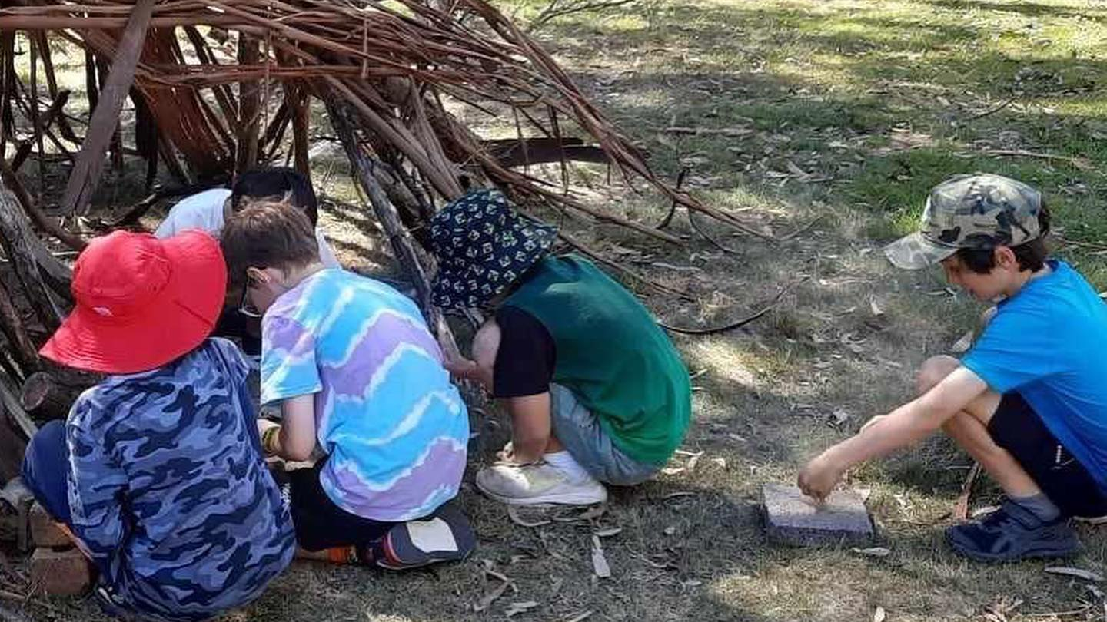
Program change in 2025 and beyond
Getting Victorian voices into the chat

Slide 14
Nationally, we’re due to review the program!
National Scouting Organisations need to review their program regularly. We’re due!
The National Youth Program Team are identifying challenges and potential improvements to the program and its achievement pathways, as well as supporting resources
In Victoria, we will help deliver and promote any nation-wide consultation processes for youth and adults.
If we think there are gaps in engagement, we’ll consult Victorians to inform Scouts Victoria’s position.
Notes:
While we may feel that we’re still rolling out our current program, it’s actually time for a review.
The National Youth Program Team are already looking at quick-wins to make the Achievement Pathways smoother.
We know that Units have valuable insight about what’s working and what needs tweaking, or what needs a deeper think.
For those who were around for the last Youth Program Review, this is not going to be the same scale. But we are keen that Victorian insights inform improvements to the program.
Don’t worry about any of your youth members having their Peak Award disrupted – if any change emerges that would impact current members, we’ll make sure there are change management measures when rolled out in Victoria.
It’s exciting that we’re at a stage where we can have a decent conversation about what to lock in and what to evolve. We’ll find ways to keep that conversation buzzing throughout the year.

Slide 15
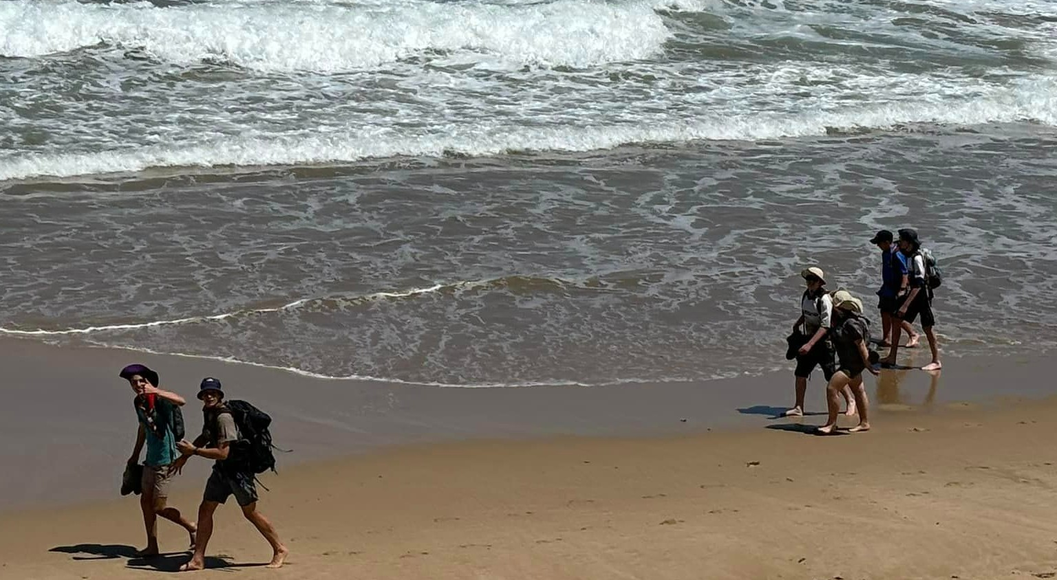
Getting to what matters What LOAs can look for when supporting Units
Notes:
[Time permitting]
Now that we’ve talked about some tools available to Units that you can reinforce, I want to talk briefly about what we can do as Leaders of Adults to support great program and youth retention.
As Leaders of Adults, some of us support multiple sections in a Group, or work with Units in very different contexts in Districts and Regions. We all bring some program wisdom, but no one can know everything.
So what are the key thing we should be looking for when we’re spending time with our Units?

Slide 16
Getting to what matters What to look for when supporting Units
Our current program is big, but successful Units tell us there are some key things to look out for
Young people in the lead | Adults aren’t (regularly) doing what young people can do
Youth-led programming | Young people are involved in the full programming process through P>D>R>. They’re also aware of and thinking about their own development
Diverse adventure | The program includes multiple OAS areas, and the Unit knows how to draw on expertise
Individuals are not constrained | Individuals can pursue OAS and SIAs that they’re ready for. When they transition sections, they don’t go backwards
Dynamic program cycles | While big events and goals can be locked into long-term planning, there is space for young people to bring their ideas to fruition without waiting for months
Adults champion the Achievement Pathways
Unit Council are central to the daily life of the Unit
Notes:
This is what we hear from the Units who are nailing it.
Units running the current program really well get the spectrum of youth leading and adults supporting right for the age group. Adults are not the centre of attention for things like ceremonies, and they’re not unduly cluttering young people who can lead activities suitable to their age. But nor are adults abrogating responsibility for the program – it’s still the adult’s role to make sure everyone has a fun night (and a safe night).
Fundamentally young people set their own program with adult support. This can look different at different age levels, but it’s probably not going to just be a Unit brainstorm followed by an adults-only meeting. Part of this is that the language of Plan-Do-Review should be pretty normal for a section night or a whole program cycle, with particular emphasis on the review component. A really important change is that our educational program has as a core assumption that young people need to be aware of their own development to be empowered in it – the review part of the cycle is critical for this.
There should be evidence in the Unit program that they’re trying out some different Outdoor Adventure Skills. Maybe not a new one each week, but maybe a new one each term or program cycle.
Our Outdoor Adventure Skills, our Special Interest Areas and even the Leads and Assists for the Milestones, shouldn’t hold young people back in what they can do. There should never be a sense of going back to the beginning after moving sections because the young person has exceeded the progress of their new peers.
We have more responsive program cycles. This doesn’t mean we don’t have a long term program or even Term programs, but it means that we have enough flexibility in the program so that a young person can turn an idea into reality while they’re enthused and they don’t have to wait 6 months for an opportunity to arise.
Our Adults don’t need to be experts in the Achievement Pathways, but they need to be champions. They’re allowed to look things up. And while the program is individualised, there’s a general rule that remains that kids making progress in the Achievement Pathways and getting badges are critical for happy Units.
And Unit Council is central to how we live, even at the younger age ranges. And this should be evident over the course of a section night.
And if you’re seeing these sorts of elements regularly in your Units and you’re seeing some progress in the Achievement Pathways, now’s the time to give a pat on the back and some reassurance that they’re on the right path.

