Slide 1
Youth Recruitment and Retention
Daniella Taglieri
Deputy Chief Commissioner

Slide 5
Joey Scouts

Slide 6
AJ2028
Extranet tells us that we have 1,037 Cub Scouts and 1,016 Scouts who are 11 years of age.
If Jamboree was in 2029; they would have missed out.
However, they can all attend a 2028 Jamboree!
Only 322 out of a total of 2,053 attended AJ2025 – this means there are 1,731 youth possibly thinking they won’t get to a Jamboree unless we tell them.

Slide 8
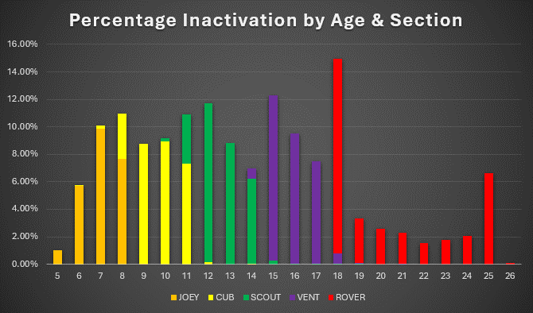

Slide 9
Venturer Scouts
The Victorian Venturer Council visited every 14 year old at AJ2025
Created the handbook for linking Scouts

Slide 10
Rover Scouts
Meet Bill the Duck
Revamped the 17.5 email
Stole the VVC handbook idea and are adapting it
Have overhauled what they are doing at Venturer events

Slide 12
