Slide 1
People and Culture
Daniella Taglieri
Deputy Chief Commissioner

Slide 2
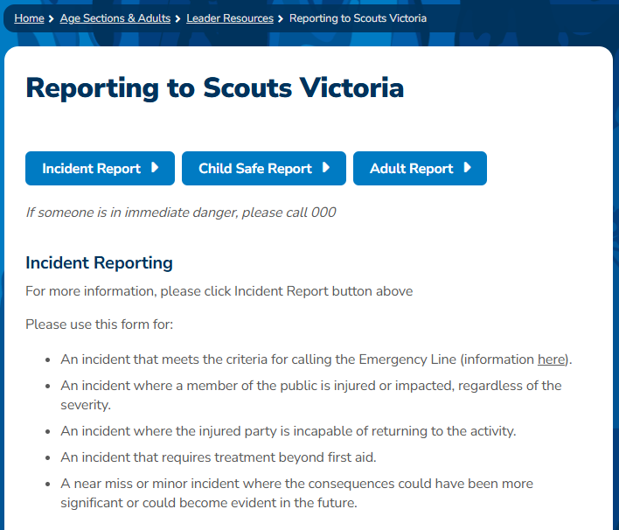

Slide 3
Incident reports
Please use this form for:
An incident that meets the criteria for calling the Emergency Line 8543 9877 (see the Safety tab)
An incident where a member of the public is injured or impacted, regardless of the severity
An incident where the injured party is incapable of returning to the activity
An incident that requires treatment beyond first aid
A near miss or minor incident where the consequences could have been more significant or could become evident in the future

Slide 4
Plans in 2025
The operational risk and safety working party
A focus on preventing and reacting to anaphylactic episodes

Slide 5
Child safety reports
Please use this form:
If the person of concern is under 18
If you form a reasonable belief that a young person could be at risk of harm or you have concerns for their safety or well-being. This could be for many reasons, including mental health or family violence.
If someone discloses sexual, physical, psychological or emotional harm or neglect towards a young person. This includes any disclosures from young people in regard to harm towards themselves.
If you have observed harmful behaviour towards a young person or seen suspected signs of abuse
You have observed a young person participate in harmful behaviour towards themselves or someone else
You have an incident that is continuing to escalate beyond local resource capacity or assistance by Scouts Victoria is required
Child Safety Line 1800 870 772

Slide 6
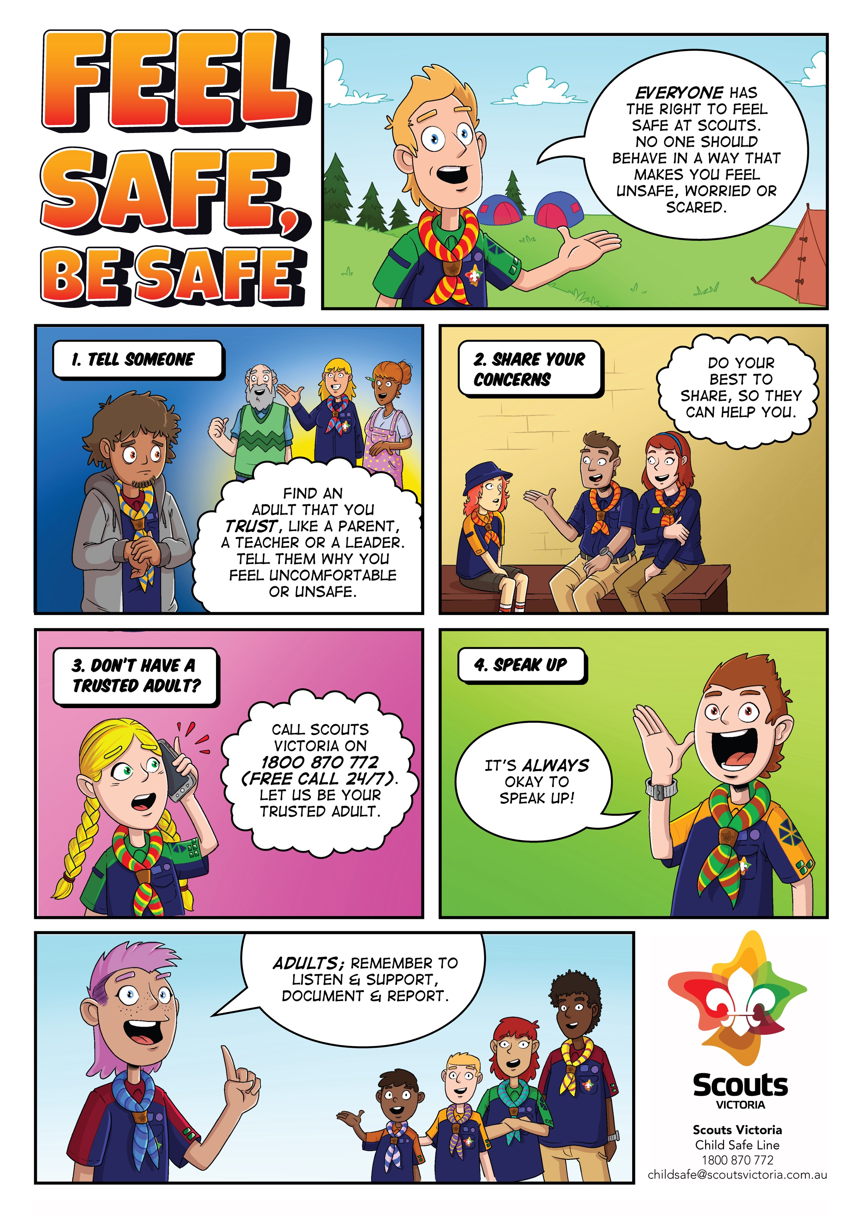
Plans in 2025
Thank you
Ensuring posters are on display
Further developing Unit Codes of Conduct
Improved reporting
Increased understanding of digital safety

Slide 7
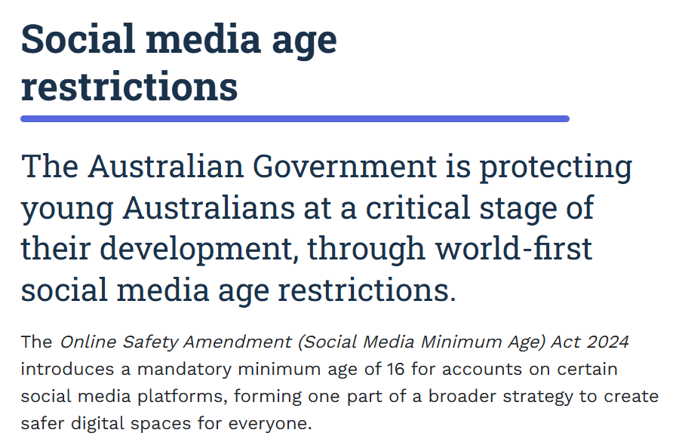

Slide 8
Adult reports
Please use this form if the person of concern is a member of Scouts Victoria, is 18 years old (or older) AND one of the following apply
You have experienced discrimination, harassment or bullying
You believe you have been treated unfairly
You would like to make a complaint about a member’s behaviour or actions
You have concerns that a member has breached the Adult Code of Conduct, Code of Ethics or an appropriate policy
You would like support with managing an adult conflict, dispute or grievance

Slide 9
Plans in 2025
Support teams
Three types of adult reports and how they are managed
Updated Scouts Australia Adult Code of Conduct
Rover training: Rovering by the Scout Law
Legislation updates

Slide 10
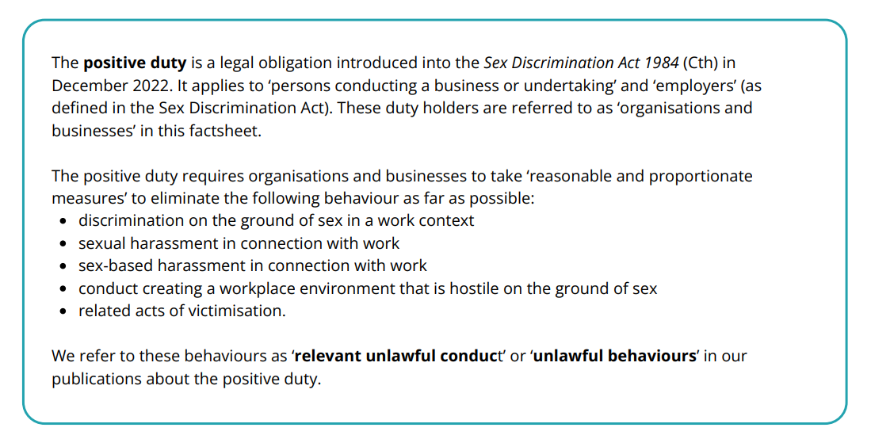

Slide 11
