Slide 1
Outline timings
Timing | Slides | Segment
12:00 |  | Introduce myself and session objectives (Rosie)
12:03 12:13 |  | Scoping the problem: BMW session (discuss with a partner, then take shares from individuals) Key issues with scout volunteering (Rosie)
12:20 |  | Sharing the vision for a new volunteering model/ support structure (Rosie)
12:25 12:35 |  | Building a healthy volunteering pipeline in your group Share new volunteering model of flexi roles (Rosie) Explain concept of a pipeline (Rosie) Unpack how the assistant leader role will be trialled in Victoria (Craig/ Daniella)
12:40 12:50 12:55 |  | Recruiting new volunteers Suggested targets and strategies (Rosie) Key messages (Rosie) Deploying experienced adults in scouting e.g. as mentors, ‘flexi leaders’ etc (Craig/ Daniella) Commitment to action in 2025 (participant discussion in pairs/ small groups)
1:00 |  | Invite to afternoon workshops and close for lunch

Slide 2
Strengthening volunteer support in Scouts Victoria 2025 conference plenary
1 February 2025
Rosie Connor
Key Move Manager (Volunteering), Scouts Australia

Slide 3
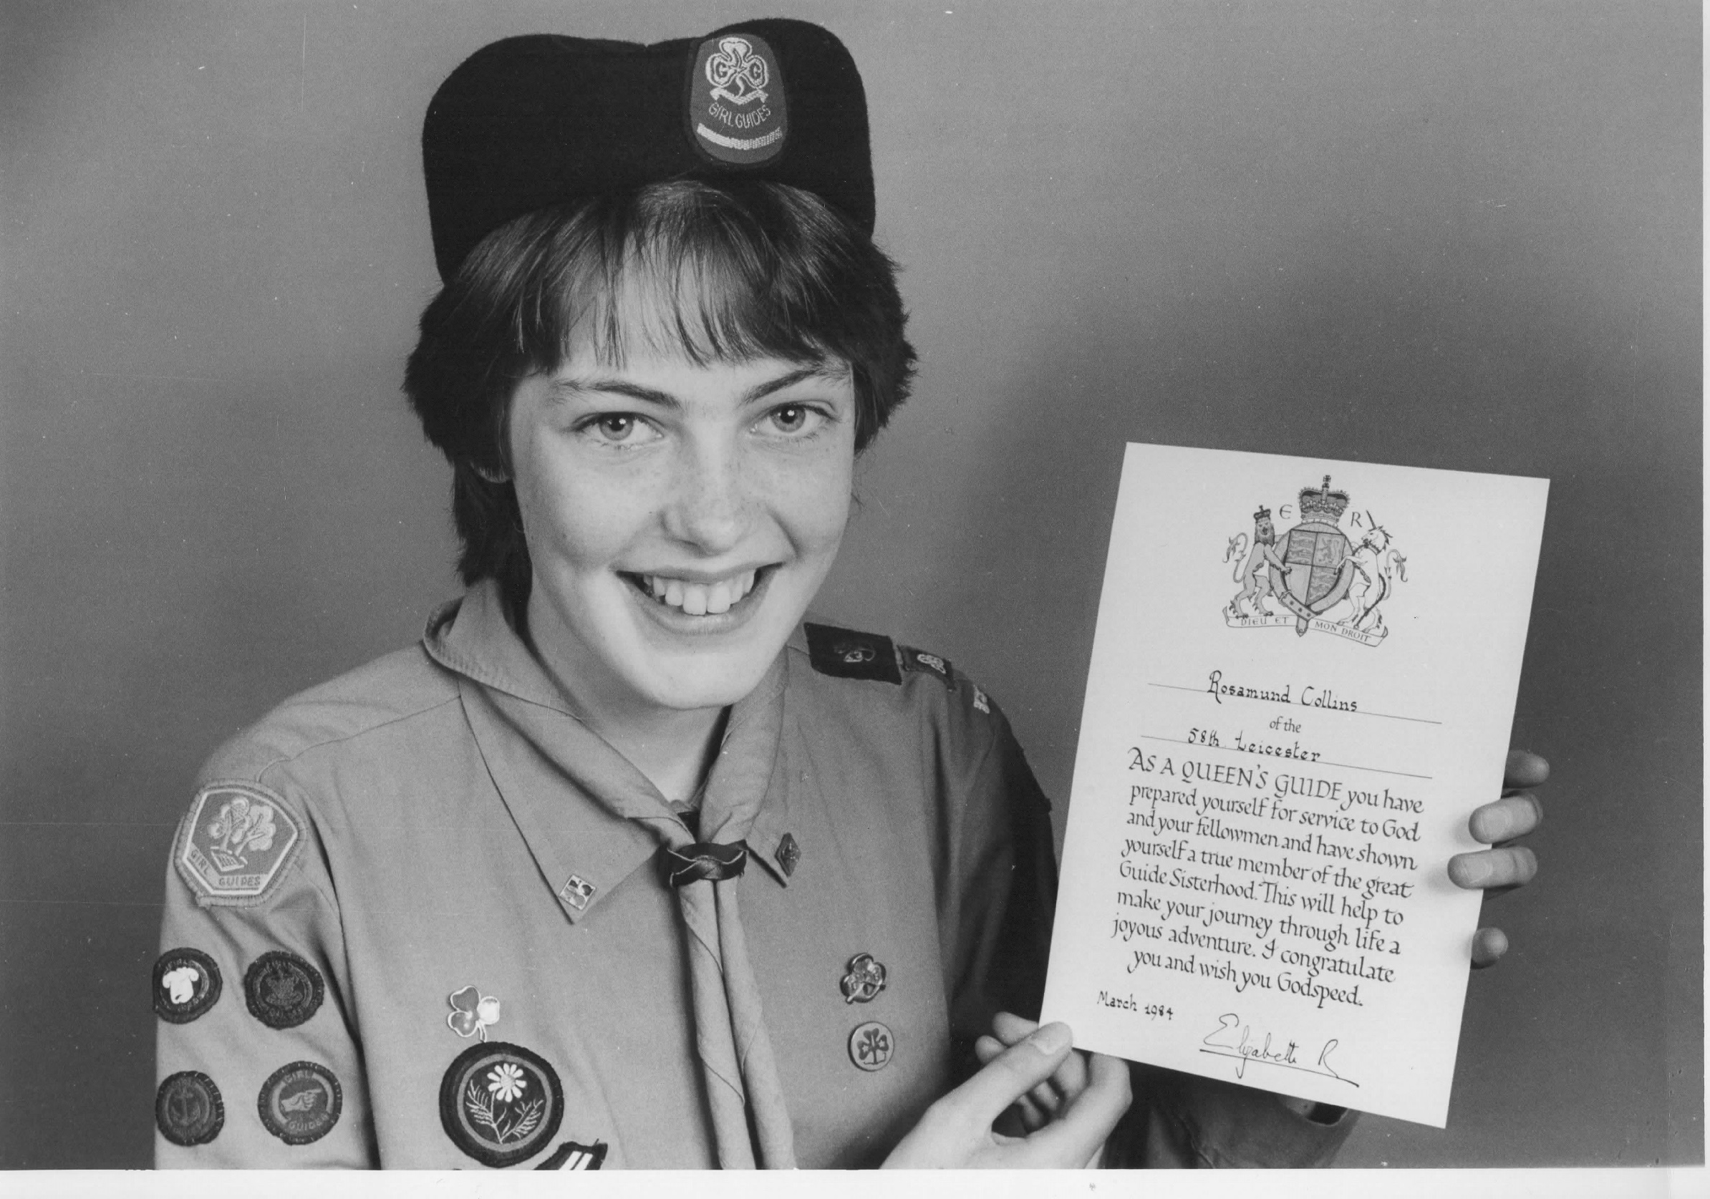


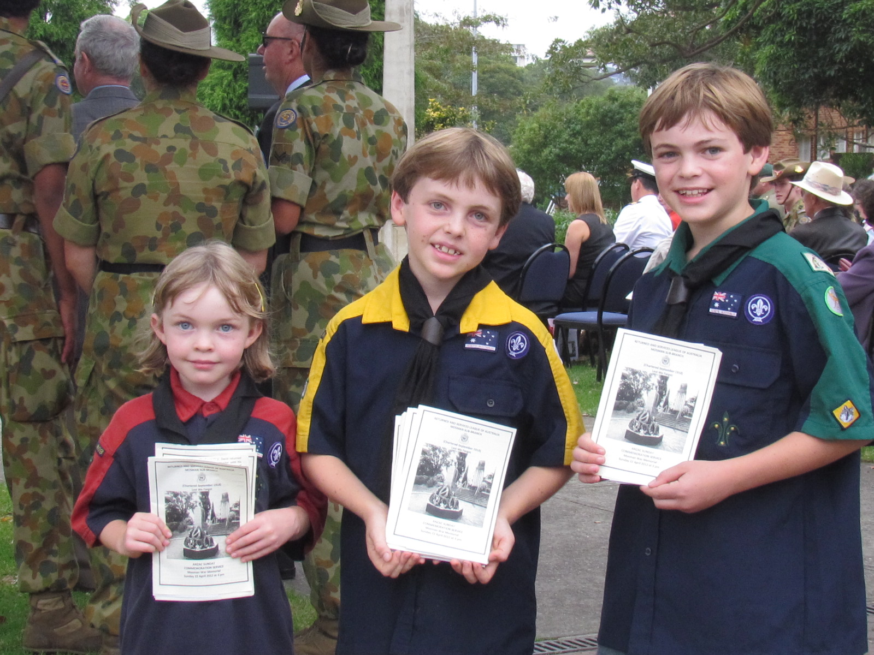
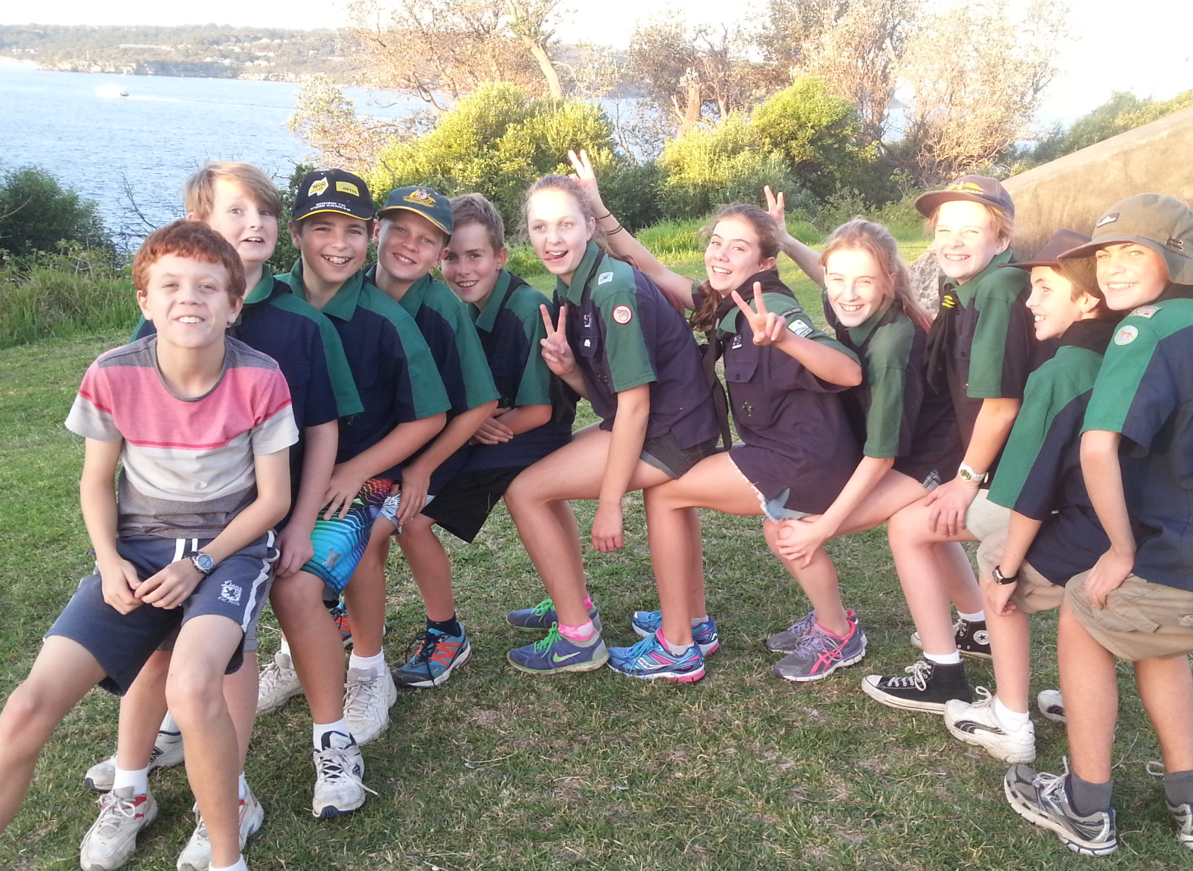
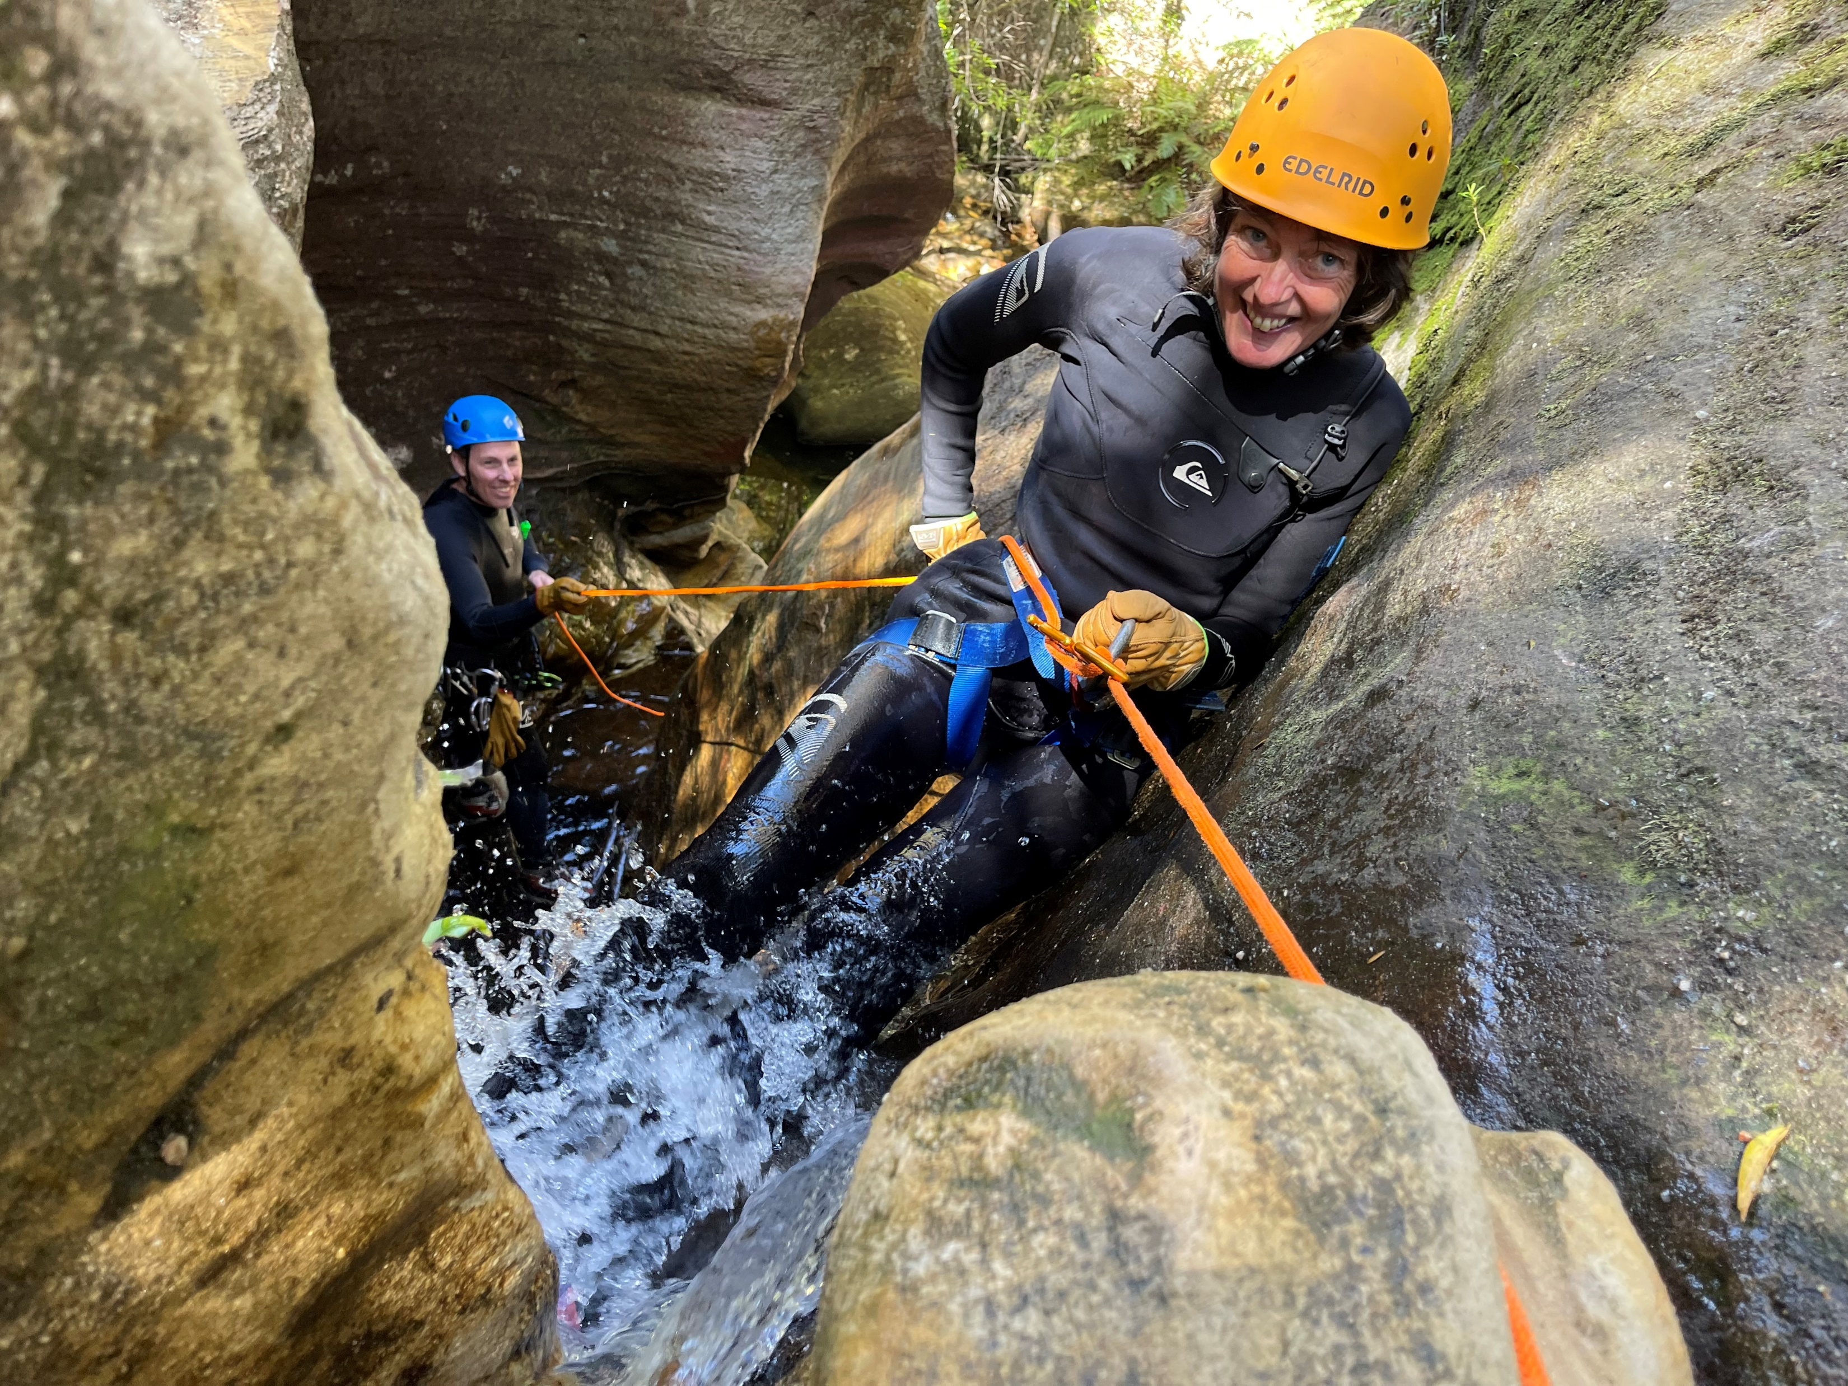

Slide 4
Session objectives
1
2
3
Explore the issues that we face in recruiting volunteers
Share and co-construct a new, ‘flexi’ volunteering model for scouting
Reflect on how you build a pipeline of volunteers in your scout group

Slide 5
What are the “top” five rankings?
Insights from Adult Experience Survey 2023
5
… but we’re also aware that there are many serious issues

Slide 6
Why is it so difficult to recruit and retain volunteers in scouts?
Let’s have a 5-minute BMW discussion
Bitches
Moans
Whinges

Slide 7

Issue #1
We try to recruit into a single ‘one size fits all’ role of LEADER.
“Instead of telling people ‘this is what we need from you, we should ask them ‘what are you able to offer’?”

Slide 8


Issue #2
Leaders are seen as superheroes … exceptional, alone and committed forever
“We need to find a way so that normal people, a collective of parents, are able to run scouts.”

Slide 9

Issue #3
We make it REALLY hard to become a leader
# Numerous child safety checks
# Personal references
# Several authorisation levels
# … and then there’s the training

Slide 10

Issue #4
Training
Average 1.5 years to complete (cf leader average tenure is 2.4 years)
Does not recognise prior learning
“Why do we expect everyone to go through everything?”

Slide 11
What are the “bottom” five rankings?
Insights from Adult Experience Survey 2023
5

Slide 12
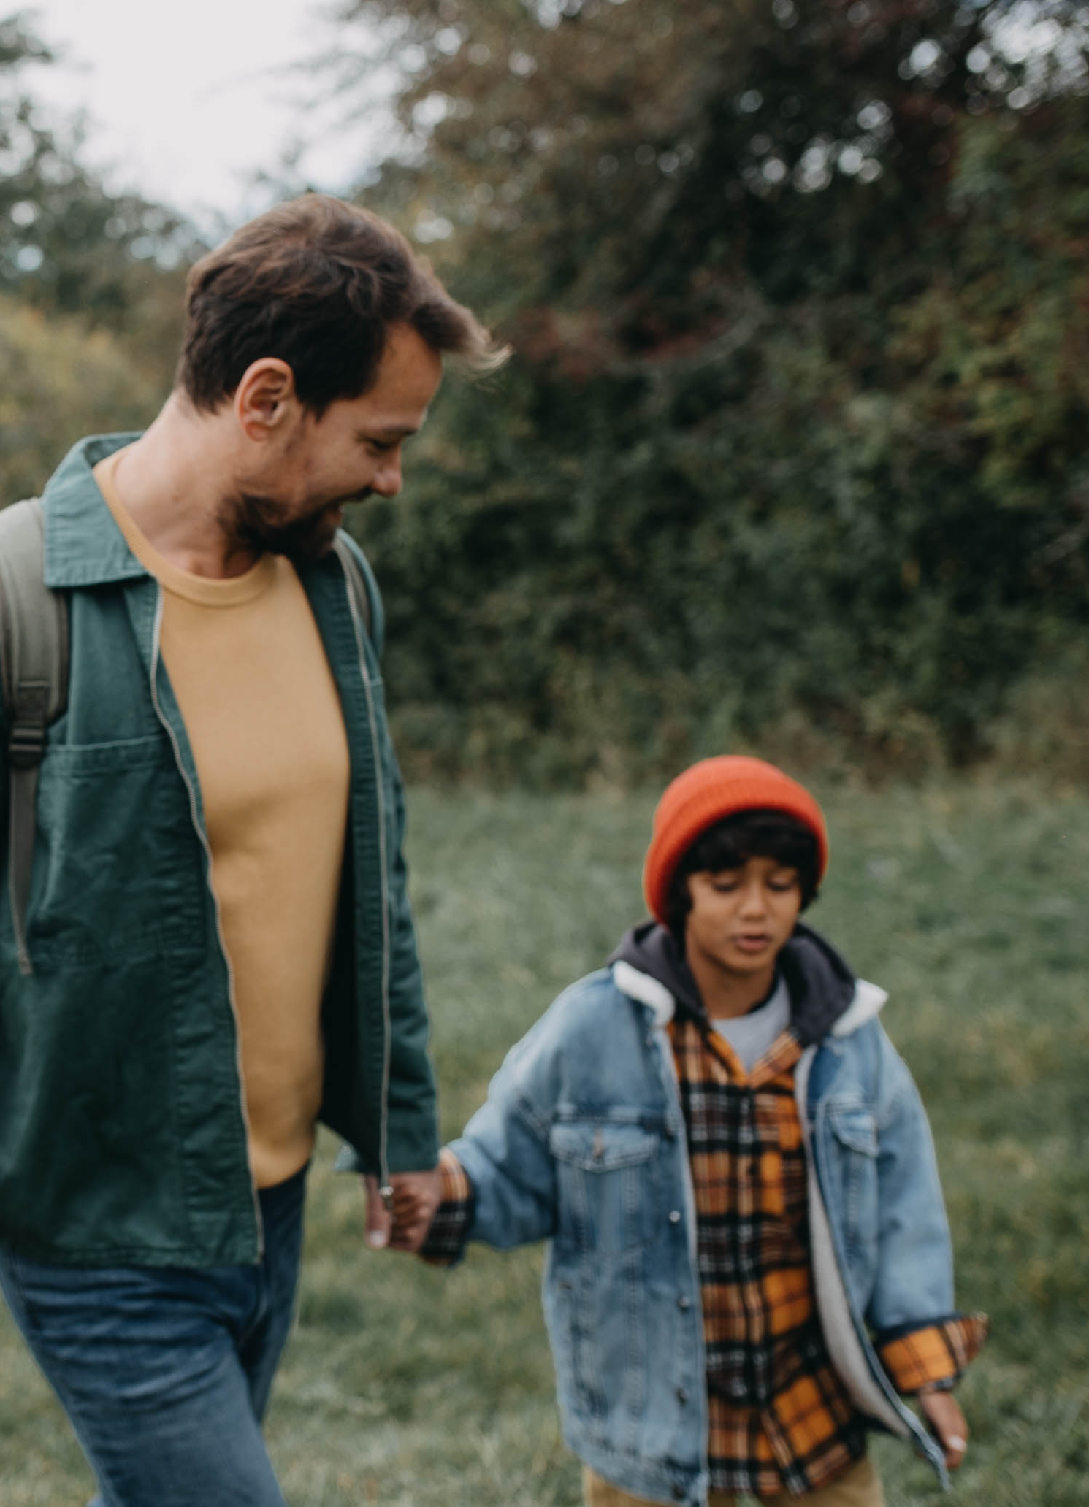
Issue #5
There is ‘churn’…
Many volunteers are parents. When their children leave or transition, they too leave.
Other leaders burn out.

Slide 13
If adults are planning to leave, then why?
Insights from Adult Experience Survey 2023
29.6% (~30%) of Adults do not see themselves being in Scouting three years from now.
514 responses were offered as to why they may leave e.g.
  Politics and bureaucracy
  Lack of respect / feeling undervalued
  New Program – especially Scouts | Terrain
  Burnout (heavy workload)
  Age and Health
  Cost of living

Slide 14

Issue #6
Many of our volunteers are disillusioned. They express frustrations with:
over regulation
IT systems
leadership
As ‘detractors’, they may not be great advocates to recruit new volunteers.

Slide 15
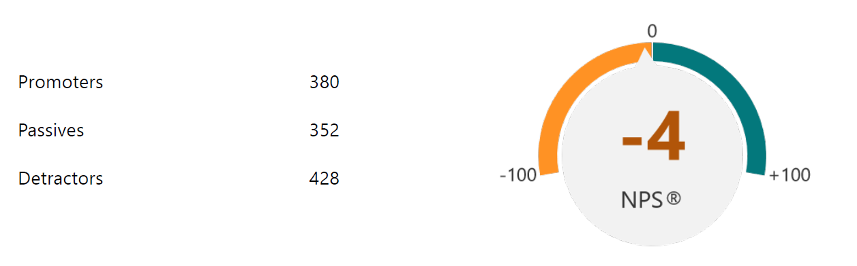
Are our Adults promoters for Scouting?
Insights from Adult Experience Survey 2023
Note: an NPS of >0 is desirable and >50% considered excellent.

Slide 16

Issue #7
We may be ‘top heavy’. 57% of our volunteers are not youth leaders. Many experienced youth leaders leave to go into ‘other’ roles.
Have we got the balance right?

Slide 17

Issue #8
Some types of scout groups may be especially struggling to recruit volunteers
e.g. small groups?
regional locations?

Slide 18
Key issues re volunteering
We try to recruit into a one-size-fits-all role of ‘leader’.
Leaders are seen as superheroes … exceptional, alone and committed forever.
We make it REALLY hard to become a leader.
Training takes too long to complete.
There is churn as leaders leave us.
Many of our volunteers are disillusioned.
We are ‘top heavy’. Experienced youth leaders go into ‘other’ roles.
Small groups and rural groups find it tough.
Behaviour management increasingly challenging.
Poor reputation of Scouting from historical child abuse

Slide 19

3
Building a healthy volunteering pipeline
Big
Ideas
Recruiting new volunteers
Retaining current volunteers (workshop)

Slide 20

3
Building a healthy volunteering pipeline
Big
Ideas
Recruiting new volunteers
Retaining current volunteers

Slide 21


How can we flip the system, so that Scout Groups are always the No 1 priority?

Slide 22
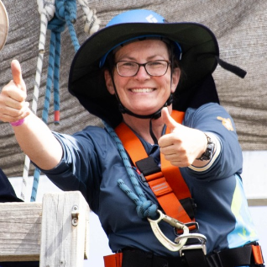

So, what’s the vision for a new support structure?
Activity experts available to book via a skills database for first aid, adventurous activities, arts etc
Assistant leaders share the load running weekly sessions
Activity ideas ‘in a box’ or on a termly theme
Admin streamlined
Training differentiated
Clear communications re what paperwork is needed and why
IT systems improved with 24/7 technical support
New leaders get mentored

Slide 23

Flexi volunteering options
‘Activity support’
‘Scouting fellows’ offering skills e.g. outdoor adventure skills, first aid, drama, STEM, environment etc.
‘Youth support’
Assistant leaders
Helpers
Leaders
‘Adult support’
‘Committee support’
Mentors of new leaders in a region or branch
Group leaders
Committee members – shared across groups?
Flexi-leaders in a scout group to sub in to any section

Slide 24
Could we consider 4 levels of volunteers involved with ‘youth support’… and 4 levels of training?
For example…
Level 1 Assist in youth meetings/ activities
Level 2 Able to lead a youth meeting/ activity
Level 3 Overall responsibility for a section (including investitures, patrol system etc)
Level 4 Able to lead scouts on certain adventurous activities such as overnight camps or bushwalks
Let’s explore this new ‘Assistant Leader’ role

Slide 25
Consider your own scout group …
Complete the workforce planning sheet, by answering these 3 questions…
What leaders, assistant leaders and regular helpers do you have in each section right now … and what are the current gaps?
How about in 18 months’ time? Which of the current leaders, assistant leaders and helpers will you have then … and will the gaps be?

Slide 26

3
Building a healthy volunteering pipeline
Big
Ideas
Recruiting new volunteers
Retaining current volunteers

Slide 27
Recruiting more volunteers:
How might we target these groups?
Former scouts, venturers and Rovers (18-30 yrs)
Parents of former scouts
Parents
(more effectively)
Public
Military /
ex-military
Unis
Adventurous activity enthusiasts (bushwalkers, climbers etc)
Former youth leaders
Redirecting ‘other’ volunteers back to youth sections?

Slide 28
Recruiting more volunteers into your scout group:
Actions you can take in 2025
Run a Leaderbuild campaign to recruit parents
Reach out to former scouts/ venturers who are now 18-30 years (and who don’t want to be Rovers) and explore if they’d like to get involved (as leaders, adventurous activity experts, committee members etc)
Reach out to the parents of former scouts/ venturers (e.g. whose children have now left home so they have more time) and explore if they’d like to get involved (as leaders, adventurous activity experts, committee members etc)
And ask all new parents to enrol as adult helpers when their child joins scouts

Slide 29
3 key messages when recruiting volunteers
1
2
3
We offer flexi volunteering, with different roles and time commitments
We need volunteers and we welcome everyone to join us
When you volunteer, you join a team

Slide 30
Consider your own scout group …
Discuss with a colleague…
What action are you going to take in 2025 to secure a healthy pipeline of volunteers in your scout group?

Slide 31
Strengthening volunteer retention in Scouts Victoria 2025 workshop
1 February 2025
Rosie Connor
Key Move Manager (Volunteering), Scouts Australia

Slide 32
Outline timings
Timing | Slides | Segment
10 mins |  | Check in. Discuss main issues in retaining volunteers
10 mins |  | 5 actions to support volunteer retention
15 mins |  | 4 faces of coaching
5 mins |  | Conclusions, actions

Slide 33

3
Building a healthy volunteering pipeline
Big
Ideas
Recruiting new volunteers
Retaining current volunteers

Slide 34
Happy wife, happy life
Happy partner, happy life
Happy leaders, happy life

Slide 35
What are the main issues you face in retaining volunteers?

Slide 36
If adults are planning to leave, then why?
Insights from Adult Experience Survey 2023
29.6% (~30%) of Adults do not see themselves being in Scouting three years from now.
514 responses were offered as to why they may leave e.g.
  Politics and bureaucracy
  Lack of respect / feeling undervalued
  New Program – especially Scouts | Terrain
  Burnout (heavy workload)
  Age and Health
  Cost of living

Slide 37




How can you support volunteer retention?
‘Checking in’ with your volunteers
Coaching your volunteers
Deploying experienced leaders in support roles
Scheduling time out to avoid burnout
Communicating the rationale for changes

Slide 38
The Four Faces of Coaching

Slide 39
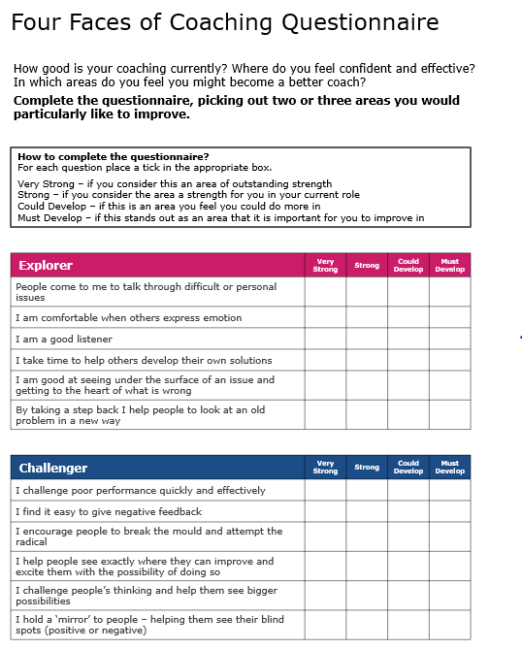
Complete the Four Faces Questionnaire

Slide 40
Your coaching “face”
I challenge poor performance quickly and effectively
I find it easy to give constructive feedback
I encourage people to break the mold and attempt the radical
I help people see exactly where they can improve and excite them with the possibility of doing so
I challenge people’s thinking and help them see bigger possibilities
I hold a ‘mirror’ to people – helping them see their blind spots (positive or negative)
People come to me to talk through difficult or personal issues
I am comfortable when others express emotion
I am a good listener
I take time to help others develop their own solutions
I am good at getting under the surface of an issue and getting to the heart of what is wrong
By taking a step back I help people to look at an old problem in a new way
Challenger
Explorer
I am respected and seen as a role model by my team, and am regularly sought out for advice
I set high standards
Where appropriate I tell people exactly what to do in a given situation
I do things others try to emulate and learn from
I make time to share my experience and knowledge with my team and to show people how to do tasks in a thorough way
I explain things in a clear and compelling way
I build the confidence of those around me
I find it easy to give praise
I find it easy to see the best in people, (and to spot their potential)
I find stretching tasks for my people to do, giving them the opportunity to grow
I empower my team, helping them find their own solutions to problems (rather than doing it for them)
I’m good at letting go and allowing others the freedom to make mistakes so they can learn.
Expert
Supporter

Slide 41
Additional slides
(not used)

Slide 42



See Hear Speak
See)
A great coach knows how to make others feel seen, being fully present when speaking with them and seeing the world through their eyes.
Hear)
A great coach knows how to make others feel heard listening not just to the content being spoken but also to the needs, fears and hopes that sit behind it.
eSpeak)
A great coach delivers their feedback or message in a way that helps others see and recognise aspects of themselves they couldn’t on their own.

Slide 43
Strengthening volunteering in a scout district:
Actions you can take in 2025
Train group leaders in volunteer recruitment e.g. using Leaderbuild, share ‘Actions you can take in 2025’ with scout groups
Encourage scout groups to contact former scouts/ venturers who are now 18-30 years and/or their parents to invite them to volunteer
Reach out to 25-year-old Rovers and explore how they may want to get involved
Build partnerships with new source of volunteers e.g. outdoor adventure groups (bushwalking groups, climbing clubs etc), military/ retired military, universities/ colleges, state volunteering organisations etc.
Review and streamline all branch/ district roles not involved with groups; encourage ‘other’ volunteers to get redeployed in groups.
Get curious about why volunteers leave – make an effort to ring a sample of these, listen to their experiences and identify what needs to change
Other ideas?

Slide 44

The Four Faces of Coaching
What is the coaching face you feel most present in you, or that you find most comfortable using?
Share with your partner…
  When should you use this face?
  What are two benefits of this face?
  What happens when you overuse it?
Take a shot for reference during the breakout activity

Slide 45
The Four Faces of Coaching
What is the coaching face you least feel present in you, or that you find most challenging to use?
Share with your partner…
  What is stopping you from using this face?
  What’s the impact of underusing it?
Take a shot for reference during the breakout activity

Slide 46




How Each Face Helps Your Coachee
Challenger Helps the coachee to: See blind spots in their thinking and plans Recognize how they might be the limiting factor Break the mold and look for new ways of doing things Skills / Qualities Feedback Assertive Language Courage | Explorer Helps the coachee to: Find own solutions to issues and challenges Look at the problem in a new light Share feelings and concerns which block progress Skills / Qualities Playback and prompt content Playback and prompt feelings Respect
Expert Helps the coachee to: Receive clear guidance and instructions Deepen their knowledge and understanding Break a complex challenge down into manageable chunks Skills / Qualities Passion for sharing knowledge with others Communicates clearly and concisely Wisdom | Supporter Helps the coachee to: Believe in themselves and what they are doing Celebrate success Build a trusting and open relationship Skills / Qualities Encourages and acknowledges Demonstrates understanding of coachee’s position Care

Slide 47
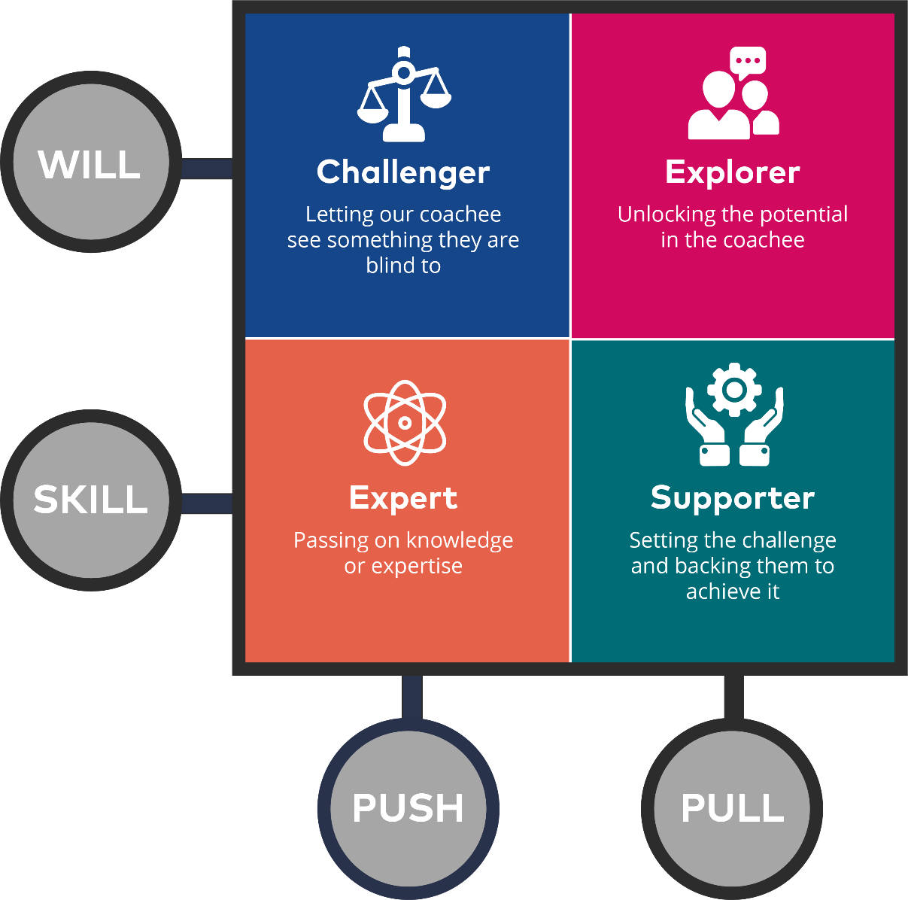
Skill and will
Flexing your coaching style
Skill vs Will
  Primarily about experience and comfort with the situation
Push vs Pull
  Primarily about what coaching posture will be most helpful

