Slide 1
King’s Scout Award Badge Presentation Ceremony
Notes:
This presentation was originally developed for use at the Venturer Scout Leadership Course, now known as the Personal Development Course.
While you are in Venturers you are likely to be involved in a King’s Scout Badge Presentation Ceremony. This ceremony is organised by the Unit Council of the Venturer concerned.
Attendees at this course are very likely to be KS Awardees, part of an Organising Patrol, MC or Host, Speaker and Presenter.

Slide 2
What’s in this Pack
Further Resources
Contents of the Presentation Toolkit
Purpose of the Ceremony
Planning & Delivering the Ceremony
Key Elements of the Ceremony
Key People
Details of the Key Elements
Notes:
In this slidepack, are included:
The Scouts Victoria web URL for the King’s Scout Presentation Toolkit
An overview of the documents available on that web page
The purpose of the King’s Scout Award Badge Presentation Ceremony
What is involved in planning and delivering the ceremony
An outline of the key elements, broken down into
Essential
Necessary
Standard
Desirable
Possible
Who are the key people and what they do
Details of the elements unique to this ceremony

Slide 3
Further Resources
Scouts Victoria website in the Venturers pages at
https://scoutsvictoria.com.au/age-sections-adults/venturers/venturer-section-resources/
you will find the “King’s Scout Presentation Toolkit”
Notes:
The KS Presentation Toolkit has a lot more information and guidelines. You have learnt and practiced the skills you will need for any part of a KS Badge Presentation Ceremony by completing this Leadership Course. You are ready!

Slide 4
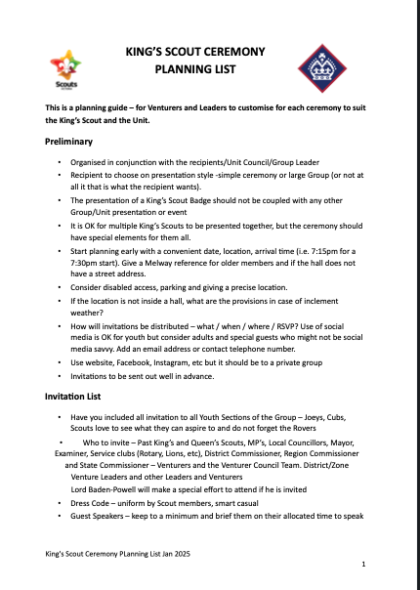
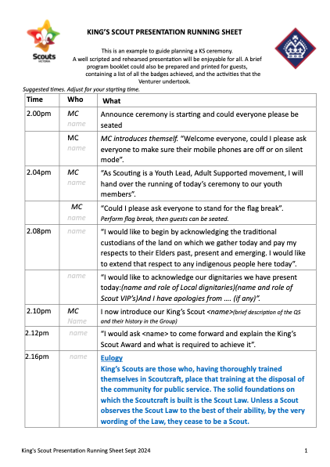
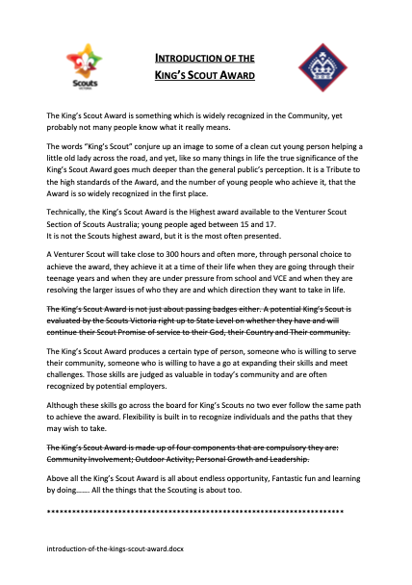
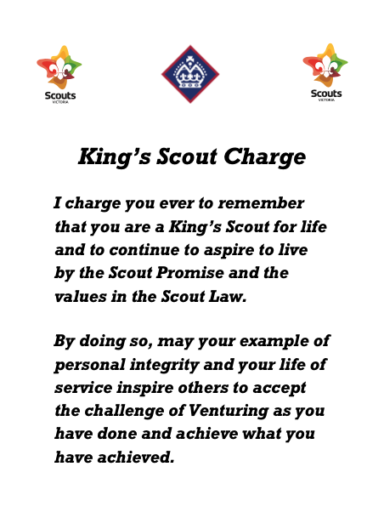
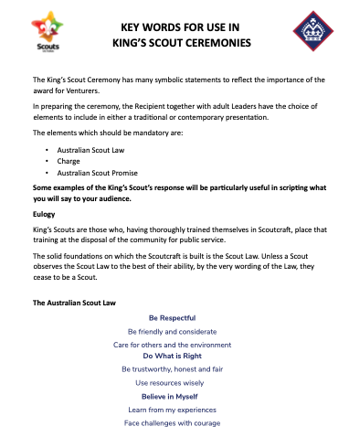
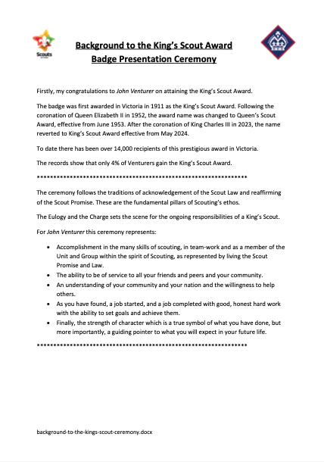
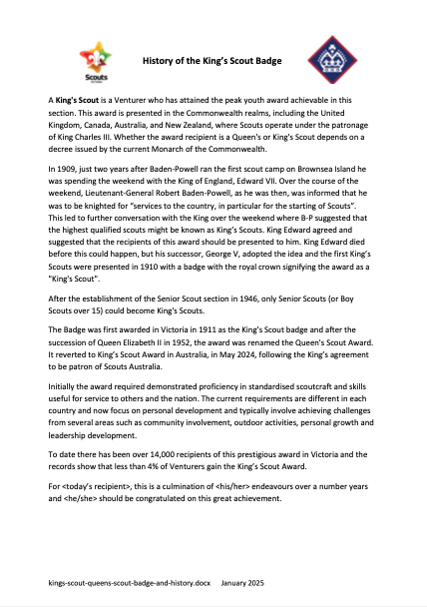
Presentation Toolkit
Planning Guide
Running Sheet
Example Program
Introduction
Charge
This pack
Key Words
Background
History
Notes:
These are the documents you will find links to on the King’s Scout Presentation Toolkit webpage.
They can be divided into two categories, Ceremony Examples and Reference Material
The Ceremony Example documents include:
Planning Guide
Running Sheet
Example Program
Key Words (Promise and Law, and Charge), and
Charge (for handing to the Proclaimer)
The Reference documents include:
This slidepack
An Introduction to the King’s Scout Award
Background of the King’s Scout Award
History of the King’s Scout Award

Slide 5
Purpose
of the King’s Scout Award Badge Presentation Ceremony
Present the King’s Scout Award badge
Re-affirmation of Australian Scout Promise by King’s Scout Awardee
King’s Scout Charge
Recognise and celebrate the achievements of the King’s Scout Awardee in completing their peak award.
Notes:
The King’s Scout Award Badge Presentation Ceremony is a formal occasion and a celebration. It is like a graduation, citizenship or commitment ceremony.

Slide 6
Planning and Delivering
the King’s Scout Award Badge Presentation Ceremony
 | WHO | WHAT
Planning | Venturer Unit Council | Takes the planning lead
 | King’s Scout Awardee | Ceremony preferences Collation of photographs & records
 | Group (s) | Access to hall Provision of refreshments Honour Board
 | VVC | Engagement and recognition
Delivery | Venturer Unit | MC, Gift
 | Group (s) | Honour Board, Gift
 | VVC | Gift
Notes:
The Badge Award Ceremony is planned and delivered to reflect the unique personality and contributions of the Awardee.
Presenters , Speakers and Participants in the Ceremony are people that are significant to the awardee personally, during their scouting journey and/or on the KS Award pathway.
The Venturer Unit will have benefitted from the interests ,activities and skills the Awardee has shared and developed on their KS Award pathway. This has added to a vibrant Unit program. The King’s Scout Award Presentation Ceremony recognises and thanks the Awardee for their contribution to the Venturer Unit.
Forming a Project Patrol to plan and deliver a KS ceremony is an efficient way to gather and use resources, share responsibilities and spread the task load.

Slide 7
Essential Elements
of the King’s Scout Award Badge Presentation Ceremony
Possible | Procession of Group sectional Flags, World Scout Flag, Australian Flag, King’s Scout Awardee and Venturer Unit
Necessary | Flag Break Acknowledgement of Country
Standard | Welcome to Special Guests, Dignitaries and Audience Introduction of King’s Scout Awardee
Desirable | Brief explanation of King’s Scout Award Pathway Overview of Awardee’s Scouting journey Highlights of Awardee’s King’s Scout Award pathway
ESSENTIAL | King’s Scout Awardee re-confirms Australian Scout Promise Presentation of King’s Scout Award Badge King’s Scout Charge
Possible | Unveiling of King’s Scout Honour Board(s), Presentation of Official gifts to Awardee
Standard | Awardee thank you speech to Parents, Examiners, Leaders, etc.
Desirable | Awardee presents KS thankyou pins to Parents
Possible | Awardee is welcomed by other King’s Scouts and Guides present
Standard | General thank-you to Speakers, presenters, helpers, attendees, etc.
Necessary | Flag Down
Possible | Retiring procession of Flags, King’s Scout Awardee and Venturer Unit
Desirable | Refreshments / Afternoon Tea / Supper
Possible | Decorated celebratory Cake
 | King’s Scout Awardee re-confirms Australian Scout Promise Presentation of King’s Scout Award Badge King’s Scout Charge
Notes:
We will build a common basic King’s Scout Award Badge Presentation Ceremony. The Ceremony is built around these 3 essential elements.

Slide 8
Necessary Elements
of the King’s Scout Award Badge Presentation Ceremony
 | Flag Break Acknowledgement of Country
 | Flag Down
Possible | Procession of Group sectional Flags, World Scout Flag, Australian Flag, King’s Scout Awardee and Venturer Unit
Necessary | Flag Break Acknowledgement of Country
Standard | Welcome to Special Guests, Dignitaries and Audience Introduction of King’s Scout Awardee
Desirable | Brief explanation of King’s Scout Award Pathway Overview of Awardee’s Scouting journey Highlights of Awardee’s King’s Scout Award pathway
ESSENTIAL | King’s Scout Awardee re-confirms Australian Scout Promise Presentation of King’s Scout Award Badge King’s Scout Charge
Possible | Unveiling of King’s Scout Honour Board(s), Presentation of Official gifts to Awardee
Standard | Awardee thank you speech to Parents, Examiners, Leaders, etc.
Desirable | Awardee presents KS thankyou pins to Parents
Possible | Awardee is welcomed by other King’s Scouts and Guides present
Standard | General thank-you to Speakers, presenters, helpers, attendees, etc.
Necessary | Flag Down
Possible | Retiring procession of Flags, King’s Scout Awardee and Venturer Unit
Desirable | Refreshments / Afternoon Tea / Supper
Possible | Decorated celebratory Cake
Notes:
Formal Scout events begin with Flag Break and end with Flag Lowering. Acknowledgement of Country is also part of a formal scout meeting

Slide 9
Standard Elements
of the King’s Scout Award Badge Presentation Ceremony
Possible | Procession of Group sectional Flags, World Scout Flag, Australian Flag, King’s Scout Awardee and Venturer Unit
Necessary | Flag Break Acknowledgement of Country
Standard | Welcome to Special Guests, Dignitaries and Audience Introduction of King’s Scout Awardee
Desirable | Brief explanation of King’s Scout Award Pathway Overview of Awardee’s Scouting journey Highlights of Awardee’s King’s Scout Award pathway
ESSENTIAL | King’s Scout Awardee re-confirms Australian Scout Promise Presentation of King’s Scout Award Badge King’s Scout Charge
Possible | Unveiling of King’s Scout Honour Board(s), Presentation of Official gifts to Awardee
Standard | Awardee thank you speech to Parents, Examiners, Leaders, etc.
Desirable | Awardee presents KS thankyou pins to Parents
Possible | Awardee is welcomed by other King’s Scouts and Guides present
Standard | General thank-you to Speakers, presenters, helpers, attendees, etc.
Necessary | Flag Down
Possible | Retiring procession of Flags, King’s Scout Awardee and Venturer Unit
Desirable | Refreshments / Afternoon Tea / Supper
Possible | Decorated celebratory Cake
 | Welcome to Special Guests, Dignitaries and Audience Introduction of King’s Scout Awardee
 | Awardee thank you speech to Parents, Examiners, Leaders, etc.
 | General thank-you to Speakers, presenters, helpers, attendees, etc.
Notes:
The Items listed as Standard are common courtesy items.
Introducing the Awardee may appear to be a redundant thing, but there may be people attending representing an organisation who do not know the Awardee, and over time people change (sweet Joeys turn into anime Venturers).
A Venturer usually receives support and assistance from others to achieve this peak award. It is appropriate the Awardee formally thank these people and acknowledge the unique contribution of their parents.

Slide 10
Desirable Elements
of the King’s Scout Award Badge Presentation Ceremony
Possible | Procession of Group sectional Flags, World Scout Flag, Australian Flag, King’s Scout Awardee and Venturer Unit
Necessary | Flag Break Acknowledgement of Country
Standard | Welcome to Special Guests, Dignitaries and Audience Introduction of King’s Scout Awardee
Desirable | Brief explanation of King’s Scout Award Pathway Overview of Awardee’s Scouting journey Highlights of Awardee’s King’s Scout Award pathway
ESSENTIAL | King’s Scout Awardee re-confirms Australian Scout Promise Presentation of King’s Scout Award Badge King’s Scout Charge
Possible | Unveiling of King’s Scout Honour Board(s), Presentation of Official gifts to Awardee
Standard | Awardee thank you speech to Parents, Examiners, Leaders, etc.
Desirable | Awardee presents KS thankyou pins to Parents
Possible | Awardee is welcomed by other King’s Scouts and Guides present
Standard | General thank-you to Speakers, presenters, helpers, attendees, etc.
Necessary | Flag Down
Possible | Retiring procession of Flags, King’s Scout Awardee and Venturer Unit
Desirable | Refreshments / Afternoon Tea / Supper
Possible | Decorated celebratory Cake
 | Brief explanation of King’s Scout Award Pathway Overview of Awardee’s Scouting journey Highlights of Awardee’s King’s Scout Award pathway
 | Awardee presents KS thankyou pins to Parents
 | Refreshments / Afternoon Tea / Supper
Notes:
We cannot assume that all attendees know what the King’s Scout Award is, or what needs to be done to achieve it.
For the overview of the Awardee’s Scouting Journey Adult Leaders or significant people from the Awardees time in previous sections may be invited to give a brief speech about the Awardee’s time in that section and are likely to include major events attended, significant activities and anecdotes.
Often Examiners and Mentors are invited to speak about the challenges chosen by the Awardee for their KS Award pathway. Other Venturers who participated in chosen challenges will speak about those challenges.
Usually, 1 speaker for the KS Award pathway, 1 speaker from each previous section and 1speaker for each challenge is sufficient.
The Awardee’s Parents have usually been responsible for getting the Venturer to this point in their life and are often a key source of support and help to achieving the KS Award. The pins are a symbolic recognition of the parents' role and a thank you. Sometimes the Awardee may also present a personalised gift to their parents.
Refreshments/Afternoon Tea/Supper this is the party time. The food and management of the kitchen is usually the responsibility of the Project Patrol for this event and often a joint effort between the Venturer Unit and the Group.

Slide 11
Possible Elements
of the King’s Scout Award Badge Presentation Ceremony
Possible | Procession of Group sectional Flags, World Scout Flag, Australian Flag, King’s Scout Awardee and Venturer Unit
Necessary | Flag Break Acknowledgement of Country
Standard | Welcome to Special Guests, Dignitaries and Audience Introduction of King’s Scout Awardee
Desirable | Brief explanation of King’s Scout Award Pathway Overview of Awardee’s Scouting journey Highlights of Awardee’s King’s Scout Award pathway
ESSENTIAL | King’s Scout Awardee re-confirms Australian Scout Promise Presentation of King’s Scout Award Badge King’s Scout Charge
Possible | Unveiling of King’s Scout Honour Board(s), Presentation of Official gifts to Awardee
Standard | Awardee thank you speech to Parents, Examiners, Leaders, etc.
Desirable | Awardee presents KS thankyou pins to Parents
Possible | Awardee is welcomed by other King’s Scouts and Guides present
Standard | General thank-you to Speakers, presenters, helpers, attendees, etc.
Necessary | Flag Down
Possible | Retiring procession of Flags, King’s Scout Awardee and Venturer Unit
Desirable | Refreshments / Afternoon Tea / Supper
Possible | Decorated celebratory Cake
 | Procession of Group sectional Flags, World Scout Flag, Australian Flag, King’s Scout Awardee and Venturer Unit
 | Unveiling of King’s Scout Honour Board(s), Presentation of Official gifts to Awardee
 | Awardee is welcomed by other King’s Scouts and Guides present
 | Retiring procession of Flags, King’s Scout Awardee and Venturer Unit
 | Decorated celebratory Cake
Notes:
The Processions of the Flags, Awardee and Venturer formally mark the beginning and end of the Ceremony.
The unveiling of the Honour Board places the Awardee in the history of the Group or Unit.
All gifts /mementoes to the Awardee have the KS Award logo and commemorate this occasion. Usually any of the following may be presented to the Awardee by the Unit or Group :- Commemorative Plaque (dated), Lapel pin ( Brooch, Tie Pin), Woggle and Miniature Badge to wear on Rover uniform. Some Units and Groups have traditions of presenting particular items to the Awardee.
When the Awardee is welcomed by other KS it emphasises the history and continuity of the Award and gives a glimpse of the variety of Awardees. This usually done by inviting any attendees who are QS or Queen’s Guides to come forward and shake hands with the Awardee.
A specially decorated cake and to celebratory atmosphere. Often the cake is cut as the opening of the refreshments (party) part of the occasion.

Slide 12
All Elements
of the King’s Scout Award Badge Presentation Ceremony
Possible | Procession of Group sectional Flags, World Scout Flag, Australian Flag, King’s Scout Awardee and Venturer Unit
Necessary | Flag Break Acknowledgement of Country
Standard | Welcome to Special Guests, Dignitaries and Audience Introduction of King’s Scout Awardee
Desirable | Brief explanation of King’s Scout Award Pathway Overview of Awardee’s Scouting journey Highlights of Awardee’s King’s Scout Award pathway
ESSENTIAL | King’s Scout Awardee re-confirms Australian Scout Promise Presentation of King’s Scout Award Badge King’s Scout Charge
Possible | Unveiling of King’s Scout Honour Board(s), Presentation of Official gifts to Awardee
Standard | Awardee thank you speech to Parents, Examiners, Leaders, etc.
Desirable | Awardee presents KS thankyou pins to Parents
Possible | Awardee is welcomed by other King’s Scouts and Guides present
Standard | General thank-you to Speakers, presenters, helpers, attendees, etc.
Necessary | Flag Down
Possible | Retiring procession of Flags, King’s Scout Awardee and Venturer Unit
Desirable | Refreshments / Afternoon Tea / Supper
Possible | Decorated celebratory Cake
Notes:
The complete ceremony should include at least the Essential, Necessary and Standard elements.
The Desirable and Possible elements would emphasize the fun and celebration of the achievement.
The exact order of the elements is not fixed, and the example documents that can be found in the Toolkit contain alternative examples of programs.

Slide 13
Key People
Master of Ceremonies (MC)
King’s Scout Awardee
Presenter of King’s Scout Award Badge§
Proclaimer of King’s Scout Charge§
§ Nominated by the King’s Scout Awardee
Notes:
There are likely to many other people involved as speakers and presenters, on project patrols organising the ceremony and doing the many other tasks needed to make the event happen and run smoothly.

Slide 14
Master of Ceremonies (MC)
Who they are:
A Venturer usually Unit Chairperson or another Unit member
Another person can be requested by the Awardee because they are significant to the Awardee
What they do:
Introduce the Ceremony and Presenters and Speakers.
Ensure the event runs to time
What they should have:
Notes and information on Speakers, Presenters and program
A Running Sheet / Timetable / Program
A clear view of a time-keeping device
The information to step into any part of the program
Notes:
The MC or Host is an integral member of the Project Patrol that plans and presents the KS Award Badge Presentation Ceremony. The MC/Host needs to be well prepared, confident and relaxed.

Slide 15
King’s Scout Awardee
Who they are:
Venturer Scout receiving the King’s Scout Award Badge
What they do:
Make a speech thanking everyone who has helped them achieve the King’s Scout Award. This speech usually acknowledges the Awardees parents.
Notes:
The Awardee’s speech is their time to shine and personally impress the attendees, confirming the Awardee is a worthy recipient of the KS Award. Give a good well-polished speech !
And please, never open with “I’m not used to public speaking” or similar!

Slide 16
Presenter of King’s Scout Award Badge
Who they are:
Chosen by the King’s Scout Awardee
Often a person of special significance to the Awardee
What they do:
Present the Award Badge
May also give a short speech about Awardee
Notes:
Traditionally the King’s Scout Award has been awarded by the District Commissioner. So, some Districts, Groups and Units may still have the KS Badge being presented by the District Commissioner. There may be other Traditions that a particular Unit has regarding the presentation of the KS badge.
Usually, the Awardee chooses a person of special significance to them to present the KS Badge. This person may or may not be in Scouting. Examples – Relatives, Leaders, Teachers, Mentors, Examiners, Friends, other KS, other Venturers.

Slide 17
Proclaimer of King’s Scout Charge
Who they are:
A King’s or Queen’s Scout
May be a person of significance to the Awardee
What they do:
Read or “proclaim” the King’s Scout Charge
Notes:
The KS Charge is one of the solemn parts of the KS Badge Presentation Ceremony. The reader is respectful of the Charge and reads it clearly at an appropriate pace.

Slide 18
Versions
Original document prepared by Faye Linnell
Modified Michael Wong Sep 2024
Updated Ernie Gibbs Jan 2025

