Slide 1


Slide 2
Please take your seat, we will start in 5 minutes

Slide 3
Finance

Slide 4
BEC Update
Jon Willis
Chair – Branch Executive Committee

Slide 5
Ways to increase revenue without increasing fees

Slide 6
Scout Development Fund
Jon Willis
Chair - Branch Executive Committee

Slide 7
Scout Development Fund
90 Formations
Get 1% additional interest above the RBA rate – Earning interest at 4.6%
For Scouts Victoria, there is the benefit of “economy of scale”. It’s difficult to invest $5000 effectively, but with 10 Formations (all with $5000), it becomes a different story! The use of the money also helps Scouts Victoria with cash flow and allows us to support Scouting more effectively throughout the year.
How hard is it? A bit of effort to set up and then it’s hands-off earning
For more information, visit the Forms and Tools page on the Scouts Victoria Website under Finance Forms
bit.ly/forms-and-tools

Slide 8
Space to Co
Karl Herring
Narre Warren South Scout Group

Slide 9

30 Groups across Victoria now use the platform
Generating more than $205,000
How hard is it? Reasonable effort to set up and does require a volunteer to manage but will make hire management simpler and unlock more customers
To onboard your Hall send a request email property@scoutsvictoria.com.au

Slide 10
GST
Barbara Collins
1st Greenhills Scout Group

Slide 11
GST
GST claimed and paid to Formations
121 Formations received GST refunds in 2025
2025 calendar year = $354,256
How hard is it? Very easy no accounting experience needed, especially if you keep a detailed record during the year
For more information, visit the Forms and Tools page on the Scouts Victoria Website under Finance Forms
bit.ly/forms-and-tools

Slide 12
Monster Raffle
John Patterson
9th Brunswick Scout Group

Slide 13

Monster Raffle
166 Formations participated
Average $1261.02 raised
How hard is it? No setup, flexible to how much time a Group can invest, earning big requires effort but is not hard
More information
bit.ly/ScoutMonsterRaffle

Slide 14
Grants
Claire Mouser
Caroline Springs Scout Group

Slide 15
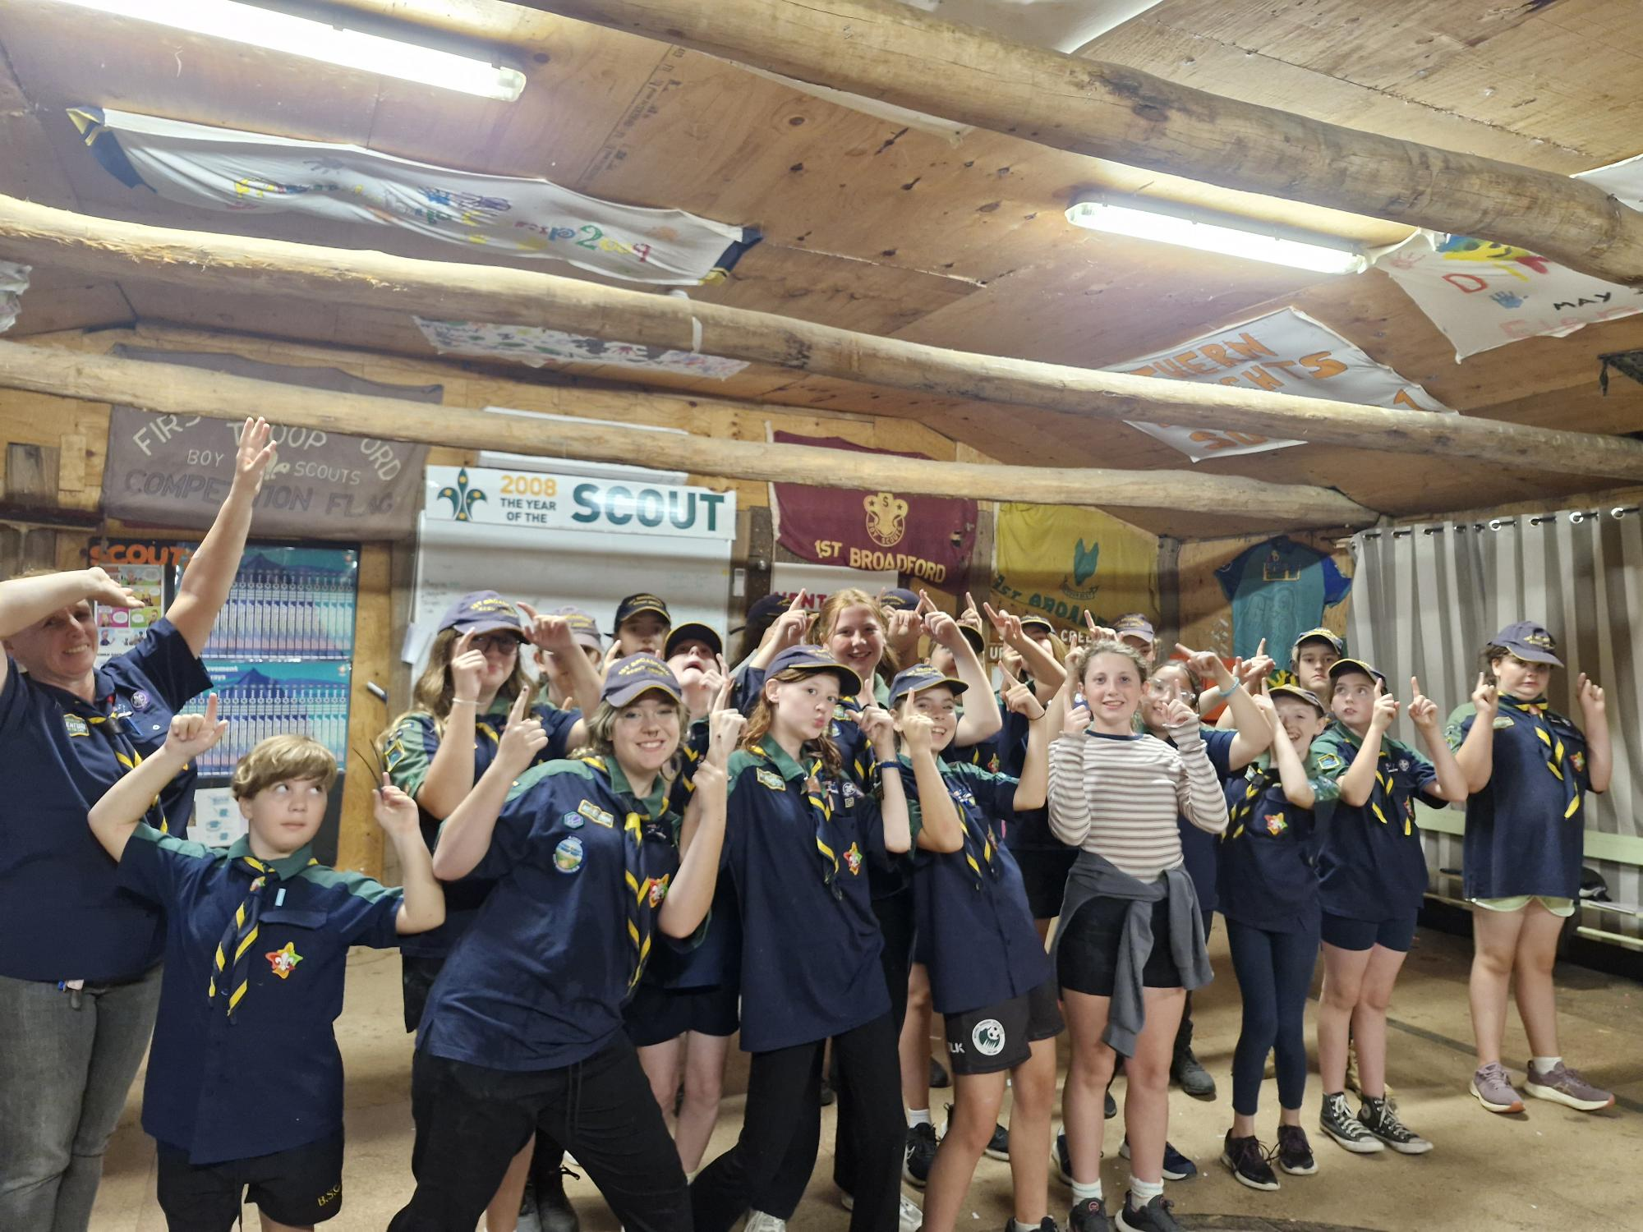
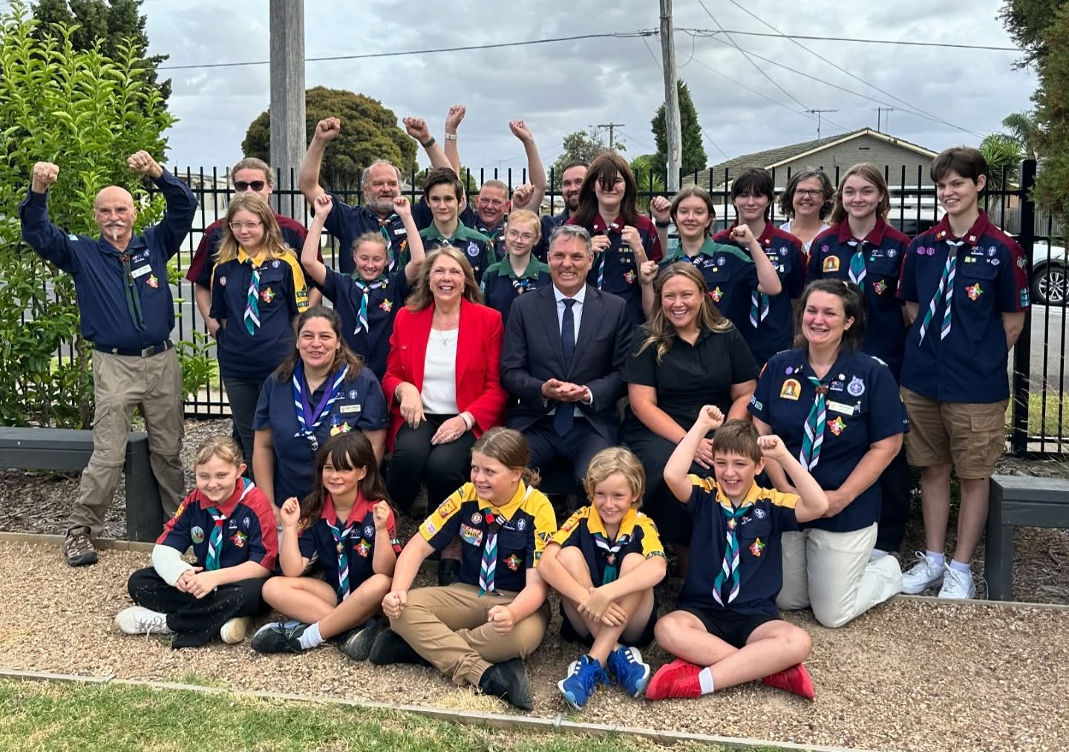
Grants
$3,354,248.41 received in grants in the 2024 -2025 financial year
198 Formations applied for grants
How hard is it? Challenging at first, but gets a lot easier with practice (follow step-by-step guide to start) – Can be very low effort, high impact with practice
Policy, procedure and more information
bit.ly/grants-for-groups
1st Broadford Scout Group
Celebrating new lighting from Southern Cross Gold
Norlane West Scout Group
Celebrating the announcement of the Growing Regions grant for their new Hall

Slide 16
Container Deposit Scheme
Craig Waters
1st Broadford Scout Group

Slide 17
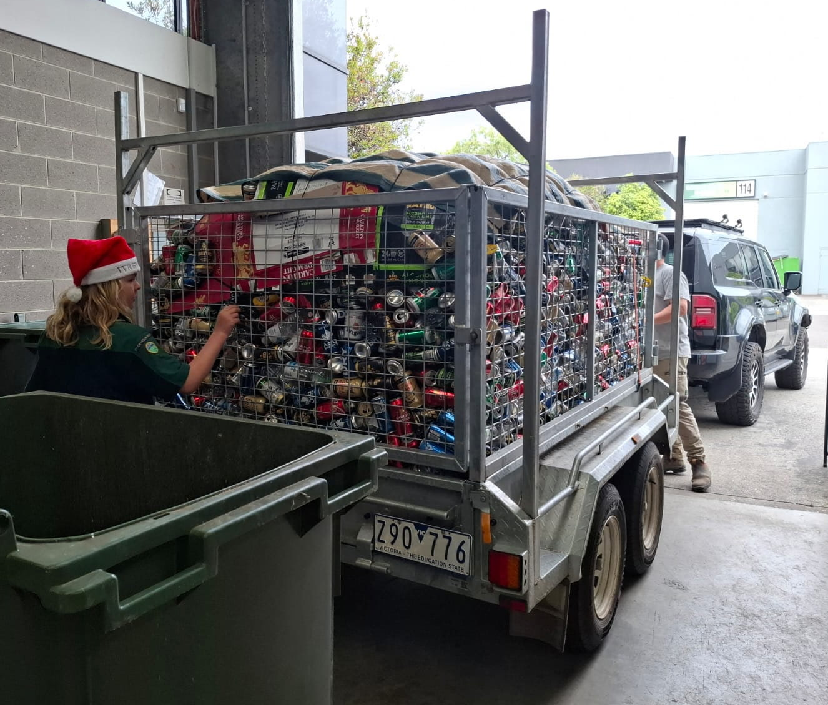
Container Deposit Scheme
127 Formations have participated in the CDS scheme from September 2024 - September 2025
Raising $84,008 within this timeframe
How hard is it? Very easy to collect containers and minimal time needed to visit a depot – super easy!
Find more information at bit.ly/CDSKnowledgeBase
1st Croydon Hills Scout Group
Collected 18,500 containers in the lead up to Christmas, raising nearly $2,000 for their Group

Slide 18
Christmas Trees
Derek Youdale
13th Malvern Scout Group

Slide 19
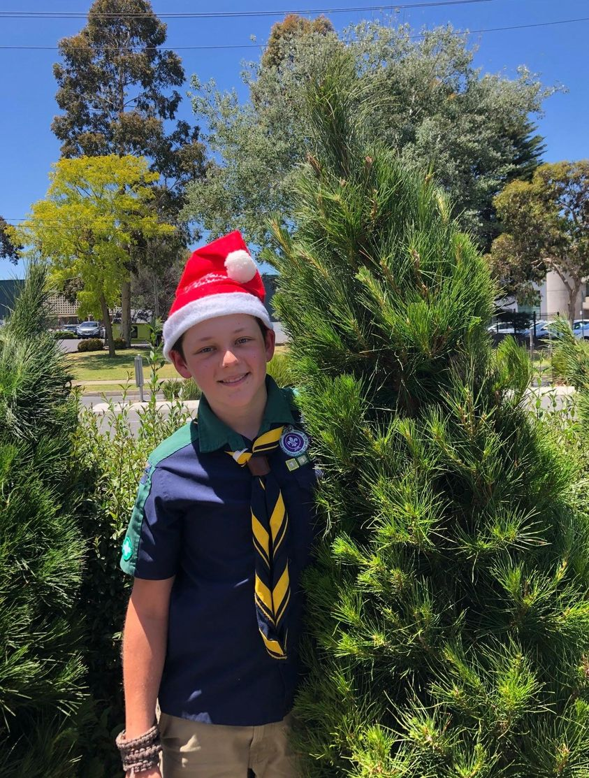
Christmas Trees
84 Formations participated
$9,143.94 is the average profit from what Formations have reported so far
Group feedback
This will inform new resources for 2026
bit.ly/2025XmasReview
How hard is it? Lot of planning and lots of volunteer time – once you have return customers it gets a lot easier to sell
More information
bit.ly/ChristmasTreesResources

Slide 20
Morning Break

